Slide 1
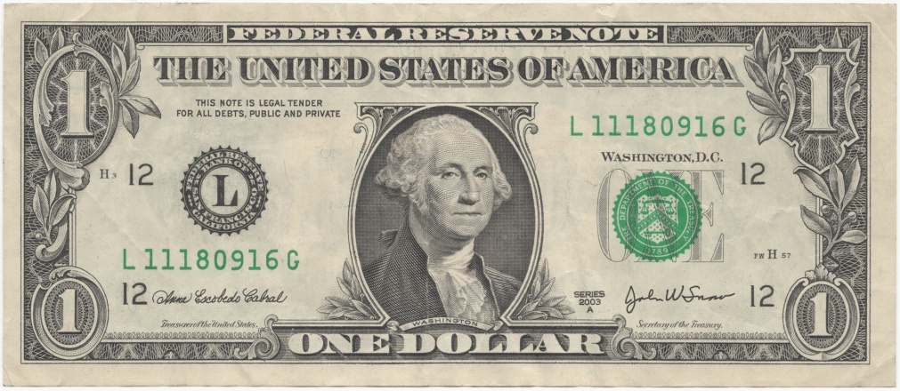

Warmup
Why does the dollar on the left have value, while the one on the right does not?

Slide 2
Personal Finance & Credit

Slide 3
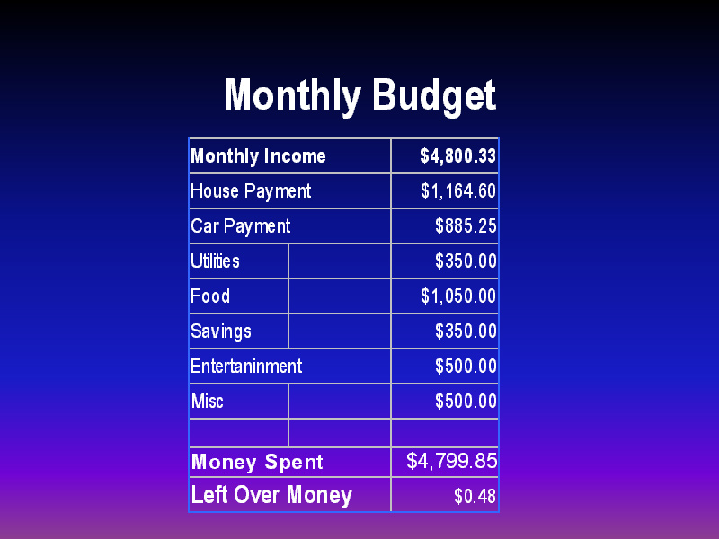
What is a budget?
A record of all the money you earn and spend

Slide 4


Income versus Expenses
Income – money you earn
Expenses – money you spend

Slide 5
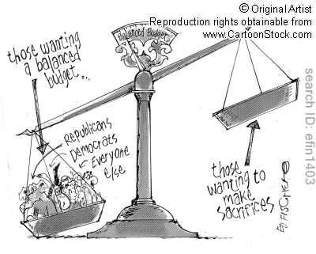
Income versus Expenses
Balanced budget – income = expenses
Budget surplus – income > expenses (good)
Budget deficit – income < expenses (bad)

Slide 6



Where do people go to borrow money (or, what are sources of credit)?
Banks
Credit unions
Finance companies
Credit Cards

Slide 7
Credit terms
Lender – any person or group that loans money to another person or group
Borrower – the person who borrows money from the lender and must pay back the amount owed plus interest
Interest – fee paid by a borrower of assets to the owner as a form of
compensation for the use of the assets

Slide 8
Credit Terms
Annual Percentage Rate (APR) - describe the interest rate for a whole year rather than a monthly interest rate on a loan.
Credit Rating - evaluates the credit worthiness of an issuer of specific types of debt, specifically, debt issued by a business enterprise such as a corporation or a government

Slide 9
Credit Terms
Collateral - borrower's pledge of specific property to a
lender, to secure repayment of a loan
Bankruptcy – person or business that can not pay back its loans and debts

Slide 10


Why should people save money?
To make big purchases
Emergencies
Luxuries

Slide 11
What is the advantage of putting savings in a bank?
Easy access
Earning interest

Slide 12
Types of savings accounts
Definition
Accounts at a bank, savings assoc., or credit union
Return
Interest rate is relatively low
Time Frame
Can withdraw from at any time
Bank Savings Accounts

Slide 13
Types of savings accounts
Definition
Bank notes for a set period of time at fixed interest rate
Return
Interest rates are higher than bank savings accounts
Time Frame
Varies, 6 months to 5 years
Certificates of Deposit

Slide 14
Types of savings accounts
Definition
Savings accounts that require high minimum balance
Return
Interest rates are higher than for regular savings accounts
Time Frame
Can withdraw from at any time
Money Market Accounts

Slide 15
Types of savings accounts
Definition
U.S. gov’t issues bonds as a way of borrowing money
Return
Interest rate is higher than bank savings accounts
Time Frame
Good for medium/long-term savings goals
U.S. Savings Bonds

Slide 16
What are investments?
Anything you put money into with the hope of getting some higher value in return

Slide 17
Types of investments
Savings accounts are investments, but are relatively low in risk/reward
Stocks – share of ownership in a company
  Dividend – a share of company earnings paid to stock holders
Bonds – contract to repay borrowed money with interest at a specific time
Mutual funds – people pool money together to invest in stocks &/or bonds.

