Slide 1
4th Grade Exploration and Settlement of Kentucky
Notes

Slide 2
Ways the environment promoted/restricted human activities during early settlement of Kentucky
Promoted | Restricted
Full of natural resources Land was good for farming Ohio River was used for transportation and trade | Mountains Unpaved roads Ohio River when it was low during certain times of the year

Slide 3
I can describe how roads helped people to settle in Kentucky.
What famous “road” did Daniel Boone use to explore Kentucky?
Daniel Boone used the Wilderness Trail to explore in Kentucky.
How did this road help people to settle in Kentucky?
He helped clear the path so wagons can travel over the road so settlers could make their way into Kentucky.

Slide 4
Identify 4 groups of diverse people who settled and explored in Kentucky.
Enslaved people with settlers
Native Americans and settlers
Settlers with settlers
Explorers with explorers

Slide 5
Reasons that diverse groups settled in Kentucky
Rich, fertile soil
Lots of animals
Land for farming and growing crops

Slide 6
Which group competed for natural resources, waterways, and areas for settlement?
Settlers with settlers

Slide 7
Which group followed orders from their owners (built houses, planted crops, and cleared land)?
Enslaved people with settlers

Slide 8
Which group often competed for the same lands?
Explorers with explorers

Slide 9
Which group had different beliefs on how to use the land, religion, and government?
Native Americans and settlers

Slide 10


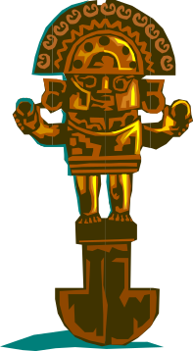
Primary Source
Historical documents, written accounts by firsthand witnesses or objects that have survived from the past
Examples:
-diaries -maps
-letters -government documents
-artifacts -articles of clothing
-photographs -coins/stamps
-paintings(if it was painted during that time)

Slide 11

Secondary Source
Accounts of past events created by people some time AFTER those events happened
Examples:
-encyclopedias
-textbooks
-paintings (if it was painted AFTER the event)

