Slide 1
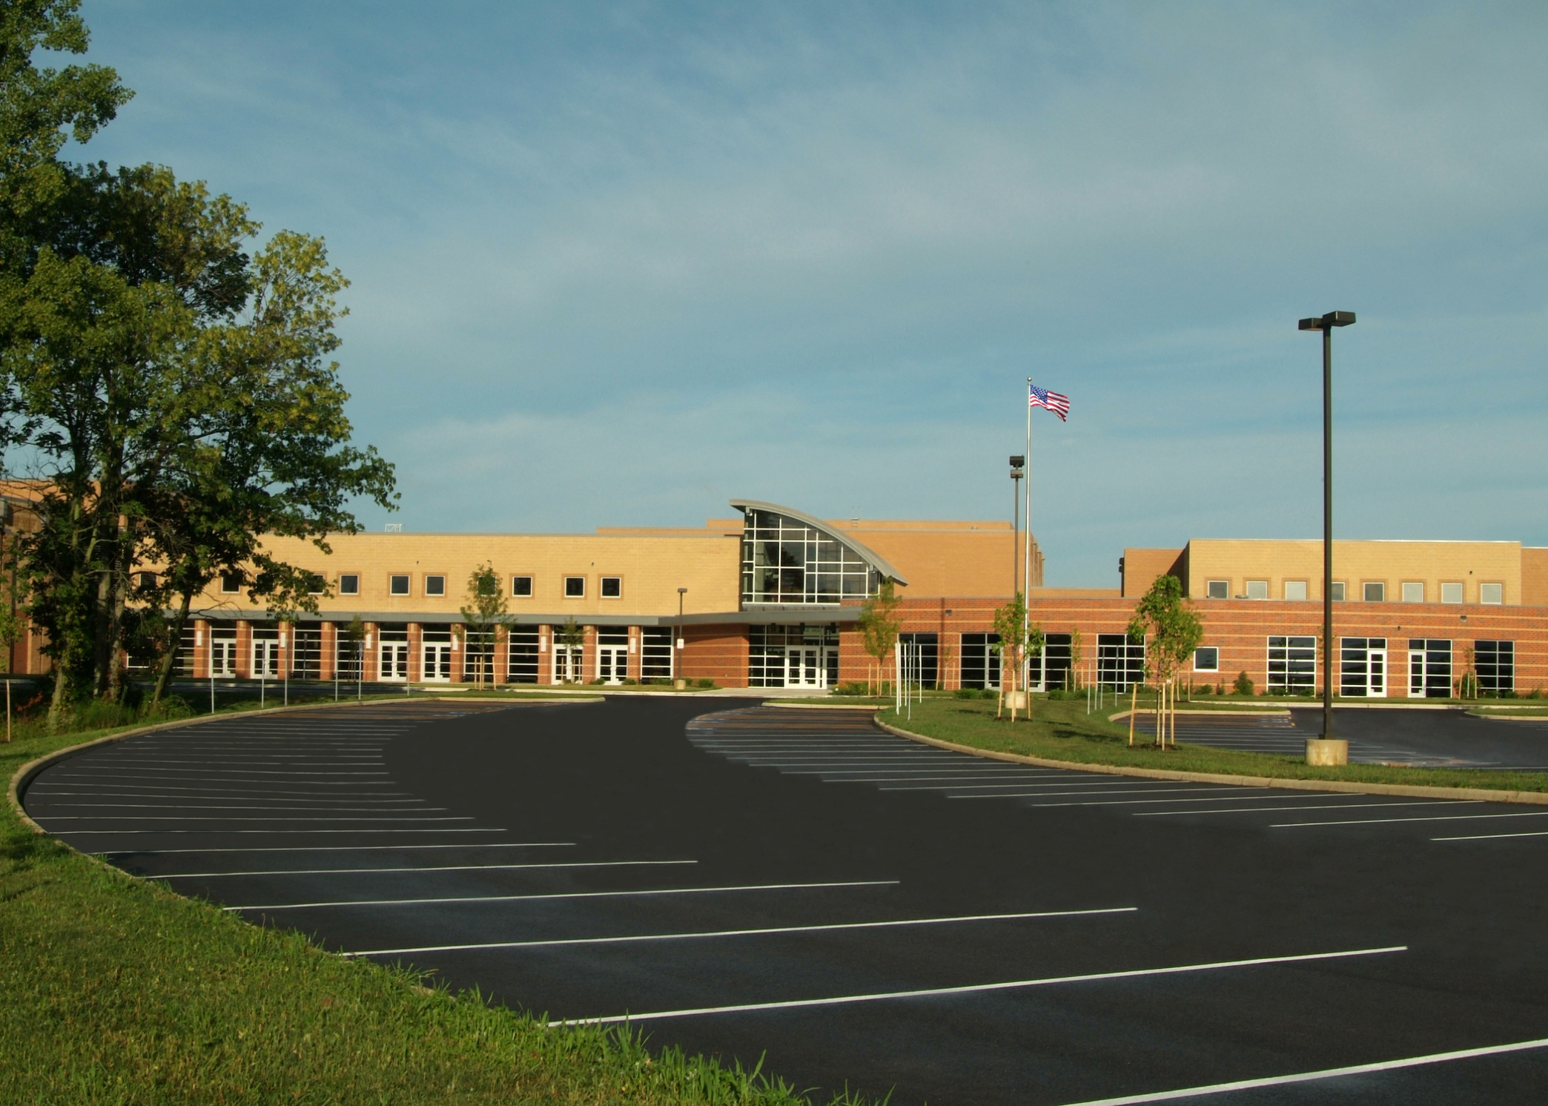
WELCOME TO OLENTANGY
ORANGE HIGH SCHOOL
Home of the Pioneers!
“An Excellent High School”
Notes:
Chris

Slide 2
Guidance Department
A-Cl Pam Otten 740-657-5118
Cm-G Stephen Gunther 740-657-5113
H-La Sarah Hanna 740-657-5112
Lb-O Matt Baumgartner 740-657-5116
P-Sk Matthew Brown 740-657-5117
Sl-Z Heather Smith 740-657-5119
Ann Pfau-Registrar
Cyndie Vande Water-Secretary

Slide 3
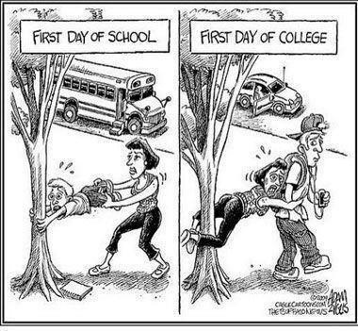

Slide 4
Senior Year
An Important Year of Transition
Four Year College 74%
Two Year College 16%
Military 1%
Employment 8%
Gap Year 1%

Slide 5
Tonight's agenda
Resources to help guide post-secondary planning
How to utilize Naviance Student to research, schedule with visiting college reps, and request transcripts and letters of recommendation
College application
Scholarships and financial aid
Important dates

Slide 6
Tasks of the Senior Year
Keep senior schedule strong
Five academic classes required (each CCP course counts for 2)
Final ACT/SAT tests, college campus visits, meet with college reps visiting OOHS, utilize Naviance for research, meet with OOHS counselor.
Develop a post-secondary plan, explore options, visit schools and research program requirements, meet application deadline dates

Slide 7
Resources and Important Information
Schoology course: OOHS Senior Class of 2020-Senior Seminars Sept. 4 & 5, periods 1, 2, 11 and 12
Graduation Requirements/Honors and Awards
The College Application Process and Naviance

Slide 8
Using Naviance
Online Resource for Planning & Advising
Overview for Parents

Slide 9
What is it?
Naviance is on the Web
  Naviance icon on OLSD
  Web-based resource that supports career and college planning
  Promotes communication between guidance counselors, teachers, students and parents
Student accounts
Teacher accounts
School Counselor and Registrar access to all accounts

Slide 10
What can students do in Naviance?
Students have been working with Naviance since their freshman year at OOHS.
Classroom lessons/activities
Career planning tools/inventories
Research colleges
Link to selected third party resources (ACT, SAT, Common Application)
Sign up for informational sessions with college representatives visiting OOHS

Slide 11
What will seniors do in Naviance?
We will be working with seniors the first week of September to teach them how to utilize Naviance during the college application process.
We will also meet with them one on one after these meetings to field any individual questions they may have as they go through this process.
Request transcripts and track submission dates
Request letters of recommendation and track their submission
Search for scholarships

Slide 12
College Application
Application (Common Application or the institution’s application)
  Fee
  Essay (depending on application)
Transcript Service - Requested on Naviance
  Includes School Profile
  Secondary School Report or Common App Counselor Recommendation form
Test Scores
  Requested from act.org or collegeboard.org (can take up to 4 weeks to process)
Letter of Recommendation (depending on the college)
  Parent Brag Sheet
  Resume
  PAY ATTENTION TO ALL DEADLINE DATES (university, program, scholarship)

Slide 13
Naviance and the CommonAPP
Over 900 colleges accept the Common Application
Naviance and Common App both owned and operated by Hobsons
They must sync electronically by a matching process through the student’s Naviance account.
To match a student must have a Common App account, list one college on the account and complete the FERPA in Common App

Slide 14
Admission decisions and deadline dates
Regular Decision-The process in which applicant completes the application by the institution’s specified date and then receives decision by April 1.
Rolling Admission-The process in which an institution reviews applicants as they complete the application requirements and renders decisions throughout the admission cycle.
Early Action-The process in which applicants apply to an institution by their EA deadline and my receive a decision well in advance of the institution’s regular response date. The institution may accept, deny or add applicant to the regular applicant pool. Many institutions require applicants apply by the EA deadline to be considered for scholarships and/or honors programs.
Early Decision-The process in which students make a commitment to a first-choice institution where, if admitted, they definitely will enroll. Students may apply to other institutions, but may have only one ED application pending at any time.

Slide 15
Scholarships & Financial Aid
Merit Based and Need Based

Slide 16
Scholarships / Financial Aid
Scholarships (Merit Based)
--Primarily Awarded by Colleges
Part of admissions application. May be special scholarships with a separate application/deadline. Check college websites.
--National, Regional and Local also available
Online databases: Fastweb, Highfive Scholarships, Cappex Scholarships (links on Naviance)
U.S. Department of Labor Scholarship Search
Organizations, Employers, Labor Unions, Credit Unions
Naviance Scholarship List

Slide 17
Scholarships / Financial Aid
Financial Aid (Need Based)
--Must Complete Free Application for Federal Student Aid (FAFSA).
--FAFSA available after October 1, 2019. www.fafsa.ed.gov
--Financial Aid Presentations on October 13 at 1:30 and 3:00 at the Columbus Suburban College Fair hosted at Otterbein University
--Family and University receives an SAR (Student Aid Report) with the EFC (Expected Family Contribution).
--May qualify for Federal Aid (grants, loans, work study). Additional need based aid from the college/university.
--CSS /Financial Aid Profile student.collegeboard.org/css-financial-aid-profile

Slide 18
Important Dates
October 1, 2019 – FAFSA application available
October 13, 2019–Financial Aid Workshop at Otterbein University at 1:30 and 3:00 PM
October 17, 2019 – Transcript request deadline for November 1st college application deadlines
November 13, 2019 – Transcript request deadline for December 1st college application deadlines

Slide 19
Important Dates Continue
December 6, 2019 – Transcript request deadline for January 1st college application deadlines
February 15, 2020 – FAFSA deadline for many colleges
April 1, 2020 – Deadline for colleges to communicate financial aid packages
May 1, 2020 – National Declaration Day
May 11, 2020 – Senior Award Program-7:00 PM
May 17, 2020– Graduation Day-12:00 P.M.

Slide 20
ACT & SAT Dates
ACT Test Dates Registration Dates
September 14, 2019 September 1 (late fee)
October 26, 2019 September 27, 2019
December 14, 2019 November 8, 2019
February 08, 2020 January 10, 2020
SAT Test Dates Registration Dates
October 5, 2019 September 6, 2019
November 2, 2019 October 3, 2019
December 7, 2019 November 8, 2019

Slide 21
ACT/SAT Continued
Must test at least 4-6 weeks prior to an application deadline date
Must order scores to be sent from testing agency to university -opportunity to send 4 score reports at time of registration, must pay for subsequent score reports
When ordering score reports, go directly to ACT or Collegeboard for SAT-allow 4-6 weeks for delivery.

Slide 22

Thank you for attending this evening.

