Slide 1

IP Addresses, Account Management & MFA
2022 County Election Administration
Training Conference

Slide 2
Agenda
Staff Introduction​
IP Addresses​
ERS & SVRS Account Assistance​
MFA Accounts​
MFA App & Phone Tokens

Slide 3
Staff Introduction
Requests are made to the OSS Election Division ​
  All requests for IP addresses and ERS, SVRS and MFA account assistance should be sent to elections.dept@state.mn.us
  Justin and Grace are regularly monitoring these and take care of requests as they come in​
Additional future contact​
  Our deputy cyber navigator will soon be taking over IP address and MFA assistance requests
  All requests will still go to the elections dept. inbox

Slide 4
IP Addresses
IP addresses are, in essence, identifiers. Adding an IP address in our systems gives permission to access our sites
IP request overview: ​
  To access SVRS, county staff and municipal users need their IP addresses added to our permissions list ​
  IP requests are made by county staff or on behalf of a designated facility​
What to include in the request:​
  The requests include contact information, system intentions, and IT requirements
  To easily get your IP, you can search "What's My IP?"
  IP requests are sent to OSS in elections.dept@state.mn.us – they can also be submitted with a physical form upon request
Once received, these requests are processed, approved, tracked and a confirmation is sent once completed

Slide 5
IP Addresses cont.
There is an issue with your IP if:
  You are unable to load SVRS and ERS overall
  You cannot even get to a login screen (the page never loads)
  Or, you receive an error message – the tell that an IP issue is present

Slide 6
ERS & SVRS Account Assistance
County Abilities: ​
OSS Assistance: ​
ERS | SVRS
County users have less control over account mgt in ERS vs. SVRS Jurisdictions with an election can use ERS for results, candidate filing and ballot setup | County users are responsible for setting up accounts for county staff and municipal staff, setting staff permissions, troubleshooting account problems, and training
ERS | SVRS
OSS sets up accounts for ERS, adds election lists, addresses result errors, and submits abstracts and post-election review work | Provides assistance with account setup, report issues, record availability, application issues, and system errors

Slide 7
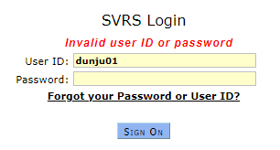
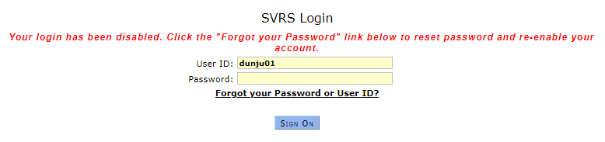
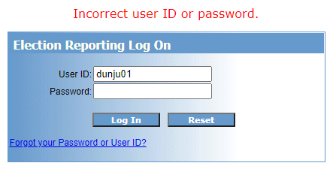
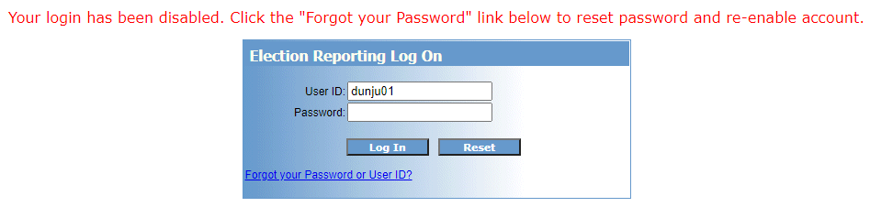
ERS & SVRS Account Assistance cont.
There is an issue with your SVRS or ERS account if you can load the page, but receive one of these error messages:

Slide 8
MFA Account
Overview​
  Keep SVRS and ERS secure and authenticate logins ​
Who can set up or reset password?​
  If you have a county admin role who manages MFA grid cards and account management that is your contact​
  If you do not have a county admin who can manage accounts contact us, elections.dept@state.mn.us ​
  Different user roles and their abilities – Staff Admin permissions can be given for expanded power and responsiveness to make it less reliant on our office.

Slide 9
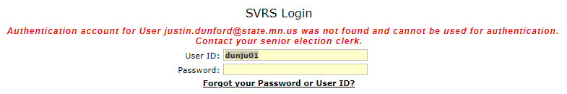
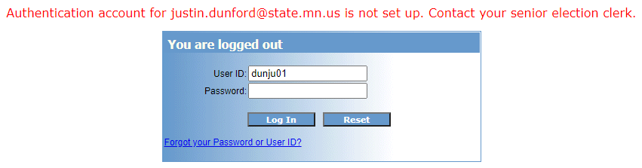
MFA Account
There is an issue with your MFA account/grid card if you can load the page, correctly type in your username and password but receive these error messages:

Slide 10
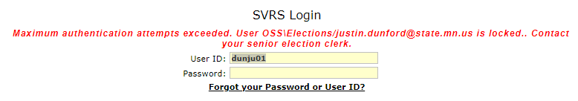
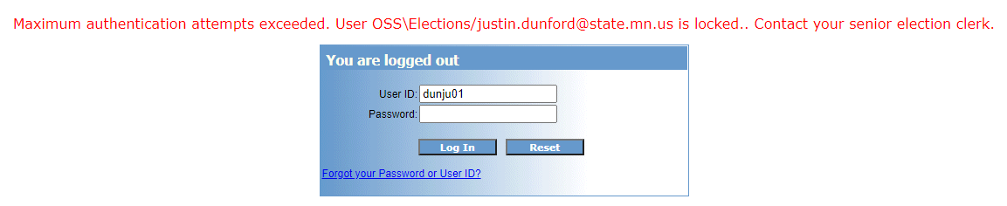
MFA Account
There is an issue with your MFA account/grid card if you can load the page, correctly type in your username and password but receive these error messages:

Slide 11
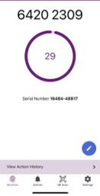
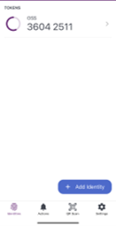
MFA App and Phone Tokens
MFA App and Phone Tokens​
  The MFA App, through Entrust, lets users enter an 8-digit token instead of using the grid card
  Advantages of this are that it doesn't expire and the token cycles every 30 seconds, meaning tokens can't be used to enter my SVRS account!​
To request it, you can email us at elections.dept@state.mn.us and we can setup the app for however many users you'd like!
  Note: Only we can issue the app token for users. That said, MFA Admins at the county level can unlock accounts in case users need more tries.

Slide 12
Questions?
Presenter Contact Information
  Justin Dunford
    justin.dunford@state.mn.us 651-556-0617
  Grace Doyle
    grace.doyle@state.mn.us 651-556-0645

