Slide 1

Project Nova Update
Challenges, Schedule Changes and SY 20-21
Investing for tomorrow, delivering today.
Notes:
To change the image on this slide, select the picture and delete it. Then click the Pictures icon in the placeholder to insert your own image.

Slide 2
The Nova Project Team
Kristina Fernandez
Johnathon Garcia
Alecia Moll
Tirumal Rao
Jean Wood
Richard Trujillo
Mark DeCamp

Slide 3
The (Unexpected) Challenges
Delays in Legislative Approved Funding
  Availability of project funding moved from April to August
  Scheduling of project task shuffled because of inability to order production hardware
Hiring Freeze
  Limited PED Team availability
Everyone Working from Home

Slide 4
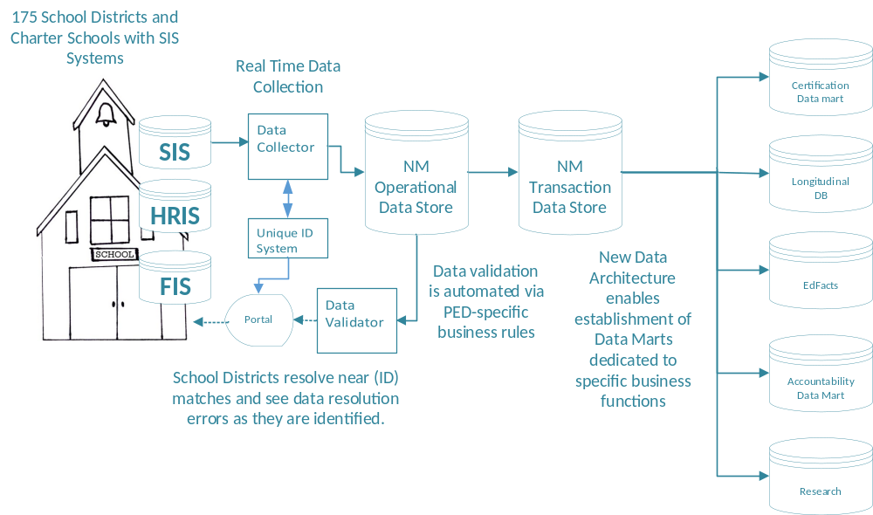
The Objective Remains the Same

Slide 5
The Work - Visualized
Business Rules for Data Validation
Migration to New Unique ID System
Interfaces and Reporting
School District SIS Connections and Real Time Data Collection
Data Profile and Database Definitions
Infrastructure and Software Acquisition, Installation, Configuration
LEA, Bureau and User Portal
Work Streams
Defines data standard, SIS modifications, and final NEW STARS data model
Creates single portal for user registration, and data management
Migration to new Unique ID, and begins use of a new System for NM
Automates Business Rules for each migrated District/Charter School
System Shakedown and Proof of Concept, District/Charter school connection
Business Value
Implement Generate tools for EdFax reporting, integration with other PED systems

Slide 6
The Big Shuffle
While waiting for funding/hardware
Decided we would continue reporting STARS templates for SY 20-21 and run parallel with the new system
Configured and set up Unique ID system, portal access and user accounts
Made significant progress on creation of automated validation rules
Began data mapping for certification and federal reporting
Began documenting the certification process

Slide 7
Pilots Update
Albuquerque Public Schools (Edupoint Synergy)
Los Alamos Schools (PowerSchool)
Turquoise Trail Charter School (Tyler Technology)
SIF Agents Installed
Connections Established
Real Time Data Collection
Manual and Automated Assignment of Unique ID to new students
Lessons Learned …

Slide 8
Steps Forward
Unique ID Automation
Data Validation
User Interfaces
Certification
Migration to Production
Pilots
System Configuration
Portal Accounts and UID Migration
Set up Connections
Certification
Go Live
Production
SIS Vendors
SIF Agent Development
Set Up Connection
Install Basic Agent
Update Agent with NM Data Profile

Slide 9
The Next Four Months
September
October - November
Data Validation Rules
Certification Design
Work with Pilots and SIS Vendors to validate data
Receive and Configure Production System
Deploy and configure software tools, applications
Move Unique ID, Accounts to production platform.
Begin Certification configuration and test with PIlots

Slide 10
The Next Four Months … and Beyond
December
January
Set up Connections (working with SIS Vendors)
“Turn on” Data Collection for all connected Districts
Early 2020
Statewide Parallel data collection and certification

Slide 11

Add a Slide Title - 4
Questions?

