Slide 1
You only Get One shot
MotivatioN

Slide 2
As we watch, jot down things that COULD HAVE gotten in their way.
https://www.youtube.com/watch?v=zLYECIjmnQs

Slide 3
With malice toward none; with charity for all; with firmness in the right, as God gives us to see the right, let us strive on to finish the work we are in; to bind up the nation's wounds; to care for him who shall have borne the battle, and for his widow, and his orphan - to do all which may achieve and cherish a just and lasting peace, among ourselves, and with all nations.
Lincoln’s Second Inaugural Address, United States Capital, Washington DC, March 4, 1865

Slide 4
Look, if you had one shot, or one opportunity
To seize everything you ever wanted. one moment
Would you capture it or just let it slip?
You better lose yourself in the music, the moment
You own it, you better never let it go
You only get one shot, do not miss your chance to blow
This opportunity comes once in a lifetime
“Lose Yourself” by Eminem, Released October 28, 2002

Slide 5
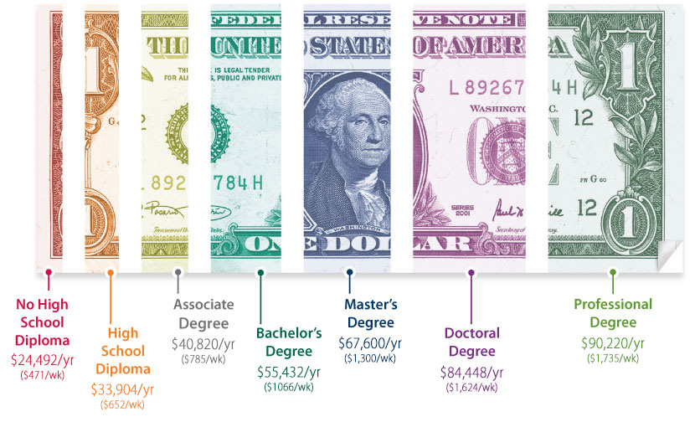

Slide 6
❑ Lack of Motivation | ❑ Homework Completion | ❑ Distractions | ❑ Family Issues
❑ Lack of Interest | ❑ Poor Tests/Quizzes | ❑ Laziness | ❑ Peer Relationships
❑ Health Issues | ❑ Negative Relationships | ❑ Attendance | ❑ Teacher Concerns
❑ Other:
Hardest Overall? Hardest Today?
What is keeping you from overcoming this/these obstacle(s)?

Slide 7
Test-Taking Tidbits
Prepare your Mind
Prepare your Body
Attitude Counts
Before the Test
During the Test

Slide 8
Push through collage
On left…
  Who I am and where I’ve been
On right…
  Who I am destined to when I push through those obstacles

Slide 9

Listen
https://www.youtube.com/watch?v=W_VQbtO3ChM
https://www.youtube.com/watch?v=WDbxmB7vqEA

Slide 10

Watch
https://www.youtube.com/watch?v=NRN_e41uExo

