Slide 1
Bell Work
In your notebooks, write about a time when you stood up for something that you believed in.
  Was the position unpopular?
  How were you treated by people who opposed you?
  Did you persuade anyone to agree with you?

Slide 2
Abolitionism

Slide 3
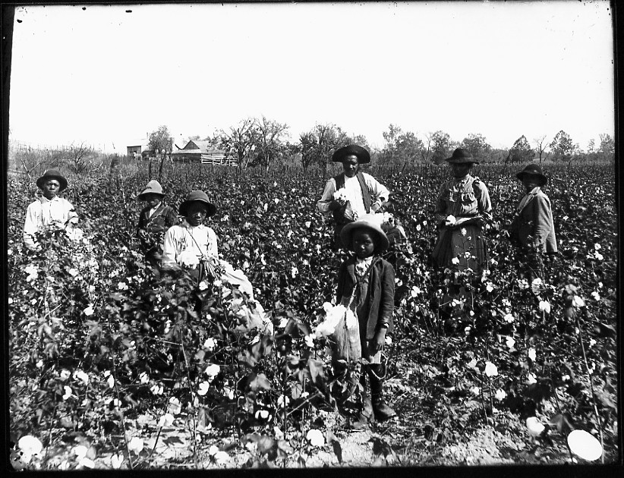
Life Under Slavery
Rural Slavery
  Men, women and children worked from sun up to sun down.
  They were whipped if they did not work hard enough
  Some slaves were house slaves: Cooks, butlers, and maids.
  They lived in small, cramped slave quarters.

Slide 4
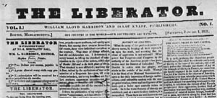
The Abolitionists
Abolition – The movement to outlaw slavery.
Supported by religious preachers and intellectuals.
Slavery was considered “a great national sin”.
William Lloyd Garrison was the most radical abolitionist.
Garrison published, “The Liberator”, an abolitionist newspaper.

Slide 5
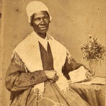
Notable Abolitionists
William Lloyd Garrison
Frederick Douglass
  Born a slave, through education, Douglass was able to escape slavery.
  He Became a great orator in the abolitionist movement.
Sarah and Angelina Grimke
  Daughters of a slave owner, they spoke out against the horrors of slavery.
Sojourner Truth
  An ex-slave, she went on speaking tours about the harshness of slavery

Slide 6
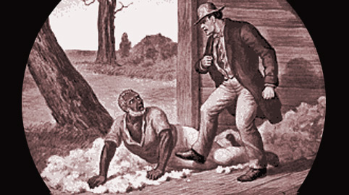
Opposition to Abolition
Slaveholders opposed abolition.
Many supported tightening controls on slaves, and all blacks in general.

Slide 7
Summarizing
Read pages 229-234
In the text on page 234, answer questions 2 and 3.
For question 2, make a t chart.
For question 3, write a paragraph (4-6 sentences).

