Slide 1
9th Grade LA
Poetry Unit

Slide 2
Do now…
Open up your SB book to page 268 – 269
Each group will be assigned a set of literary devices in poetry.

Slide 3
Create a graphic representation of your assigned words that captures the essence of the word.
Definition
Picture
Example(s)
Then, each group member will teach the word to the class…as the class takes notes!
Group One
connotation tone imagery
Group Two
diction hyperbole allusion
Group Three
symbol extended metaphor anaphora
Group Four
theme refrain onomatopoeia
Group Five
alliteration rhyme assonance consonance

Slide 4
Homework!
Read from Poemcrazy on pages 259-261
Annotate as you read:
Underline ideas you think might be helpful to a new writer of
poetry
Summarize what the author is saying about the importance of
words
Make a list of homonyms to bring to class

Slide 5
Target: We will closely read and annotate “Nikki-Rosa” Do Now:
Turn to page 270 in your SB book.
Read and highlight the literary terms – catalog poem and lining out
Annotate the HECK out of the poem on page 271
Write questions based on the poem:
Literal
Interpretive
Universal
See page 272 for examples!

Slide 6
Do Now….
Write about what you think is COOL. For example, I think it is COOL that my daughter can do four cartwheels in a row. I think it is cool that the 4th of July Parade goes past my home. And, I really think it is cool that my husband is retiring from the military.
Share!
With your table, read OUTLOUD the poem “We Real Cool” on page 273
Answer questions 1 and 2 on page 274

Slide 7
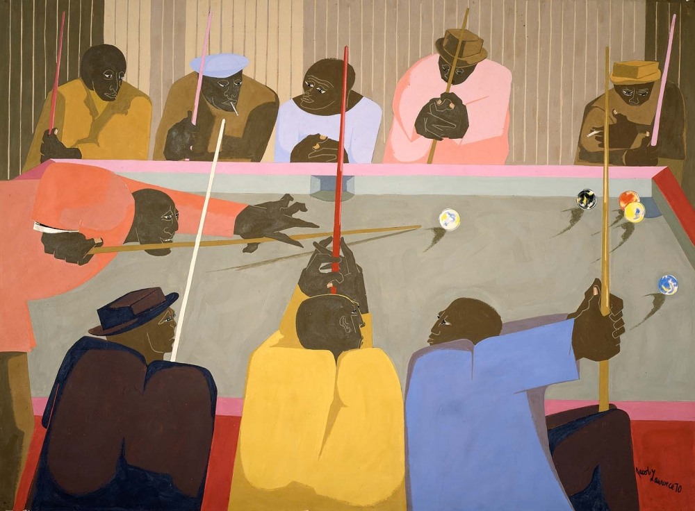

Slide 8
TARGET:
Writing a THESIS statement about the poem, “Fast Break”
DO NOW:
Write about one of your favorite hobbies or interests and explain why you enjoy the hobby or interest.
Share with your elbow partner
Read the poem on page 275 TWO times
First reading: circle diction that indicates the author is familiar with basketball terms
Second reading: circle all the VERBS and consider the effect of so many VERBS in a poem.
How would the effect be different if the verbs were in past tense?

Slide 9
Do Now….ON YOUR OWN!
After reading the poem, “Fast Break” complete the TWIST strategy worksheet.
Turn in to me when you have completed this!

