Slide 1
All Things Alternate
Part 2

Slide 2
Alternate Standards, Assessment and Diploma Timeline
Year | 2017-2018 | 2018-2019 | 2019-2020 | 2020-2021
Alternate Standards | Current Next Gen Standards 9th grade cohort | (New Standards) Policy 2520.16 Alternate Academic Achievement Standards | Policy 2520.16 Alternate Academic Achievement Standards | Policy 2520.16 Alternate Academic Achievement Standards
Alternate Assessment | Current Alternate Summative Assessment (DLM) | Current Alternate Summative Assessment (DLM) | Current Alternate Summative Assessment (DLM) | New Alternate Summative Assessment
Diploma Type | Modified Diploma | Modified Diploma | Modified Diploma | Alternate Diploma

Slide 3
Special Education Documents/Updates
Every Student Succeeds Act (ESSA)- December 2015
Federal Law passed by Congress
Dear Colleague Letter- November 2015
Clarified FAPE for Students with Disabilities
ESSA Frequently Asked Questions (FAQs)- 2016
National Down Syndrome Congress
Notes:
DCL- Clarified FAPE
ESSA- passed by congress
Develop a systematic way of meeting the FAPE DCL and ESSA expectations

Slide 4
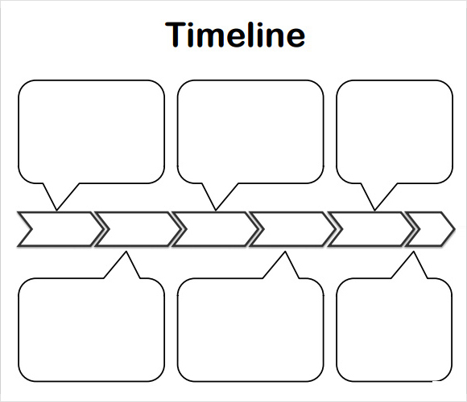
1980’s
1990’s
2015
Functional Life-Skills Curriculum to participate fully in community
INVOLVEMENT and PROGRESS in General Education Curriculum for ALL students
INCLUSION with same age peers in home school
Notes:
ESSA document page 4

Slide 5
Alignment
General State Approved
Education Grade Level
Curriculum Content Standards
(Alternate)
Notes:
In both the Dear Colleague Letter and ESSA, the general education curriculum is defined as state approved grade level content standards.
So when looking at this slide, we see that the alternate grade level content standards must be ALIGNED to grade level general education curriculum.
This means that you should see the connection between instruction for students with cognitive disabilities and the general ed curriculum.
We will look closer at alignment and see examples of content that is aligned vs content that is not aligned.

Slide 6
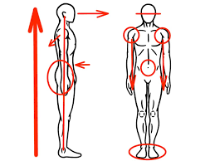

Alignment
The process of matching educational components of:
Standards
Instruction
Assessment
Notes:
Now we are going to take a look at what alignment looks like in places other than education.
Chiropractor- to align the vertebrae of the back.
Garage to align tires on a car.
Both of these make things perform better !!

Slide 7
When Education Components Align
General Curriculum
(state standards)
Assessment Instruction
Notes:
This is the expectation.

Slide 8

When IEPs Promote Alignment
General Curriculum
(state standards)
IEP Instruction Assessment
(skills taught) (state test)
IEP
Notes:
Here, lets start off with the IEP, then skills taught and finally the state assessment.

Slide 9
Alignment for 3rd Grade Math Standard
Multiplication is a
third-grade standard
Instruction Multiplication items
to multiply by 1-12 (state alternate assessment)
Notes:
Now we are looking at a particular 3rd grade standard- multiplication

Slide 10
Instruction Not Aligned to Standards
Curriculum:
Multiplication
Instruction on State alternate
IEP skill: assessment:
Telling time Combine sets
Notes:
Here is where we have to be careful.
When students are being removed from general education classes, and receiving instruction in a resource room or a separate class,
we have to be sure that the instruction that students are receiving is aligned to grade level content so that this does not happen.
Third grade curriculum is multiplication/combining sets, but during math instruction the student is working on telling time.
This does not mean that the student shouldn’t learn to tell time.
This skill would be taught in context of following a daily schedule for example.
Daily living skills such as telling time is taught “real time” ☺ not in isolated math times only/ or it might be part of a center activity.
Functional skills or daily living skills can be addressed
during naturally occurring routines,
concurrent with academic instruction,
or during some time devoted to a high priority IEP goal.
It is important not to hold students back from learning academics just because they are still catching up on some essential life skills.
Activity – grade level content standard (7th grade) 6 options with discussion.

Slide 11
3rd Grade Math Instruction Aligned to Standard
Third-grade standard:
Multiplication
Multiplication instruction: State Alternate Assess
Combining Sets Combining Sets
Notes:
How might a student with Significant Cognitive Disability be included in instruction aligned to this grade level standard?

Slide 12
Aligned IEP Goal
Third-grade math standard
Skills for IEP: Identify Instruction State alternate
Numerals with AAC on creating assessment:
device; count with one- and Combine sets
to-one correspondence combining sets

Slide 13
IEP Includes Life Skills and the General Curriculum
10th grade academic standards
IEP Instruction State Alternate
assessment
Life skills curriculum
Notes:
What about life skills curriculum?
10th grade social studies alternate standards:
Voting, basic laws
Paying taxes
Citizenship
Rural and Urban similarities and differences
Landforms and bodies of water
Map skills
2 political parties

Slide 14
Writing IEPs that Align to State Standards
Become familiar with the state standards.
Become familiar with the alternate achievement standards.
Keep the planning student focused towards graduation and post school opportunities.
Consider both specific goals and broad access goals.
Ask the question “Is it really academic?”
Notes:
Is it really academic ?? Sometimes, in extending standards, the academic component becomes lost.
Example standard of 7th grade ELA:
Determine a theme or central idea of a text and analyze its development over the course of the text; provide an objective summary of the text.
-Camilla will use her AAC device to greet peers in English class (of course this is going to happen)
-Camilla will acquire 20 sight words that relate to activities in her community and home (e.g. may have activities that address these sight words in center activities)
After hearing text summaries read aloud, Camilla will select the major theme of each using response options that include text with picture symbol support
Camilla will sequence 3 events from text read aloud to her using response options that include text with picture symbol support.
Camilla will organize story grammar elements related to fictional text on a graphic organizer and use the organizer as a support when summarizing the text.
Camilla will identify letter-sound correspondences for initial consonants and vowels and use this skill when writing using software that anticipates spelling from the first letters.

Slide 15
Standards-Based IEPs and Access Goals
Promote goals for the strategies students need to develop to learn the general curriculum content.
When given a graphic organizer, Bobby will identify key details in a story/text… (doesn’t matter the content area) 8 out of 10 times as documented by student work samples and teacher made assessment.
Goals help focus priorities within the general curriculum for students who take the alternate assessment.
When presented with a detail (picture of character or setting) from the text and a distractor that is not-text related, Maria will select the detail with 50% accuracy as documented by student work samples and teacher made assessment.
Notes:
Here is where I was talking about broad access goals- first bullet point
And focus priorities –second bullet point
Notice here how access in and progress in--- is being provided in both of these goals.

Slide 16
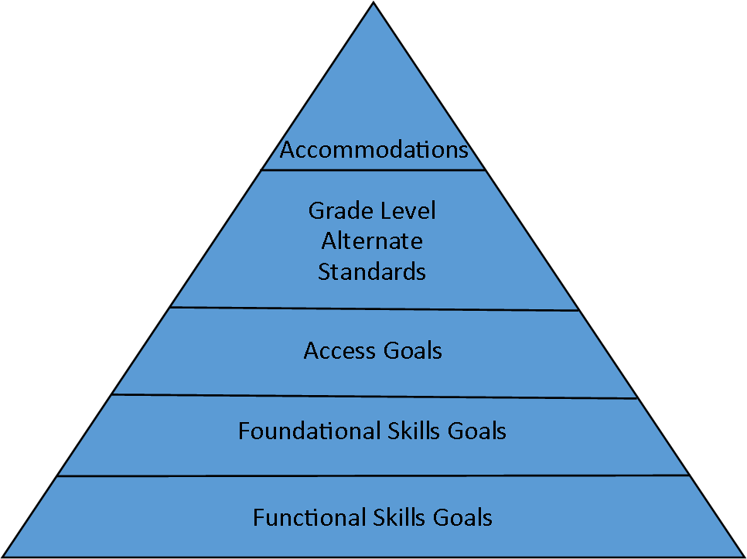
Notes:
Functional Skill Goals- skills needed for independence in life skills, accessing the community, and vocational skills for adulthood. Identify embedded vocational skills in the grade level standards.
Foundational Skills Goals related to the grade level standard. Early grades- decoding, math facts, writing.
Later grades- foundational reading skill goals that are tied to grade level standards requiring reading (main idea, characters, setting, plot).
Access Goals- executive functioning (categorizing, organizing materials, time management, study/work skills), social skills, digital skills
Grade Level Alternate Standards-Priority Areas/ CORNERSTONE GOALS-key learning targets for that grade. Universal Design for Learning strategies to accommodate learning difficulties (next slide)
Accommodations-

Slide 17
Determining Priority Areas
Are we preparing the student to be more independent and to improve his quality of life?
How can we broaden his/her world?
How do we facilitate regular and ongoing interactions with typical peers and promote social inclusion?
What instructional activities will enable the student to gain self-dependence and control over the environment?
(Sarathy, 2014)
Notes:
Questions for IEP teams to keep in mind when choosing priority areas (grade level alternate standards).

Slide 18
Priority Area Considerations
The frequency the skill will be used grade level to grade level;
Whether the mastery of the skill will increase independence; and
Whether the skill will assist the student in controlling his own environment.

Slide 19
ESSA Requirement #1 for the Alternate Diploma:
Be Standards Based
Breadth- the number of grade-level content standards that are addressed
Depth- the number of objectives considered within any of the content standards
Complexity- the requisite skills needed for successful completion of the material covered by the standards.
Notes:
NCEO Brief
ESSA document page 6.
Graduated Understandings- helps keep the focus on grade aligned content. Shows how to move a student in small, increasingly challenging steps from where they are starting toward critical grade-level academic concepts.

Slide 20
Meaningful Partial Participation
By appropriately including students with the most significant cognitive disabilities through manipulations of breadth, depth, or complexity, at least some subset of grade-level content standards will be within the student’s educational experience
Notes:
So what does this mean??
What does this look like on IEPs and what does this look like in the classroom??
Hybrid Approach to Inclusion- time in separate setting as well as appropriate time in general education.
ESSA document page 1 – to raise academic expectations and increase inclusion for students with disabilities

Slide 21
Example of Adapted Grade-Aligned Content
Multi-grade class reading The Broken Shard.
State Standards for grades 6,7, and 8 include a focus of students being able to (a) analyze how a theme is developed over time with plot and characters and (b) summarize the text.
Students with SCD accesses the text through a teacher or peer read aloud, technology, or by independently reading the simplified text.
Student working towards grade level achievement- write about the story using details to support points made.
Student with SCD working toward alternate achievement may prepare a similar essay by filling in a graphic organizer using words or pictures.

Slide 22
Example of Adapted Grade-Aligned Content
Although performance expectations are different for students with significant cognitive disabilities, the content is the same through the use of:
The same novel
The same general activity (reading and writing about the text), and
The same state content standards (analyzing theme).

Slide 23
Systematic Instruction and
Instructional Strategies
For all instruction, there are three major decisions that must happen before the instruction begins:
What will be taught?
How will it be taught?
Where will it be taught?
For students with significant cognitive disabilities, this decision breaks the standards down to their core learning targets and brings them to the application and functional living level while continuing to be challenging and grade-level core aligned.

Slide 24
Best Practice Document
Social Studies
(PE/Health and the Arts to come)
Notes:
You have a copy of the Best Practices Document in your folder.
These are “best practice” alternate standards for all grade levels for SS,
PE/Health and the Arts (music and art only) have just been updated and are to be approved by state board in April. After approval, an addition will be added to the Social Studies Best Practice Document that will include PE/ Health and the Arts (music and art).
These are not state approved alternate standards since we are not required to write standards for these subjects

Slide 25
Course Codes
All 9th grade students that are currently on Alternate Assessment, being instructed on the alternate standards, should have already had their schedules updated with the new course codes.
The course codes have been developed and can be found on the WVEIS website under the Support Tab (Course Code Change Document 2017-2018).
District WVEIS personnel and/or school counselors have been making the changes to student’s schedules. It is a district decision about particular digits within the course codes (WVEIS course codes are 4 digit numbers), districts/schools add the remaining digits.
Notes:
We have new alternate course codes for all credit bearing courses (9-12).
I recently received a question about middle school course codes and if we would have alternate codes for these courses as well.
We will not have new course codes for other grade levels.
What we are asking is that schools use the same codes as GEE and add the digit for exceptionality (direction from Joey Wiseman).
** Important piece here is that these same courses should be taught in elementary and middle school.
All grade levels should be teaching aligned grade level standards (K-12) ….. Not solely functional academics- 7636 course code

Slide 26
Current Middle School Example from WV District
76110J- Social Skills
76100J- Daily Living Skills
31080J- Work Skills
48100J- Reading Support
68070- Health (related arts)
59117- Library Skills (related arts)
Notes:
I have been getting questions about middle school schedules and course codes.
Question “ are there alternate course codes for subjects for middle school students”?
Answer- No, the only alternate course codes are written for grades 9-12.
As you see there really is nothing based on grade level here.
NCEO document ESSA criteria # 2 for an alternate diploma- diploma requirements must be aligned with state requirements for a general diploma (which include credit bearing courses).

Slide 27
Better Middle School Example
ENGLISH LANGUAGE ARTS 8 Alternate Standards 4008_ J or K
MATH 8 Alternate Standards 3008_ J or K
SCIENCE 8 Alternate Standards 6008_ J or K
WV STUDIES 8 Alternate Standards 7008_ J or K
ART Alternate Standards 7946_ J or K
PHYS ED 8 Alternate Standards 6608_ J or K
DAILY LIVING SKILLS 7610_ J or K
The _ in the 5th digit is decided by LEA
The 6th digit is determined by Special Education Category which is found on the course code document in WVEIS
Notes:
For middle school schedules (because they are not credit bearing), you are to use the same course codes and add the 5th and 6th digits.

Slide 28

Dawn Embrey-King
Coordinator, WVDE
dembreyking@k12.wv.us

