Slide 1

9th Grade Parent Meeting
Garden City High School
October 14, 2020

Slide 2
Our Counselors
Timothy Casale
( Co-Go)
Patrick Doyle
(A-Co)
Jeanne Kennedy
(McA-Pa)
Jim Malone
(Sea-Z)
Ryan Shanley
(Pa-Scu)
Karen Whiston
(Gr-Mar)
There are a few exceptions to each case load*
Mandi Stefankiewicz
Assistant Principal for Guidance and PPS

Slide 3
Topics
Tips for Parents
Sample Transcript and Activity Sheet
Community Service Opportunities
High School Diploma Requirements
Career Development and Occupational Studies: Universal Foundation Skills

Slide 4

The Counselor’s Role
Academic Counseling
College & Career Counseling
Personal/Social Counseling
Student’s Advocate

Slide 5
Tips for Academic Success in High School
Come to school on time and ready to learn
Stay organized
Set goals
Challenge yourself
Take advantage of Math Lab, the Writing Center, Peer Tutoring and Extra Help
Ask for assistance when you need it
  Visit with your counselor
  Speak to your teachers about academic support
Be your own advocate
Know your limits

Slide 6
Transition to High School - the
Socio-Emotional Component
Potential Growing Pains
New School
Changing Friend Groups
Peer Pressure
Stressful Course Load
Trying out for JV/Varsity Sports
Social Media
Who and What Can Help You?
Make it a priority to speak with support staff
  School Counselor
  School Social Worker
  School Psychologist
Speak to your teachers
Make time to relax and have fun
  Visit the mindfulness room
  Spend time with friends
  Engage in recreational activity

Slide 7
Transition and Impact of Covid-19
Fear of the Unknown
Anticipatory anxiety
Lack of predictability and loss of control
Staying in the present
Limit exposure- to the virus and to negativity
Reducing Anxiety
Focus on what you can control including your thoughts, actions, and behaviors
Self-talk: resilient, safe, connected
Kindness and compassion- assume good intent
“Fear is contagious; so is hope”.

Slide 8
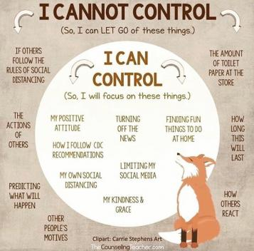

Slide 9
Get Involved
Clubs
Sports
After-School Sports/Activities in the Community
Community Service
Summer Internships
Employment
Guidance Aide
Keep a record of everything by adding it to your Activity Sheet!

Slide 10
Character Matters
Be respectful to others in the building
Abide by school policies
Help your fellow students
Be a leader
REMEMBER - You will be needing letters of recommendation for college/work and the content of these letters is not just about academics

Slide 11
New York State Graduation Requirements
English - 4 Credits
Social Studies - 4 Credits
Mathematics - 3 Credits
Science - 3 Credits
  Must include one life science and one lab science
Languages Other than English - 1 Credit
Art, Music, and/or Theater - 1 Credit
Physical Education - 2 (4 Years) Credits
Health - ½ Credit
Electives - 3½ Credits
Total Credits: 22

Slide 12
New York State Graduation Requirements:
Regents Exams
(exemptions from June and August 2020 exams)
Regents Diploma With Advanced Designation
3 - Math
2 - Science (1 life science, 1 physical science)
2 - Social Studies
1 - English
1 - FLACS B Assessment (2 additional credits in LOTE with FLACS B)
Regents Diploma
1 - Math
1 - Science
1 - Social Studies
1 - English
1 - Pathway Exam
Local Diploma

Slide 13
Add/Drop Deadlines
Semester 1, Year-Long Courses – Friday, October 16th, 2020
  If a course is dropped after 10/16/20 a W may appear on the transcript
Semester 2, Half-Year Courses - TBD
Class level changes are case by case; speak with your counselor to initiate the process
  *First quarter grade adjustment

Slide 14
Standardized Exams
PSAT - Juniors; Practice test; Oct 17, 2020
SAT - Offered 6x per year (GCHS 2020-2021) + additional testing locations
ACT - Offered 4x per year (GCHS 2020-2021) + additional testing locations
SAT II - 20 one-hour exams (Bio E/M)
AP - Offered in May Score 1-5
Test optional colleges
October
Notes:
PSAT - Abridged version of SAT Becoming less important for juniors. Top 1% recognized Test Information Release

Slide 15
Post High School Planning
Endgame for most…. College
Gr. 9-11 33% per year in GPA
Maturity Continuum - When to Start?
Academics - 70% Challenging Curriculum
Activities - 15% Meaningful Experiences
Character - 15% Honest, Trustworthy, Reliable
Notes:
1.So like….; Students starting earlier 2. Freshman questionnaire indicating law Georgetown; Visiting college - galvanize their commitment; 3.

Slide 16
How You Can Support Your Student
Check Parent Portal
Encourage them to advocate for themselves
Encourage them to build strong habits to ensure future success
Communicate with teachers and counselors when necessary

Slide 17
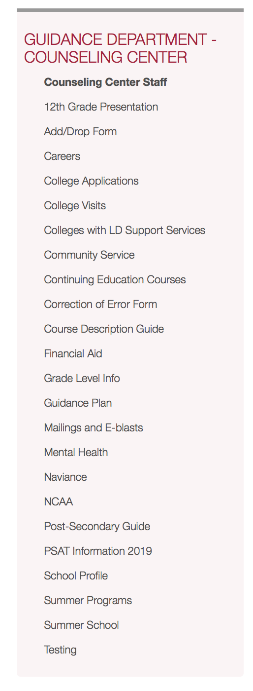
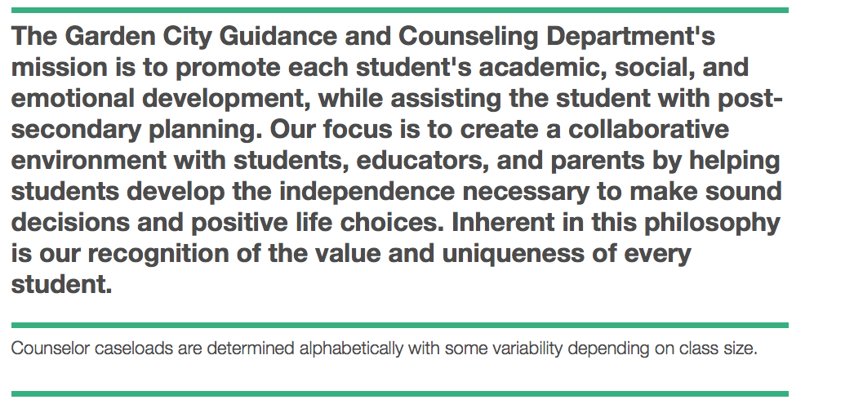
Visit Our Website!
https://www.gardencity.k12.ny.us/domain/1041

