Slide 1
9th Grade CHS Library Orientation
Michelle Chase, MLA, MLIS
August 2019

Slide 2
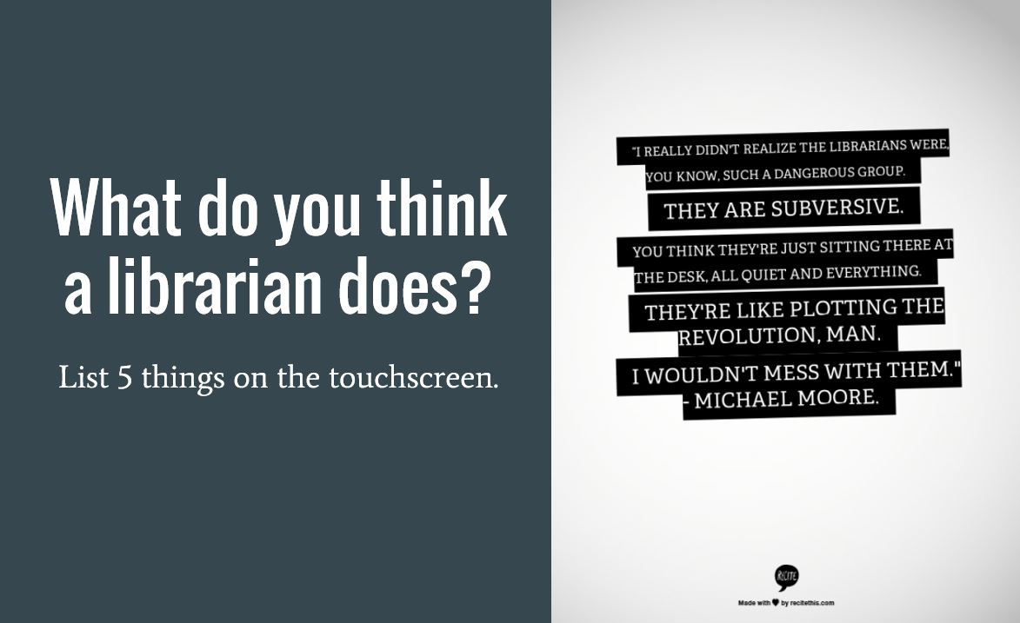
Mrs. Chase
French teacher at CHS
Elementary librarian in Great Falls
I love to read!!
I read 100s of books each year
Favs are murder mysteries, sci fi, historical fiction, biographies, textiles
mchase@chester.k12.sc.us

Slide 3

Miss Queen
Miss Queen graduated from York Tech with an Associates in Applied Science.
She has worked at CHS as the media assistant since 2016.
She enjoys gardening, workworking and spending time with her family.
mqueen@chester.k12.sc.us

Slide 4

Library Policies
Open 7:45 AM to 3:45 PM
Open during all lunches
No food allowed
Only clear water allowed
Phone use allowed. Please use earbuds or headphones.
During class times, you need a pass from a teacher
We do not give passes to class!!

Slide 5

Please keep an eye on your things, especially electronics. We are not responsible for anything lost or stolen
Be respectful of other people.
Black and white copies are: 1st page free, .10 page after
Color copies are .25 a page
Double check your document before we print it. You will have to pay for it.

Slide 6
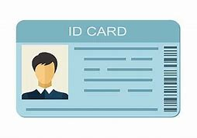
ID Cards
Once your ID is issued, you are required to wear it, on a lanyard, around your neck, at all times.
The first ID is free; replacements are $6.
Temporary IDs are $1. Only one per day will be allowed.
After we issue you 10 temporary IDs, you will receive an office referral.
Your teacher will notify the library that you need a temporary ID. It will be delivered to your class. Do not come to the library to get one – we will send you back to class (without a pass!!)

Slide 7

Checking Out Books
Books check out for 2 weeks.
No overdue fines, but you will have to pay to replace a lost or damaged book.
Kajeets check out for 3 days (not available yet, sorry)
Fingerprint scan or ID scan

Slide 8




FIC = FICTION
New fiction titles are on top of the bookcases.
If you can’t find it, ask.
Let us know what books you would like to read- if we don’t have it, we will try to get it.

Slide 9

Types of Materials
Graphic novels – 741.5
Non – fiction
Biography - 92
Reference
Magazines
Newspapers

Slide 10

ANY QUESTIONS? Please ask us!

