Slide 1
Handouts for Session 4
Goals, Sources of Evidence, Rubrics

Slide 2
Science sample growth goal
This school year, all of my sixth grade students will demonstrate measurable growth in their ability to apply the scientific practices. 100% of my students will improve by 2 or more levels on the district’s science rubric in the areas of engaging in argument from evidence and obtaining, evaluating, and communicating information. 85% of students will perform at level four on the 5-point science rubric.
Notes:
Before we share the goal setting process, let’s look at an example of a student growth goal. Read the goal just to get an idea of what a student growth goal may look like. We’ll talk more about the characteristics of a quality student growth goal and look at a variety of examples in another session.

Slide 3
Data Contributing to Baseline
Assessments using evidence from observations and text to develop and support arguments.
Short responses to identify appropriate resources to support claims
Related science journal entries

Slide 4

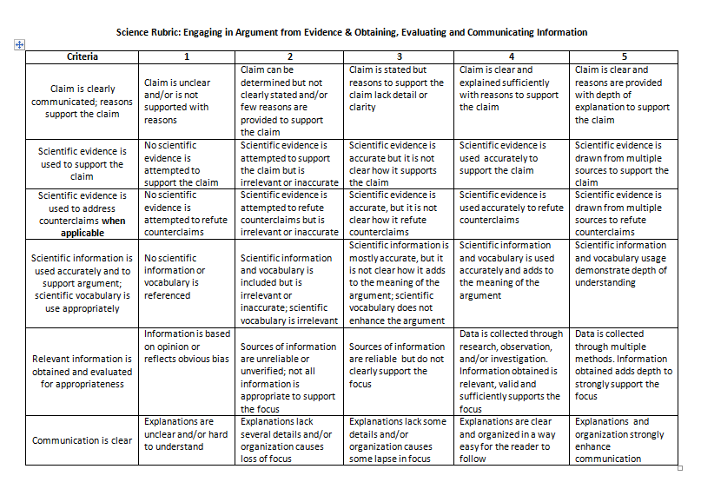
Drafted by KDE Effectiveness Coaches

Slide 5
4th grade goal: Summarization
By the end of the 2013-14 school year, all of my 4th grade students (100%) will show growth in summarizing key ideas and details in what they read. Each student will improve by 2 or more levels on the rubric developed by my PLC team for summarization. In addition, 90% of students will score Proficient or above on the rubric by the end of the year.
Notes:
So, this is this year’s goal. I certainly see improvement. In this goal, the teacher has identified a specific area of need in enduring learning/skill – specifically, the goal is centered on students being able to construct a response based on text-based evidence. This clearly connects to what students are asked to do in the ELA standards. Also, I see this teacher expects all students to show growth, although I’m not sure how much growth she expects. I see the teacher used a rubric design to show student performance in this enduring skill. And our kids know this rubric as well. The teacher worked with her students to create a kid-language rubric. Kids are able to pick it out now and assess themselves.
4th grade standard - Determine the main idea of a text and explain how it is supported by key details; summarize the text. Need to see the rubric and explanation of how MAP works.

Slide 6
Data contributing to baseline
MAP data (DesCartes Continuum regarding summarization skills)
Written summaries
Journal entries
M/C items where students identify main ideas and supporting details.

Slide 7
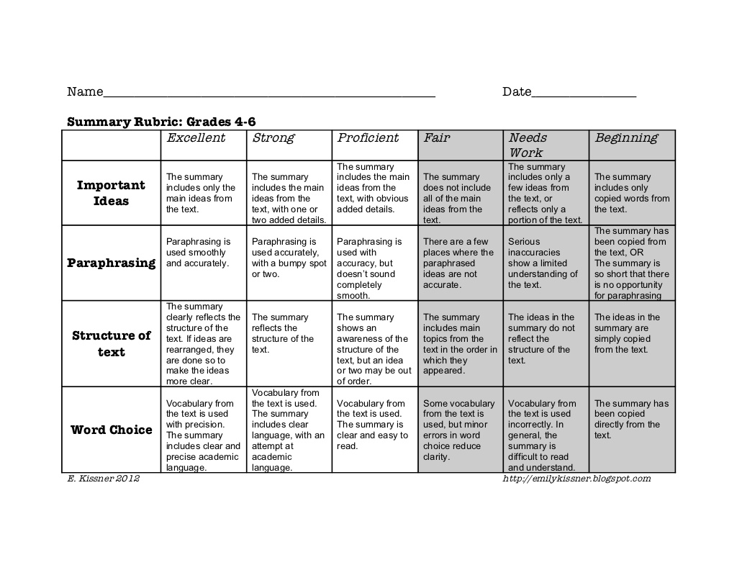
Sample Rubric

Slide 8
Student Growth Goal Sample
For the 2012-2013 school year, 100% of my students will make measurable progress in argumentative writing. Each student will improve by at least one performance level in three or more areas of the LDC argumentation rubric. Furthermore 80% of my students will score a 3 or better overall.
23
Notes:
This goal meets SMART.
S – The specific need the goal will target is identified in red. This should be obvious in every goal.
M – The measure of growth is appropriate for the need. Notice the teacher is using a descriptive rubric to allow her to make judgments about students needs from multiple sources of evidence.
A – This goal is based on literacy, so it is appropriate for teachers in history, science, ELA and technical subjects.
R – Notice how specific the goal and the proficiency measures are. In both cases, those goals were set after considering where students were with the baseline data.
T - The time interval is identified in the first line of the goal. (The goal must cover the course or school year.)

Slide 9
Data contributing to baseline
On demand writing prompts
Writer’s Notebook responses
Short research assignment

Slide 10
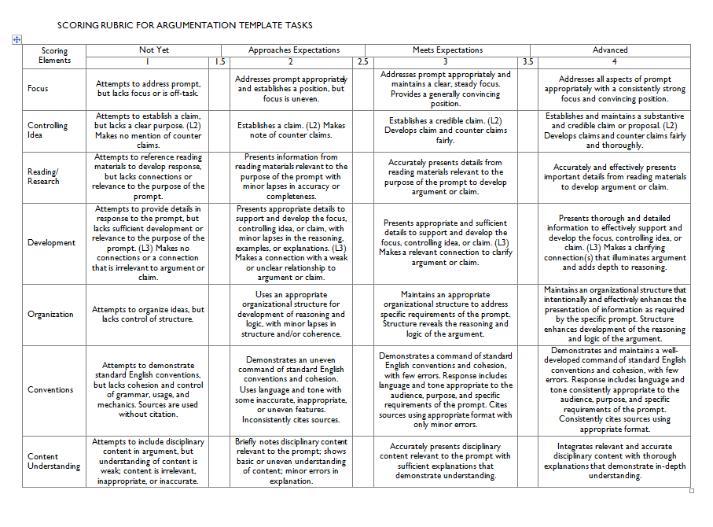
Literacy Design Collaborative

Slide 11
Art Goal Sample
This year, all 8th grade art students will improve their skills in creating and critiquing works of art. Each student will improve at least one level in all areas on the district art standards-based rubric. At least 70% of the students will demonstrate proficiency in all criteria of the rubric.

Slide 12
Data contributing to baseline
Beginning Portfolio of artwork
Art on-demand assignment
Critique of art work
Feedback to peer

Slide 13
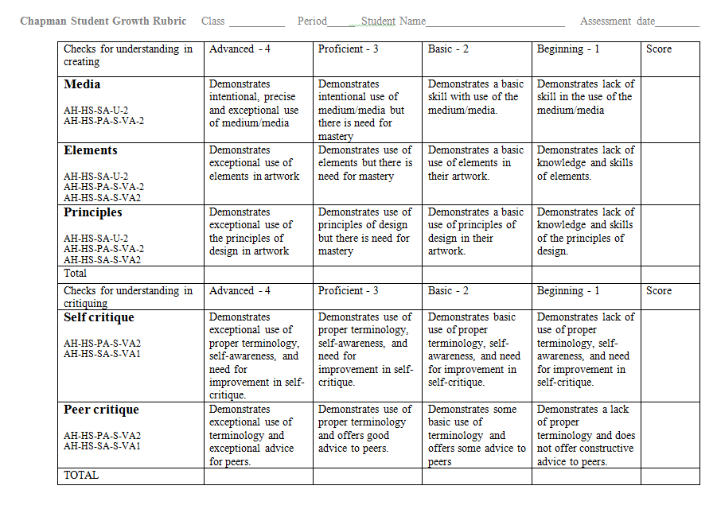
Chapman, Ashland Independent School District

Slide 14
Mathematics Goal Sample
During the 2014/15 school year, 100% of my 6th grade students will improve their ability to make sense of problems and persevere in solving them. Each student will improve by at least one level on at least two indicators on the Mathematics Problem Solving rubric. In addition, 80% of my students will perform at the proficient level on all three indicators on the rubric.

Slide 15
Data contributing to baseline
MAP (DesCartes)
Common assessments
Math Design Collaborative formative assessment lessons

Slide 16

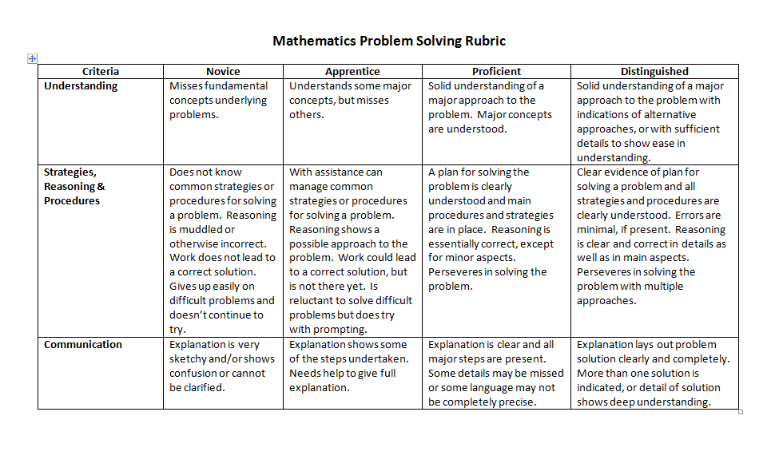
Drafted by KDE PGES Consultants

