Slide 1


Slide 2
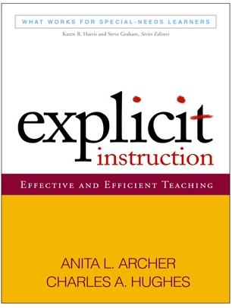
Explicit instruction: effective and efficient teaching

Slide 3


Slide 4
What is explicit instruction?
Design and delivery oriented
Characterized by scaffolds or supports
Applicable to skills and content
Systematic
Intentional
An important teacher tool

Slide 5
Rosenshine (1987)
“…a systematic method of teaching with emphasis on proceeding in small steps, checking for student understanding, and achieving active and successful participation by all students.”

Slide 6
8th Grade Geometry

Slide 7
Intervention research
Writing process
Reading comprehension
Small group instruction

Slide 8
Why would you want to invest in this book and facilitate a professional learning community based on its concepts?

Slide 9
Dispels misconceptions about explicit instruction
Provides opportunities for special education teachers to engage in relevant and purposeful professional discourse
Lays a foundation for effective, research-based instruction and intervention practice

Slide 10
Check out the companion website at:
http://explicitinstruction.org/

Slide 11
Purchasing Info

