Slide 1
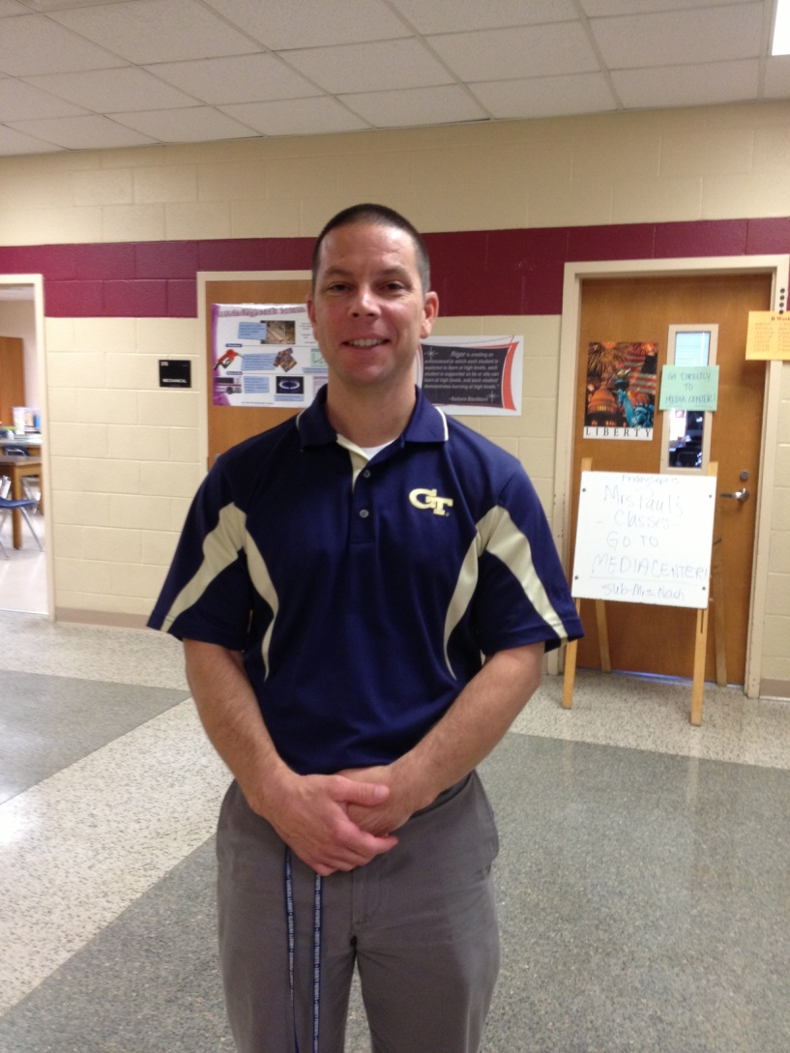
8th Grade Math
Mr. Biccum

Slide 2

8th Grade Math
Units of Study
1st Semester
Unit 1 Transformations, Congruence, and Similarity - 3 weeks
Unit 2 Exponents - 5 weeks
Unit 3 Geometric Applications and Exponents - 4 weeks
Unit 4 Functions – 1 week
Unit 5 Linear Functions – 4 weeks
2nd Semester
Unit 6 Linear Models and Tables – 5 weeks
Unit 7 Solving Systems of Equations – 4 weeks
Unit 8 Review - 3 weeks
Unit 9 Show what we Know/ High School Prep – 5 weeks

Slide 3
8th Grade Accelerated Math
Units of Study
1st Semester
Unit 1 Relationships Between Quantities - 4 weeks
Unit 2 Reasoning with Equations and Inequalities - 3 weeks
Unit 3 Linear and Exponential Functions- 5 weeks
Unit 4 Describing Data – 4 weeks
Unit 5 Transformations in the Coordinate Plane – 1 week
2nd Semester
Unit 5 Transformations in the Coordinate Plane – 2 weeks
Unit 6 Connecting Algebra & Geometry Through Coordinates – 4 weeks
Unit 7 Similarity, Congruence, and Proofs – 5 weeks
Unit 8 Right Triangle Trigonometry - 3 weeks
Unit 9 Circles and Volume – 3 weeks

Slide 4

Curriculum Links
Grade 8 Math- http://www.forsyth.k12.ga.us/cms/lib3/GA01000373/Centricity/Domain/22/Grade%208%20Pacing%20Guide%20with%20Unwrapped%20Power%20Standards.pdf
Grade 8 Accelerated –http://www.forsyth.k12.ga.us/cms/lib3/GA01000373/Centricity/Domain/22/Accelerated%20Coordinate%20Algebra%20Pacing%20Guide%20with%20Unwrapped%20Standards.pdf

Slide 5

This web site will allow students to get notifications
of special events taking place at school and even
check assignments online.
Dates to Remember
1st Semester Math mid-term – December 19th
2nd Semester Math Final – May 23th
CRCT for Math – April 15th
EOCT for Accelerated Math students – May 12th

Slide 6
Reteach and Recovery
We offer students the opportunity to retake Summative Tests, provided they have met certain criteria for that unit.
Only students who score lower than an 90 can retake a Summative and the cap score on the retake is an 90.
We will offer a redelivery session that students must attend before giving students the opportunity to retest. Redelivery is done either before school, after school, or during CIA.

Slide 7
Contact Information
Bryan Biccum- bbiccum@forsyth.k12.ga.us
770-781-4889 x 290203

