Slide 1












RISING 9TH GRADE
REGISTRATION PREVIEW
2017 – 2018
Registration
http://unioncounty.schoolwires.net/Domain/55

Slide 2
9TH GRADE YEAR IN HS
○ College admissions will be based upon:
▪ GPA (weighted vs. unweighted)
▪ Class Rank
▪ The rigor of your courses (Honors and AP)
▪ ACT / SAT Scores
▪ School and community involvement
▪ Community service
○ Rigor is important but so is the right choice.

Slide 3
HIGH SCHOOL COURSES TAKEN IN MIDDLE SCHOOL
State Board of Education policy allows middle school students in grades 6 -8 to receive graduation credit for high school courses taken in middle school. To receive credit, students pass the course and score a Level III on any EOC associated with the course, if applicable. The course must conform to the high school course of study and provide135 hours of instruction.
These courses meet graduation requirements but are not factored in to a student’s high school GPA.

Slide 4
GRADUATION REQUIREMENTS
English | 4 Credits: Eng. I, Eng. II, Eng. III, & Eng. IV
Math | 4 Credits: Math I, Math II, Math III and a 4th Math
Science | 3 Credits: A Physical Science course, Biology, & Earth/Environmental Science
Social Studies | 4 Credits: World History, Civics & Economics, American History I & II
Health/PE | 1 Credit Health/Physical Education
Electives | 2 Credits: Art, CTE or World Language + 4 Credits: Additional electives
Second Language* | Not required for graduation: However, 2 levels of the same language required to meet minimum application requirements for UNC schools.

Slide 5
ACADEMIC DIFFICULTY OF COURSES
▪College Prep (CP) – Course content, pace, and academic rigor follows standards specified by the NCSCOS with content enrichment where appropriate.
▪Honors - Course content, pace, and academic rigor place high expectations on the student and surpass standards specified by the NCSCOS. These courses demand greater independence and responsibility than CP Level courses. This level or higher is suggested for competitive college admission .
▪Advanced Placement– Course content, pace, and academic rigor are college-level as adopted by the College Board and prepare students to take the AP examinations which may lead to college credit.

Slide 6
WEIGHTING OF CLASSES
Grade | # Grade | CP | Honors | AP
A | 90-100 | 4 | 4.5 | 5
B | 80-89 | 3 | 3.5 | 4
C | 70-79 | 2 | 2.5 | 3
D | 60-69 | 1 | 1.5 | 2
F | 0-59 | 0 | 0 | 0

Slide 7
REGISTRATION PROCESS
○ Your student has received an ivory colored registration card & Program of Studies
○ Registration card includes core classes and electives
○ Please select 8 classes by marking an X by the course
○ Please select 4 alternates by marking an “A” by the course.
○ Counselors will meet with students the
week of April 11.

Slide 8
ENGLISH RECOMMENDATIONS
8th Grade ELA
(Final Grade 60 - 89)
•CP English I
8th Grade ELA
(Final Grade 90+)
•Honors English I
English I (Level I – III)
•CP English II
English I
(Level IV+)
•Honors English II

Slide 9
SOCIAL STUDIES RECOMMENDATIONS
8th Grade Social Studies (Final Grade 60 - 85)
• CP World History
8th Grade Social Studies (Final Grade 85+)
• Honors World History

Slide 10
MATHEMATICS RECOMMENDATIONS
Pre-Algebra
(Final Grade 60 - 79 and lower than Level III)
Foundations of Math I
Math I
New for 2017/18
Honors Math I
Recommended for students with an average over 90%
Pre-Algebra
(Final Grade 80 - 90 and Level III+)
CP Math I
8th Grade Math I
(Final Grade 60 - 79)
CP Math II
8th Grade Math I
(Final Grade 80 -100)
Honors Math II
8th Grade Math II
Honors Math III

Slide 11
SCIENCE RECOMMENDATIONS
Science EOG
Level 1-3
• CP Earth Science
Science EOG
Level 4+
• Honors Earth
Science

Slide 12

HEALTH AND PE
All students must have one credit of Health and PE. This is typically a Freshman course. If you have not passed Health/PE you must register for this course!
Health/PE (required for all)

Slide 13
WORLD LANGUAGE
○ World Language is not required for graduation, however to meet the minimum requirements for any UNC system school, you must have a minimum of 2 levels of the same world language.

Slide 14










ELECTIVES (CTE)
Agriculture
& Natural Resources
Information Technology
Marketing
Family & Consumer Sciences
Business & Information Technology
Health Sciences

Slide 15




ELECTIVES (CON’T)
JROTC
Visual Arts
Physical Education
Electives
Core Electives
Performing Arts
World Languages

Slide 16
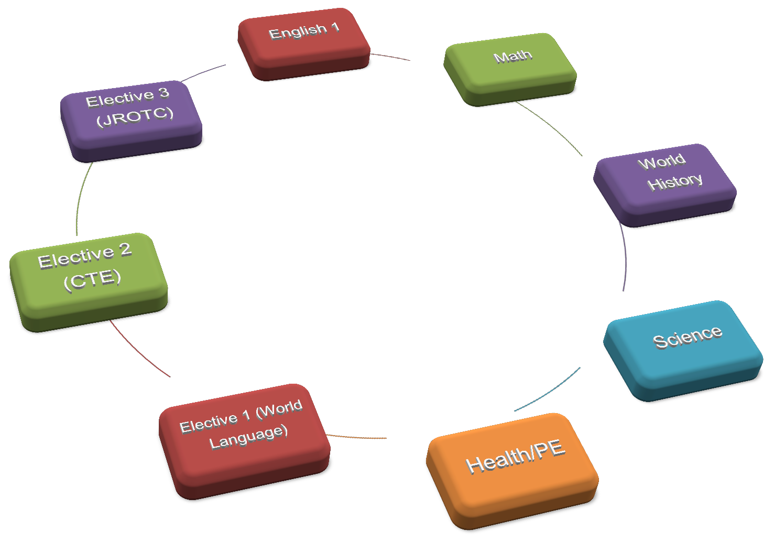
9TH GRADE COURSE
SELECTIONS

Slide 17
EXAMPLE OF A 9TH GRADE SCHEDULE
FALL 2017 (August – January) |  | SPRING 2018 (January – June)
₁st | English I | ₁st | Math I
₂nd | Earth Science | ₂nd | Spanish I
₃rd | JROTC I | ₃rd | Theatre Arts I
₄th | Health and PE | ₄th | World History

Slide 18
CLASSIFICATION/PROMOTION
STANDARDS
Grade Level | Promotion Requirements
Grade 9 | Promoted from 8th Grade
Grade 10 | 6 credits including English 1
Grade 11 | 13 credits including English 2
Grade 12 | 20 credits including English 3

Slide 19

PASS/FAIL COURSES
Students will be permitted to enroll in one (1) elective course per school year on a Pass-Fail basis. The course may be in addition to courses that use only a Pass-Fail grading system. However, the student must decide within the first two weeks if the course is to be taken on a pass- fail basis. NC Scholars may not take a required course on pass/fail status.

Slide 20
WAIVERS
As you are selecting your courses, you will have the option of selecting CP, Honors, or AP courses. If your grade in a previous course does not meet the
recommended grade to take an advanced course, you may be asked to complete a waiver. This waiver will require a parent/guardian’s permission to take
the advanced course.
You will be notified by a counselor if a waiver is required.
Waivers are available on the school counseling website

