Slide 1

Let’s look at schedules and talk about forecasting
Current 6th graders might be wondering:
What about next year?

Slide 2


* Math- year long class
* Language Arts- year long class
* Science-year long class
* 2 Trimesters of Social Studies
* 1 Trimester of Health
* 1 Trimester of PE
7th grade schedule Part 1
Required classes:

Slide 3
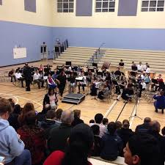
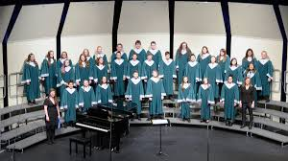
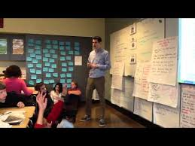
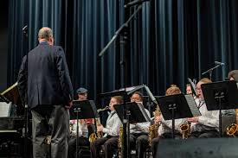
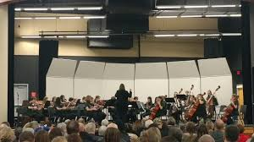
Band-Choir-Orchestra-ELD-AVID-Art-Peer Partner-PE- FACS Exploration
Youth & Law-Engineering & Design- Career Explorations
*Intervention classes
7th grade schedule Part 2
2 Elective choices

Slide 4
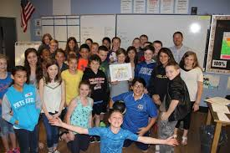
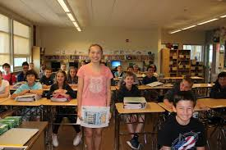
*Intervention classes
Some students will receive additional support in reading, writing and/or math in order to provide them a strong foundation as they prepare for high school.
7th grade schedule Part 3

Slide 5
6 PERIOD DAY DRAFT
TRIMESTER SCHEDULE
57-minute classes 5-minute passing time 30-minute lunch
6 Period TRIMESTER SCHEDULE (5 min. passing)
Period | Time | minutes
1 | 8:00-9:00 | 60
2 | 9:05-10:02 | 57
3 | 10:07-11:04 | 57
Lunch A | 11:04-11:34 | 30
4-A | 11:39-12:36 | 57
4-B | 11:09-12:06 | 57
Lunch B | 12:06-12:36 | 30
5 | 12:41-1:38 | 57
6 | 1:43-2:40 | 57

Slide 6
GENERAL 7th grade draft STUDENT SCHEDULE
Period | Trimester 1 | Trimester 2 | Trimester 3
1 | Math | Math | Math
2 | ELA | ELA | ELA
3 | Science | Science | Science
4 | Social Studies | PE | Social Studies
5 | Health | Full Year Electives AVID/Music or Trimester Electives Or Supports Class | Full Year Electives- AVID/Music Trimester Electives & Supports-
6 | Full Year Electives AVID/Music or Trimester Electives Or Supports Class | Full Year Electives AVID/Music or Trimester Electives Or Supports Class | Full Year Electives AVID/Music or Trimester Electives Or Supports Class

Slide 7
STUDENT SUPPORT
COUNSELORS MRS. MORRISON Student last name: A-K morrison_kimberly@salkeiz.k12.or.us MS. WARD L-Z Student last name: L-Z ward_brittany@salkeiz.k12.or.us
BEHAVIOR SPECIALIST - MR. THORP thorp_joshua@salkeiz.k12.or.us
OFFICE MANAGER - Mrs. Orozco orozco_rosa@salkeiz.k12.or.us
REGISTRAR - Mrs. Gallardo gallardo_angelica@salkeiz.k12.or.us
ASSISTANT PRINCIPAL- MRS. HAMPTON hampton_tamika@salkeiz.k12.or.us
PRINCIPAL - MR. MCCARTHY mccarthy_denny@salkeiz.k12.or.us

Slide 8

It's that time of year again when we start planning and thinking about next year. We look forward to seeing our students in the "new normal" of being in the building for the 2021-2022 school year!
IMPORTANT: You must complete forecasting next year's classes. You will need a piece of paper and something to write with to complete your forecasting.
NEED HELP? We got your back! Join us in the ZOOM ROOM https://salkeizsd.zoom.us/j/9534321058?pwd=alMwZUlwcmhLeHNyZUl4WWkvaHBRdz09&from=addon
Friday, April 2 following Advisory: 9:15-10:30AM.
Thursday, April 8th , from 9:30-10:30 AM
Friday, April 9th from 9:30-10:30AM
Please contact us for any and all help,
Mrs. Morrison & Ms. Ward
School Counselors
Kimberly Morrison School Counselor, Last names A-K morrison_kimberly@salkeiz.k12.or.us 971-332-3948 | Brittany Ward School Counselor, Last name L-Z ward_brittany@salkeiz.k12.or.us 503-300-7282 | Angelica Gallardo Straub Registrar gallardo_angelica@salkeiz.k12.or.us 503-399-2030

Slide 9
"Wow! Planning for 7th grade already?!“
Step 1: Get that piece of paper and something to write with- this is about what YOU want next year.
Step 2: Review descriptions of Trimester Long Elective Choices here: 7th Grade Trimester Long Electives
Here is a short video about Career Explorations Elective: https://drive.google.com/file/d/1nE_i2_jcTAaG3TK27KdtfXOr7Oy-akZD/view?usp=sharing
Step 3: Review descriptions of Year Long Elective Choices here: 7th Grade Year Long Electives
Step 4: Write down (on your sheet of paper) your 8 elective choices. #1 is your top priority and #8 will be your last priority.
Step 5: Fill out the COURSE SELECTION HERE: Current STRAUB 6th graders (Links to an external site.)
*Step 6: Instrucciones para traducir el documento de pronóstico del inglés al español u otro idioma: Translate Google Form
*Make sure your parent signs the bottom of the Google Form!
Once your forecasting is completed, you are on your way to becoming a 7th grader!

Slide 10

The End
Make sure and complete your forecasting by April 16th!

