Slide 1
How to Succeed in Middle School
Classroom Guidance –Academic Lesson for the Summer Bridge Program

Slide 2
Today in classroom guidance
Topic: Academics!!
Activity: ‘What’s your style?’-Learning style inventory, How to make it happen-Setting goals.
Beginning Question(S): How will understanding my learning style help me succeed in 6th grade? What is a SMART goal? What is the difference between a short-term goal and a long-term goal?
When it’s all said and done: 6th graders will be able to identify his/her learning style. 6th graders will also be able to articulate different types of goals, and will be able to set a short-term goal SMART goal.

Slide 3
What’s YOUR Style?
There are 3 learning styles:
  Visual
  Auditory
  Tactile or Kinesthetic
Directions: Read each statement carefully. Chose one answer for each. You have 10 minutes!

Slide 4
Let’s add up the score
What did you discover about your learning style?
Time limit 3-4 minutes

Slide 5


Slide 6
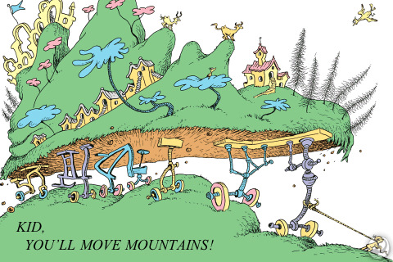
Turn and talk
Share with one person at your table your
  Everyday Choices
  Slumps
  Future Goals

Slide 7
Part 2: Goals-Make it Happen!
What is a goal?
What is the difference between a short –term goal and a long-term goal? –Ask the person next to you.
Time Limit: 2 minute

Slide 8
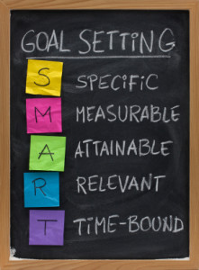
SMART Goals
Time limit: 4 minutes

Slide 9
SMART Goals
Let’s Practice!
Example 1
Example 2
I want to earn a 93 or better in ELA on my 3rd quarter report card
Label each of the SMART “parts.” ☺ Is there anything to add to make it a SMART goal?
I want to get a lot of good test grades
Label each of the SMART “parts.” ☺ Is there anything to add to make it a SMART goal?
Time limit: 8 minutes

Slide 10
Working Together
Summer Plans (Group 1)
Making Money (Group 2)
Achieving in School (Passing 3rd quarter!) (Group 3)
Achieving in sports, theater or music (Group 4)
Getting a job (Group 5)
In pairs, set one short-term and one long-term goals for your chosen topic.
Time Limit: 8 minutes

Slide 11
Let’s talk about it for a second…
Are the goals you set SMART?
Why or Why not?
What needs to be changed to make it a SMART goal?
What are some challenges/obstacles you may encounter?
Time Limit: 8 minutes!

Slide 12
You’re on your own now!
Independent work!
Take a look at the short term goal worksheet.
Set a SMART goal for 1st quarter at Winkler Middle School!
Time Limit: Until 2 minutes before the bell

