Slide 1
Core Focus on
Ratios, Rates & Statistics
Lesson 4.1
Introduction to Statistics

Slide 2
Warm-Up
1. What type of pets do you have? Talk to five classmates and list the types of pets that they have.
2. How many pets do you have? Talk to five classmates and list the number of pets that they each have.

Slide 3

Introduction to Statistics
Lesson 4.1
Identify and write statistical questions and the type of data that will result.

Slide 4

Vocabulary
Statistics
The process of collecting, displaying and analyzing a set of data.
Good to know!
A good statistical question is one in which the data will vary.
Categorical Data
Data collected in the form of words.
Numerical Data
Data collected in the form of numbers.
Bias
A systematic error that contributes to the inaccuracy of your data.

Slide 5
Explore! A Question of Statistics
Step 1 For each question below, decide whether it is a statistical question or not. Make a list of each question that is a statistical question. There should be 6 in your list.
A. What type of pets do students have?
B. What is the fastest land mammal?
C. What is each student’s favorite TV show?
D. How much does an airplane ticket cost?
E. How many books are checked out daily from the library?
F. How much money do doctors make?
G. How many teams are in the NFL?
H. Which movie made the most money in 2012?
I. How did students get to school today?
J. How many books were checked out yesterday from the library?
Step 2 For each question in your list from Step 1, decide whether the question would give categorical data or numerical data. Write “Categorical” or “Numerical” next to each question.
Step 3 Create two more statistical questions. Identify whether each question would give categorical or numerical data.

Slide 6
Example 1
Mrs. Crenshaw asks her 6th grade students the following questions:
How old are you in years? How old are you in months?
Which question will give data that is more varied? Explain.
The second question will give more varied answers. Since Mrs. Crenshaw’s students may all be roughly the same age in years, there may be little difference in students’ answers (11- or 12-years old). Because there are 12 months in a year, asking for students’ ages in months could give far more varied answers.
For example: 11 years and 3 months = 135 months,
11 years and 4 months = 136 months, and so on.

Slide 7
Example 2
Which is a better statistical question for a doctor to ask a patient about exercise? Explain your answer.
Do you exercise? OR How many days a week do you exercise?
The first question only gives an answer of “yes” or “no”. This question does not give any information about whether the patient is getting enough exercise.
The second question is better because it will give the doctor more specific information.

Slide 8
Example 3
Explain how there could be bias in each of the following situations.
A restaurant owner asks customers to rate their dining experience on a scale of 1 – 10 as they leave the restaurant.
Some customers may not feel comfortable being honest with the restaurant owner so the data collected may be misleading.

Slide 9
Example 3 Continued…
Explain how there could be bias in each of the following situations.
b. A worker surveys people outside the monkey exhibit at the zoo, asking: “What is your favorite animal at the zoo?”
People outside the monkey exhibit may be more likely to enjoy the monkeys best. Their opinions may not represent all visitors at the zoo.

Slide 10
Example 3 Continued…
Explain how there could be bias in each of the following situations.
c. An ice cream company surveys customers, asking: “What is your favorite type of ice cream: Chocolate, Vanilla or Caramel Fudge Swirl?”
Only giving customers three options to choose from may not give the most reliable results. Also, the third option sounds more exciting than the other two, so it might be chosen more often.

Slide 11
Example 3 Continued…
Explain how there could be bias in each of the following situations.
d. A hotel leaves a comment card in each room where customers can choose to rate their experience at the hotel on a scale of 1 – 10.
Optional surveys may not give the most reliable results. They often receive responses that are really positive or really negative and not many in the middle.

Slide 12
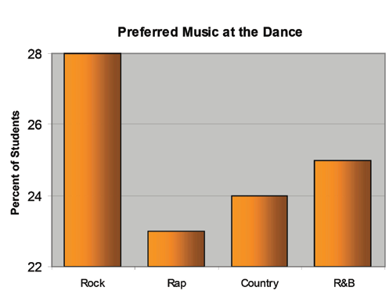
Example 4
Students at Humphrey Middle School collected data on the type of music students would prefer for the next school dance. The bar graph below shows the results.
a. What is misleading about the graph?
The graph does not start at 0%. This makes it appear that Rock had a large majority of the votes. There is really only a five percent difference between Rock and Rap.

Slide 13
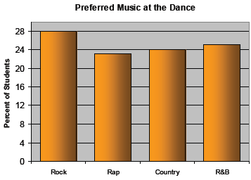
Example 4 Continued…
Students at Humphrey Middle School collected data on the type of music students would prefer for the next school dance. The bar graph below shows the results.
b. Draw a new bar graph that is not misleading.
Starting the graph at 0% would better represent how close the vote was.

Slide 14
Example 4 Continued…
Students at Humphrey Middle School collected data on the type of music students would prefer for the next school dance. The bar graph below shows the results.
Why might someone use the original graph to represent the data?
Someone who likes Rock music might use this graph. They may want to hear more Rock music at the next school dance.

Slide 15
Communication Prompt
Why is it important to eliminate bias in a data set?

Slide 16
Exit Problems
  1. How could you modify the following situation to eliminate bias?
Placing a 1-800 number on the back of a movie ticket
stub where people can call and give a review of the movie.
2. Classify each data set as either categorical or numerical.
a. the speeds of the first one hundred cars down a stretch of highway
b. the favorite basketball team of each student in your class
c. the weights of twenty dogs at the veterinarian office
Offer a discount on the next movie for giving a review. This will get more opinions.
numerical
categorical
numerical

