Slide 1
6th grade Social Studies
Part II of Review for the upcoming year

Slide 2
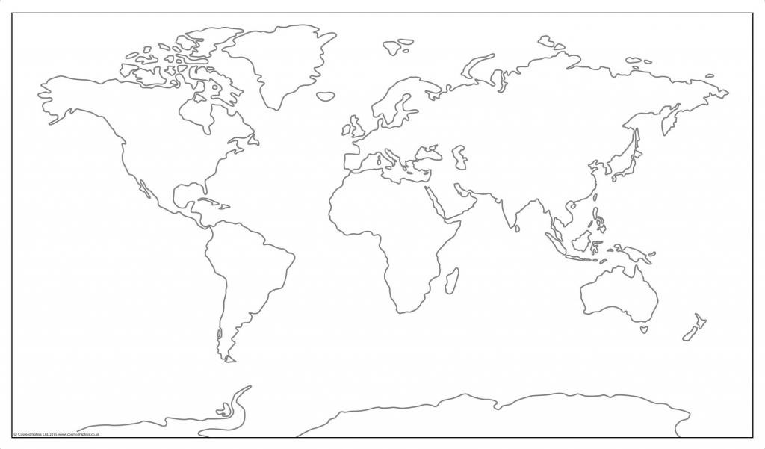
Grab a blank copy of the world Map and label all 7 continents

Slide 3
What are the 7 continents?
Video for help: https://www.youtube.com/watch?v=rCYERpZ4Ujc
7 Continents:
North America
South America
Europe
Africa
Antartica
Australia
Asia

Slide 4
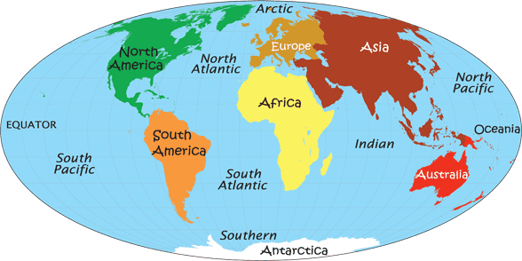
World MAP Labeled

Slide 5
Cardinal Directions-record information underneath map
There are really six cardinal or main directions. Up and down are two main directions.
Up is any direction away from the center of the Earth. Down is any direction toward the center of the Earth.
The four other cardinal directions are north, south, east and west.

Slide 6
Cardinal directions continued…
The poles define two of the cardinal (major) directions, north and south. North is toward the North Pole. South is toward the South Pole.
The direction in which the Earth rotates defines the other cardinal directions, east and west. The Earth rotates from west to east.
East is to the right as you face the North Pole. West is to your left as you face the North Pole.

Slide 7
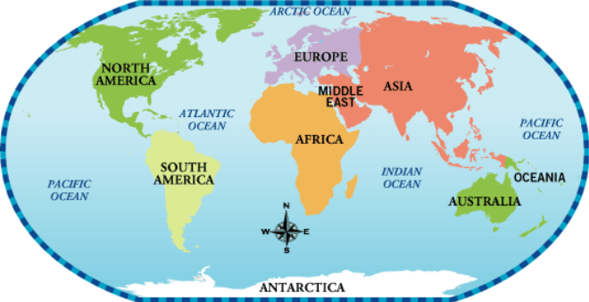
Do you Understand? Let’s answer the following questions?
What continent is south of Europe?
What ocean is east of Africa?
Which continents are south of the Equator?
What ocean is north of Asia?
Which ocean is east of South America?

Slide 8
Intermediate Directions
When you are traveling in directions between north, south, east or west, you are traveling in an intermediate direction.
When you name intermediate directions, you use north and south with either east or west to make one word. When describing an intermediate direction you always place north or south in front of east or west. You would NOT say that Hawaii is eastsouth of San Francisco. New York is NOT westnorth of Mexico City.
There are four intermediate directions, northeast, northwest, southeast, and southwest.

Slide 9
Intermediate Directions
NEVER EAT SOGGY WORMS=North, South, East, West
Now, watch this video for review of cardinal and intermediate directions.
https://www.youtube.com/watch?v=ZM6jcWZHa_U

Slide 10
Latitude/Parallels
Do you remember the starting point for latitude? The Equator is zero (0) degrees. You measure latitude in degrees north and south from the equator. There are 90° of latitude north and 90° of latitude south.
North latitude ends at the North Pole. South latitude ends at the South Pole. The North Pole is 90° north latitude. The South Pole is 90° south latitude

Slide 11
Longitude/Meridians
The starting point for longitude is the Prime Meridian. This line is longitude zero (0°). Longitude measures east and west from this line. Longitude is measured in degrees. There are 180° of longitude east and 180° of longitude west.
*Longitude degrees are “long”er than the latitude lines.
Video link for review: https://www.youtube.com/watch?v=MSA88mmFuyE

