Slide 1


Team: Gladiators
6th Grade
Eisbacher
Guffey

Slide 2
Gladiators
2 Teacher team
2 Morning Blocks
1st/2nd and 3rd/4th
Guffey- Math & Science
Eisbacher- Language Arts & Social Studies

Slide 3

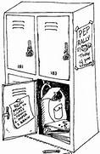

Fees: .50
Lock /Locker Rental -- $0.50
If lock is lost…replacement fee is $5.00

Slide 4

Agenda book
Each student receives a FREE agenda
Homework assignments
Tests/Projects
Communication Tool
**If lost or damaged students pay $5 for a new agenda

Slide 5
Team Expectations
As a member of the Gladiators Team, I will:
1. Be respectful in words and actions
2. Be on time
3. Be prepared for learning with all assignments
and materials
4. Follow instructions and respond POSITIVELY
to ALL adults
5. Follow teacher and school procedures

Slide 6

Team Consequences
1. Verbal Warning
2. Silent Lunch
3. Student Conference
4. Parent Conference
5. Parent/Student Conference
6. Office Referral- (D-1)
**Students will be sent straight to the office for “Major” Infractions!

Slide 7

Team Rewards
Positive Reinforcement
Team Treats
Open Lunch
Lunch Outside
Homework Pass

Slide 8
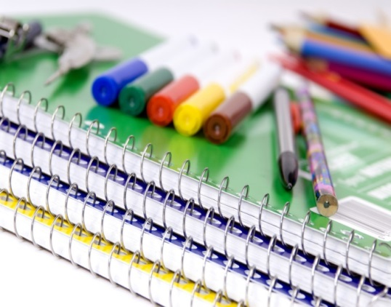
Materials
1 inch Binder for Math with dividers (5 sections)
Packs of Loose Leaf Paper
Pencils
Pens
Pack of Highlighters
Glue Sticks
Pencil Pouch
Colored Pencils, Markers or Crayons
2-Pocket Plastic Folders with Prongs (colors needed)
1- green for Homework for ALL Core classes
1- red for Social Studies
1- yellow for Science
1- blue for Language Arts
3 Composition Notebooks
Box of Kleenex
Hand-held Pencil Sharpener

Slide 9
6th Grade Schedule
7:00-7:30 Homebase
7:30-7:35 (Announcements, Pledge, Dress Code Check)
7:35-12:15 Block 1 and Block 2
1st/2nd 3rd/4th
12:20-1:05 5th Period
1:10-2:00 6th Period

Slide 10
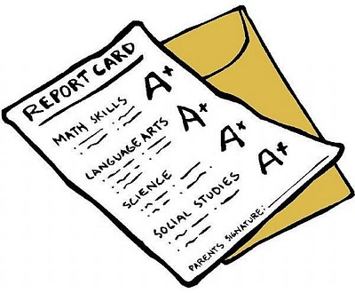
New Grading Scale
A 90-100
B 80-89
C 70-79
D 60-69
F 59 and below

Slide 11
Teacher Websites
http://wsfcs.k12.nc.us/sms#

Slide 12
Remind
To subscribe via text
  Enter this number: 81010
  Text this message: @guffb
To subscribe via email
  Email guffb@mail.remind.com
  You can leave the subject line blank

