Slide 1
Clans !doone’4
6th Grade
Notes:
Day 1

Slide 2
I will identify, name and recognize kinship through paternal grandfather’s clan group
Kid friendly objective:
Notes:
Day 1

Slide 3
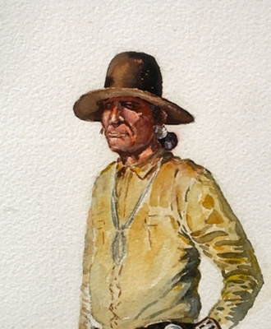
Shin1l7
Notes:
Day 1
Students will describe their paternal grandfather.
e.g. Shinali like the color blue. Shinali’s name is Jim Begay. Shinali works at NTUA.
District Worksheet 1.

Slide 4
Identify and name kinship of paternal grandfather’s clan.
Shin1l7 hastiin
_______dah shin1l7.
Shizh4’4
Shizh4’4 bizh4’4
Notes:
Day 2: Students are making a connection of paternal grandfather’s clan to father’s 2nd clan.

Slide 5
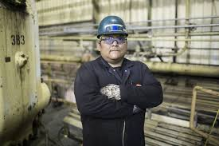
Shin1l7
Shizh4’4
Shin1l7 47 shizh4’4 bizh4’4.
Shin1l7 _____ nil9.
Shizh4’4 _______y1shch99n.
_______ dashin1l7.
Notes:
Day 2: See worksheet related to this template. Shinali doo shizhe’e Worksheet.

Slide 6
Identify and recognize kinship of paternal grandfather’s clan group.
Shin1l7 hast88
Yi[k’4 da’ahi’di’ n7n7g77
K4 naazt’i’
K4 ts’0s7
Notes:
Day 3: Students are making connection that nali’s clan has sub clans.

Slide 7
Shin1l7
Shin1l7 Hashk’22 Hadzoh7 nil9.
D77 47 yi[k’4 da’1hidi’n7:
Hon1gh1ahnii
T0’ahan7
Ta’neeszahnii
Nih0b1anii
Ts’ah yisk’idnii
Dzi[ t[‘ahnii
Dzi[ n1’oodi[nii
Shizh4’4 Hashk’22 Hadzoh7 y1shch’99n.
Notes:
Students here will use the district worksheet 1 to identify their paternal grandfather’s clan.

Slide 8
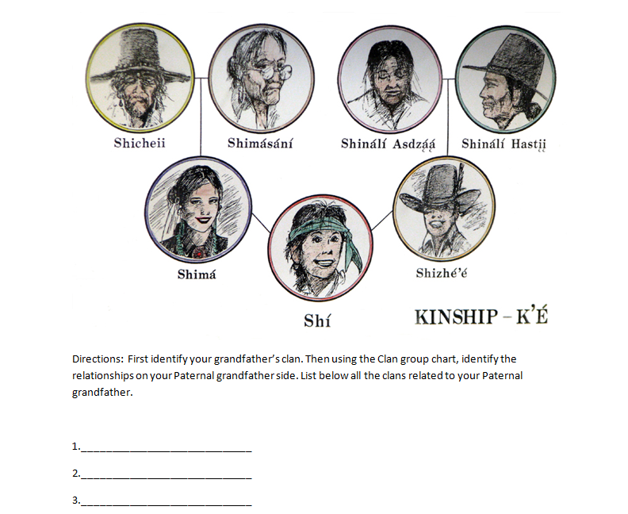
Worksheet to complete:

Slide 9
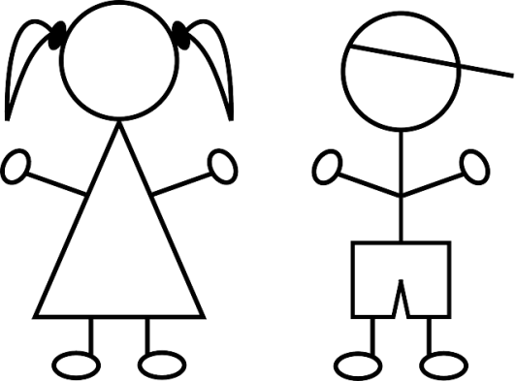
Shin1l7
I will identify, name and recognize kinship through paternal grandfather’s clan group.
Your paternal Clan: 4th Clan
You are a n1l7 granddaughter or grandson
1stClan :Your N1l7
Shin1l7 asdz11n or hast88
2nd Clan: Your Unlce or Aunt
Shizh4’4 y1zh7 or Shib7zh7
3rd Clan:
Your cousin
Shi[naa’aash or Shizeed7
4th Clan:
Sibling
Shideezh7, Sh1d7, Shtsil7, Sh7naa’7
Notes:
Peer clans worksheet from District website.

