Slide 1
6th Grade Wax Museum
Charity Selection

Slide 2
Past Wax Museum Donations…
2014: $2,213.95 to the Make a Wish Foundation
2015: $2,920.95 to the Make a Wish Foundation

Slide 3
Four Options
Make-A-Wish
Brookings Boys & Girls Club
Brookings County Food Pantry
Brookings Regional Humane Society

Slide 4
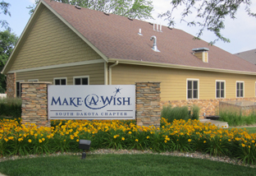
Make-A-Wish
http://southdakota.wish.org/

Slide 5

Boys & Girls Club
http://greatfuturessd.org/page14422.aspx

Slide 6
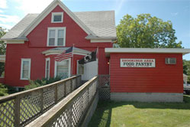
Brookings County Food Pantry
http://www.brookingscountyfoodpantry.org/index.htm

Slide 7

Brookings Regional Humane Society
http://brookingshumane.org/

Slide 8
Cast your vote!
Please circle the one charity that you would like to support most with the 6th Grade Wax Museum contributions!
Return your ballot to your teacher without your name.

