Slide 1
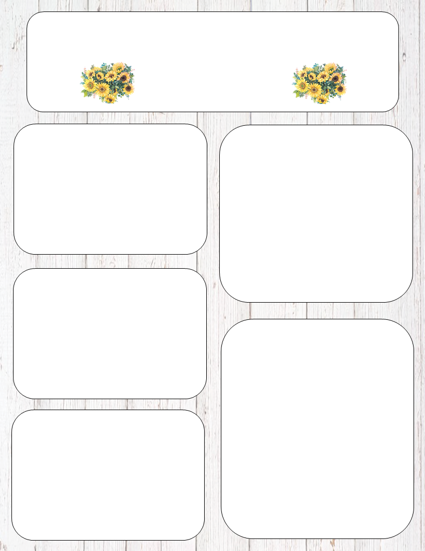
Sixth Grade Social Studies Virtual Syllabus
Contact Information:
Email:
stephaniecollie@johnston.k12.nc.us
lesleypender@johnston.k12.nc.us
michellevonhoene@johnston.k12.nc.us
abbybonner@johnston.k12.nc.us
Class Expectations:
Respect your teachers, peers and yourself.
Always stay positive
Be on time with needed materials before you join live session.
Be responsible for your actions
Mute yourself while in session. If you have a question or comment, use the chat box.
Materials:
(5) 3 prong folders with pockets
Loose leaf paper
Pencils, erasers, and sharpener
Post-it Notes
Highlighters
Device-Chromebook or computer is preferable
Headphones
Work Expectations:
Students are expected to attend one daily live social studies session
If you are not able to complete an assignment, then it is your responsibility to complete it the next day with communication to us via email or Remind,with the reason for your absence. An assignment will be marked late if it is not in by the 3rd day. Assignment due dates for a prolonged absence due to illness will be at the teacher’s discretion. Students are responsible for obtaining the work they missed during an absence. All assignments and class notes will be posted for student and parent convenience as well.
Grading Guidelines:
Classwork
Quizzes
Projects
We are awaiting further instruction before we post our grading policy. Information will be coming in the near future

Slide 2
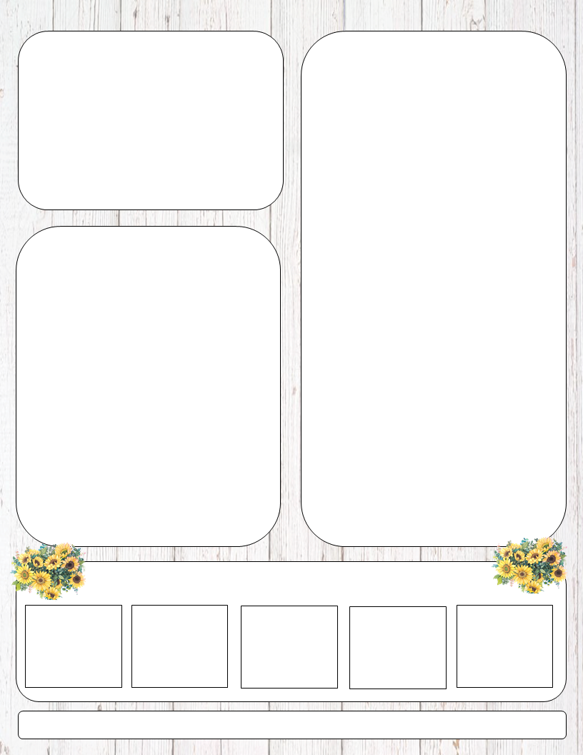
Google Classroom Assignments:
Check your teacher’s website for Google Classroom codes.
ALL assignments will be posted on Google classroom.
Expectations:
Students: Do your classwork, ask questions, follow classroom rules. Prepare everything you need before joining the live session. You are expected to be as respectful to teachers and classmates, as we will be to you.
Parents: To ensure the success of your child, we strongly recommend reviewing Powerschool with your child on a weekly basis.
Ancient Civilizations:
Maps, Globes, Continents, and Oceans
Five Themes of Geography
Why groups settled in certain areas.
Early Humans
Mesopotamia
Ancient Egypt
Ancient China
Ancient Greece
Ancient Rome
Medieval Europe
Google Classroom Live Sessions Code: nzpfyjw
Social Studies Live Sessions:
8:30 am-9:15 am
12:45 pm-1:30 pm
Remind codes will be on each individual teacher’s website or Google Classroom page.
If a student cannot attend a live session, then he or she can view a Tutorial.
Please contact us if you need help with anything!
Welcome to 6th-grade! We are looking forward to teaching you about Ancient Civilizations!

