Slide 1
Kid Friendly Objective:
I will Identify and distinguish the History of the Female Hogans
I will Analyze, Infer, and find evidence of how the female Hogans were structured

Slide 2
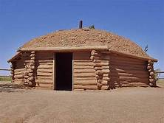
Tsindahditl’in

Slide 3
Tsin-means wood logs from the mountains
Dahdiitl’in-meaning the logs are stacked up upon another
Roof is made of sand
Doorway faces east
Woodstove is in the middle for heat

Slide 4
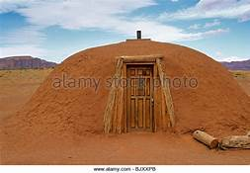
Hooghan nimazi

Slide 5
Hooghan nimazi
Hooghan-means a place of home
Nimazi-means it is a round object
Sanded roof and sides
Chimney in the roof
Doorway faces east direction
Cool in the summer
Warm in the winter
There are no windows

Slide 6
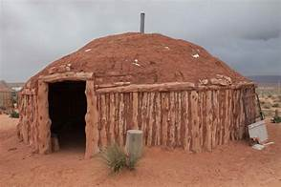
Hooghan bijaad lani

Slide 7
Hooghan bijaad lani
Bijaad lani-means something having many legs
Hooghan-means a place of home
The walls appear to have many legs hogan
The roof is sand
A fire is located in the center of the hogan
A chimney is in the center for ventilation
There are no windows

Slide 8
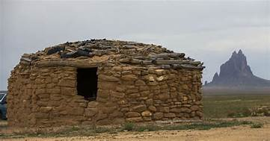
Tse bee hooghan

Slide 9
Tse bee hooghan
Tse-means a stone or brick
Hooghan-means a place of home
The hogan wall is made from bricks or stone
The middle of the hogan is where the fire is located
There is no windows in the walls
The walls will last a very long time
The top is made from logs and sand

