Slide 1
5th Grade | Topic 7
Thin Slicing | Printables
sized for 8½” x 11” paper
NOTE: Thin slicing sequences may be animated to allow you to present problems on the screen without printing, if appropriate. Click to reveal the next problem when a group is ready.

Slide 2
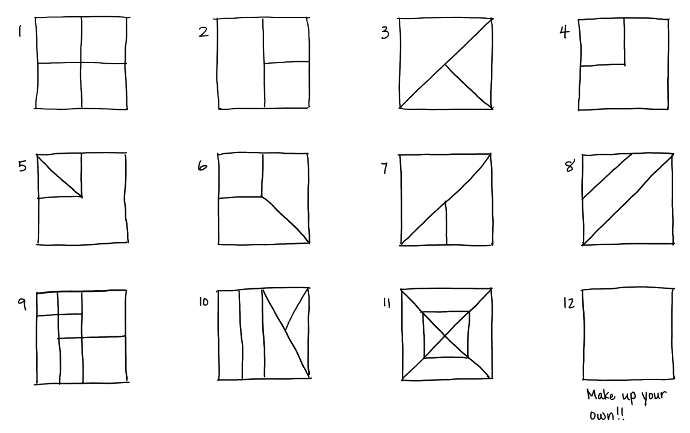
The Unusual Baker
Notes:
Tell a story of a really interesting baker you know who only makes square cakes and often cuts his cakes in unexpected ways.
Draw a square and draw a line down the middle. Explain that this is a cake and one way the baker might cut it. What fraction of the whole cake is each piece? Write it in and tell students that the first task is to label each piece with a fraction.
The second task is to prove with an equation that your fractions add up to one whole. Example: ½ + ½ = 2/2 = 1
NOTE: If students’ fraction understanding is just developing, save the second task of proving with equations as an extension instead of requiring it before they move on to the next cake. You don’t want them getting bogged down.
Today we’re going to see some of the ways the Unusual Baker cuts his cakes. We’ll label each piece and write equations to prove our thinking.
After I reveal the first cake, you’ll go to your group and draw it. Start at the top of your space, because there will be another cake when you’re done with that one, and another, and another. When you’re done with one, look for the next problem on the screen or raise your hand if the one you need isn’t showing yet.
Leave the example posted and then click to reveal #1. Randomize and have students go to boards and get started.

Slide 3
The Unusual Baker
Notes:
Tell a story of a really interesting baker you know who only makes square cakes and often cuts his cakes in unexpected ways.
Draw a square and draw a line down the middle. Explain that this is a cake and one way the baker might cut it. What fraction of the whole cake is each piece? Write it in and tell students that the first task is to label each piece with a fraction.
The second task is to prove with an equation that your fractions add up to one whole. Example: ½ + ½ = 2/2 = 1
NOTE: If students’ fraction understanding is just developing, save the second task of proving with equations as an extension instead of requiring it before they move on to the next cake. You don’t want them getting bogged down.
Today we’re going to see some of the ways the Unusual Baker cuts his cakes. We’ll label each piece and write equations to prove our thinking.
After I reveal the first cake, you’ll go to your group and draw it. Start at the top of your space, because there will be another cake when you’re done with that one, and another, and another. When you’re done with one, look for the next problem on the screen or raise your hand if the one you need isn’t showing yet.
Leave the example posted and then click to reveal #1. Randomize and have students go to boards and get started.

Slide 4
The Unusual Baker
Extension: If each cake costs $10, how much would each piece cost?
Notes:
Tell a story of a really interesting baker you know who only makes square cakes and often cuts his cakes in unexpected ways.
Draw a square and draw a line down the middle. Explain that this is a cake and one way the baker might cut it. What fraction of the whole cake is each piece? Write it in and tell students that the first task is to label each piece with a fraction.
The second task is to prove with an equation that your fractions add up to one whole. Example: ½ + ½ = 2/2 = 1
NOTE: If students’ fraction understanding is just developing, save the second task of proving with equations as an extension instead of requiring it before they move on to the next cake. You don’t want them getting bogged down.
Today we’re going to see some of the ways the Unusual Baker cuts his cakes. We’ll label each piece and write equations to prove our thinking.
After I reveal the first cake, you’ll go to your group and draw it. Start at the top of your space, because there will be another cake when you’re done with that one, and another, and another. When you’re done with one, look for the next problem on the screen or raise your hand if the one you need isn’t showing yet.
Leave the example posted and then click to reveal #1. Randomize and have students go to boards and get started.

Slide 5
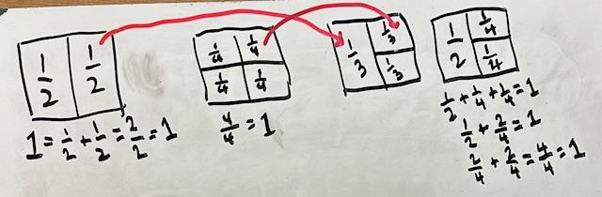
Ensure that students prove that their fractions add up to 1 whole. This channels them to create equivalent fractions with like denominators.
Support students in using what they know to revise their thinking, when needed (such as thinking that the third square above is divided into thirds):
“If the left piece is half of the first cake, wouldn’t it still be half of this cake? How many of these pieces would it take to make a whole cake?”

Slide 6
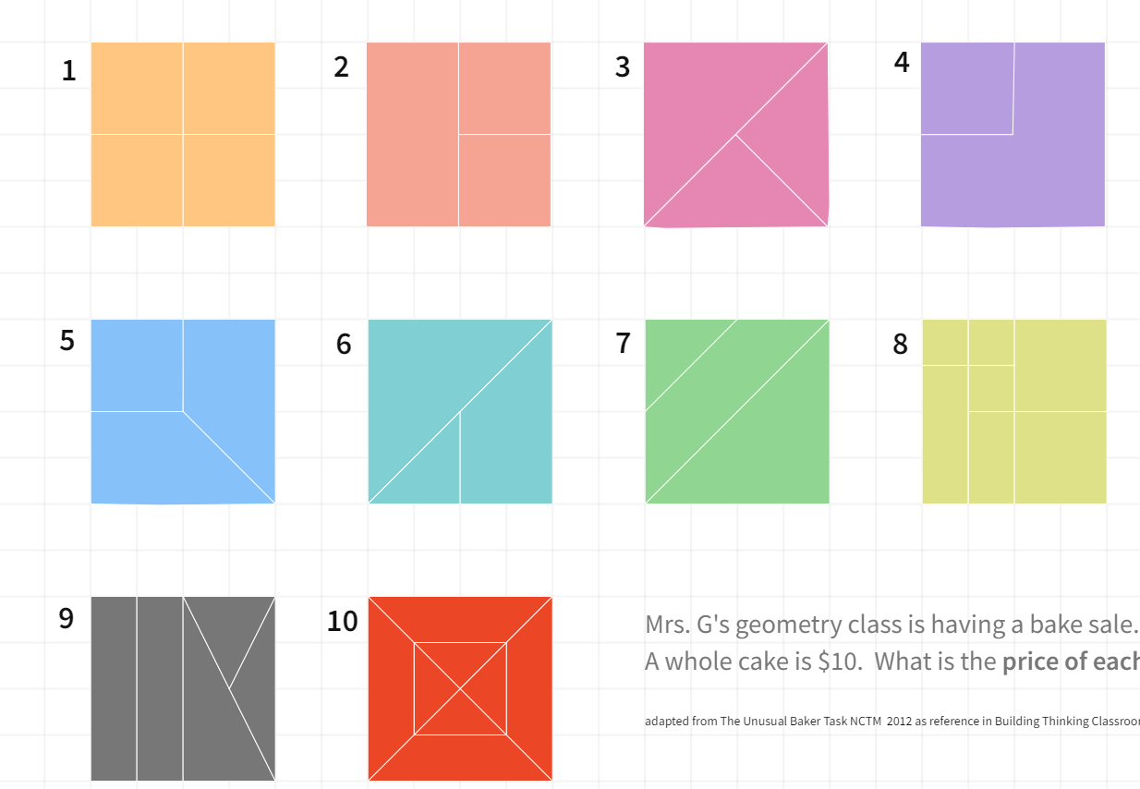
The Unusual Baker
Notes:
There was this really interesting baker who only made square cakes and often cut his cakes in unexpected ways.
Draw a square and draw a line down the middle. Explain that this is a cake and one way the baker might cut it. What fraction of the whole cake is each piece? Write it in and tells students that is the first task, to label each piece with a fraction.
The second task is to prove with an equation that your fractions add up to one whole. Example: ½ + ½ = 2/2 = 1
Today we’re going to see some of the ways the Unusual Baker cuts his cakes. We’ll label each piece and write equations to prove our thinking.
After I reveal the first cake, you’ll go to your group and draw it. Start at the top of your space, because there will be another cake when you’re done with that one, and another, and another. When you’re done with one, please turn center and raise your hands so I know you’re ready.
Leave the example posted and then click to reveal #1. Randomize and have students go to boards and get started.

Slide 7
The Unusual Baker
Notes:
There was this really interesting baker who only made square cakes and often cut his cakes in unexpected ways.
Draw a square and draw a line down the middle. Explain that this is a cake and one way the baker might cut it. What fraction of the whole cake is each piece? Write it in and tells students that is the first task, to label each piece with a fraction.
The second task is to prove with an equation that your fractions add up to one whole. Example: ½ + ½ = 2/2 = 1
Today we’re going to see some of the ways the Unusual Baker cuts his cakes. We’ll label each piece and write equations to prove our thinking.
After I reveal the first cake, you’ll go to your group and draw it. Start at the top of your space, because there will be another cake when you’re done with that one, and another, and another. When you’re done with one, please turn center and raise your hands so I know you’re ready.
Leave the example posted and then click to reveal #1. Randomize and have students go to boards and get started.

Slide 8
If each cake costs $10, how much would each slice cost?
Notes:
Extension option

Slide 9
5th Grade: 7-7
Adding Mixed Numbers

Slide 10
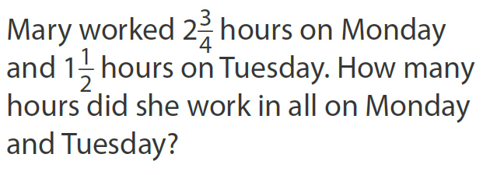
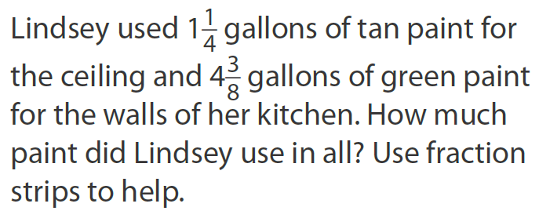
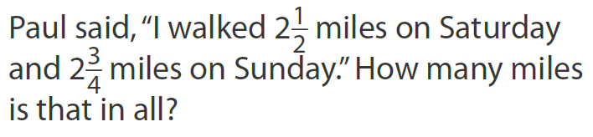
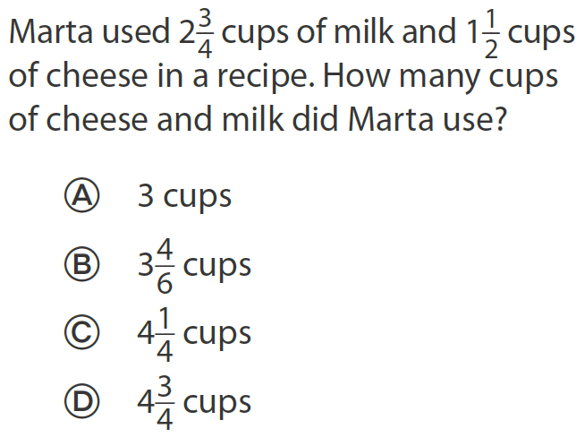
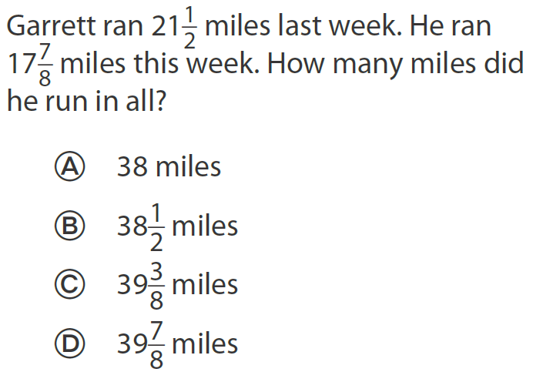
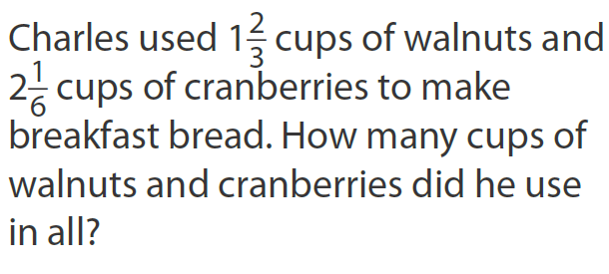

Slide 11
