Slide 1
PARAPHRASE
Simply put: Paraphrasing is putting information in your own words.
Or….saying something differently

Slide 2
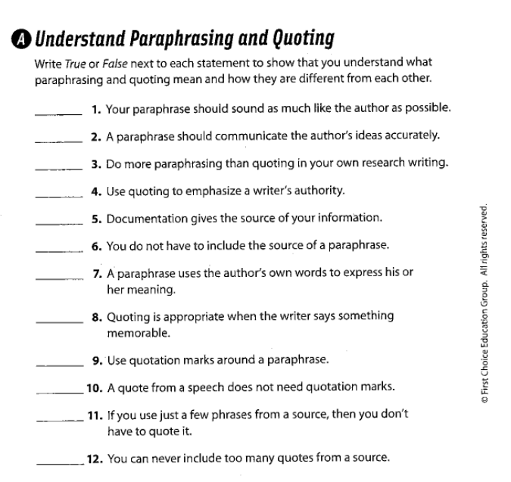

Slide 3
F
T
T
T
T
F
F
T
F
F
F
F

Slide 4
My sister told me that I'll never know, unless I try to do it.

Slide 5
My sister said, "You'll never know if you can do it, unless you try."

Slide 6
Paraphrasing starts with understanding.
If you understand you can explain.
If you can explain then you can put the information in your own words.

Slide 7
Paraphrasing starts with understanding.
If you understand you can explain.
If you can explain then you can put the information in your own words.

Slide 8
Paraphrasing starts with understanding.
If you understand you can explain.
If you can explain then you can put the information in your own words.

Slide 9
1. Replace words with synonyms
2. Rewrite
3. Explain ideas using clearer wording.
4. Translate ideas into your own words.

Slide 10
PARAPHRASE
SKILL PRACTICE

Slide 11
“The only thing we have to fear is fear itself” – President Franklin D. Roosevelt
Roosevelt said that ________.
Paraphrase
replace

Slide 12
“Minds are like parachutes – they only function when open” – Thomas Dewar
Dewar stated that ___________.
Paraphrase
rewrite

Slide 13
“The words of kindness are more healing to a drooping heart than balm or honey”
– Sarah Fielding
___________________ the author claimed.
Paraphrase
translate

Slide 14
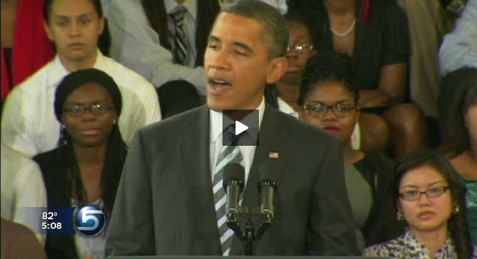
PARAPHRASE THE HIGHLIGHTED LINE.
SALT LAKE CITY -- Students in Utah and across the country listened to a back- to-school address today from President Obama. He urged students to pursue a higher education after high school, telling them the country needs their help to get back on its feet.
"Whether we fall behind or race ahead in the coming years as a nation is up to you," he said.
That message resonated with students in Ms. Pulley's 5th grade class at Escalante Elementary in Salt Lake City. They listened to the President's speech and then had a class discussion.
"When you are done with high school it doesn't mean that you are done learning," said one student."
http://www.ksl.com/?nid=148&sid=17442206&s_cid=rss-148

Slide 15
DAY 2

Slide 16
SOURCE
A PERSON or MEANS (Text, Radio, Eyewitness, Television, Government) of gaining new information.

Slide 17
ATTRIBUTION
Specifically informing the reader of where you received your information; Citing a source.
FINE PRINT: *Whether you are paraphrasing or quoting, you must inform your reader from WHO or WHERE you received your information.*

Slide 18
Attributing a DIRECT QUOTE
Attribution indicates who the speaker is
Period inside the quotation
My sister said, "You'll never know if you can do it, unless you try."
The actual words the sister spoke
the comma is used to separate the speaker from the words she spoke

Slide 19
Attributing a PARAPHRASE
Attribution indicates who the speaker is
My sister told me that I'll never know, unless I try.
What she said in my own words

Slide 20
Ways to say someone said something…
DIRECT QUOTE
He said, “……..”
PARAPHRASE
He said ……..

Slide 21
Ways to say someone said something…
DIRECT QUOTE
He said, “……..”
she stated, “………”
He claimed that “……..”
“……..,” she said.
“………….,” she protested.
According to Nick, “………”
she screamed, “………”
“………….,” he alleged.

Slide 22
Ways to say someone said something…
PARAPHRASE
He said ……..
she stated ………
He claimed that ……..
…….., she said.
She protested …….
According to Prajwal, ………
she screamed ………
…………. he alleged.

Slide 23
PRACTICE
PARAGRAPH 1
Reading teacher Mr. Paradine told his class ……………..
He said that ………
“……,” claimed the East Middle teacher.
PARAGRAPH 2
According to Paradine, ………….
“……….,” he said.
He continued stating that ……..

Slide 24
Annotate
Hershey Park Article

Slide 25
“I decline to accept the end of man. It is easy enough to say that man is immortal because he will endure: that when the last ding-dong of doom has clanged and faded from the last worthless rock hanging tideless in the last red and dying evening, that even then there will still be one more sound: that of his puny inexhaustible voice, still talking. I refuse to accept this. I believe that man will not merely endure: he will prevail. He is immortal, not because he alone among creatures has an inexhaustible voice, but because he has a soul, a spirit capable of compassion and sacrifice and endurance. The poet’s, the writer’s, duty is to write about these things. It is his privilege to help man endure by lifting his heart, by reminding him of the courage and honor and hope and pride and compassion and pity and sacrifice which have been the glory of his past. The poet’s voice need not merely be the record of man, it can be one of the props, the pillars to help him endure and prevail.” - William Faulkner

Slide 26
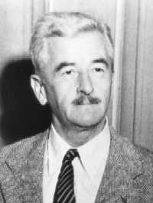
William Faulkner believed that humanity had a lot of potential. He said that writers have a duty to remind mankind of its great potential. _________________

Slide 27
William Faulkner believed that humanity had a lot of potential. He said that writers have a duty to remind mankind of its great potential. “I believe that man will not merely end; he will prevail,” he stated.

Slide 28
DAY 3

Slide 29
QUOTE
PARAPHRASE

