Slide 1
Clans !doone’4
5th Grade: Maternal Grandfather

Slide 2

I will identify, recognize and name kinship through maternal grandfather’s clan group.
Kid Friendly Objective:

Slide 3

I will identify and name kinship of maternal grandfather’s clan.
Shicheii
__________ dah shicheii.
Shim1
Shim1 bizh4’4

Slide 4
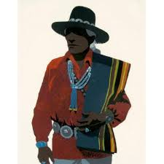
Shicheii
Notes:
Students will write simple sentences about Cheii.
e.g. Shicheii’s name is John Yazzie. Shicheii like to tell jokes.

Slide 5
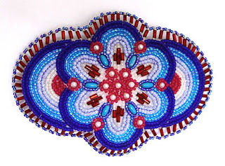
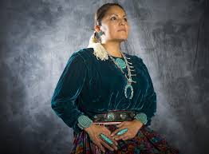
Shim1
Shicheii
Shicheii 47 shim1 bizh4’4.
Shicheii _____ nil9.
Shim1 _______y1shch99n.
_______ dashicheii.

Slide 6

I will identify, recognize and name kinship through maternal grandfather’s clan group.
Shicheii
Yi[k’4 da’ahi’di’ n7n7g77
K4 naazt’i’
K4 ts’0s7

Slide 7
Shicheii
Shicheii Hooghan [1n7 nil9.
D77 47 yi[k’4 da’1hidi’n7:
Hasht[‘ishnii
T0tsohnii
Dzaan44z [1n7
Ts4 deeshgiizhnii
L0k’aa’ dine’4
Bit’ahnii
Shim1 Hooghan [1n7 y1shch’99n.
Notes:
District website worksheet to write sub clans to maternal grandfather’s clan. Sibling
Shideezh7, Sh1d7, Shtsil7, Sh7naa’7

Slide 8
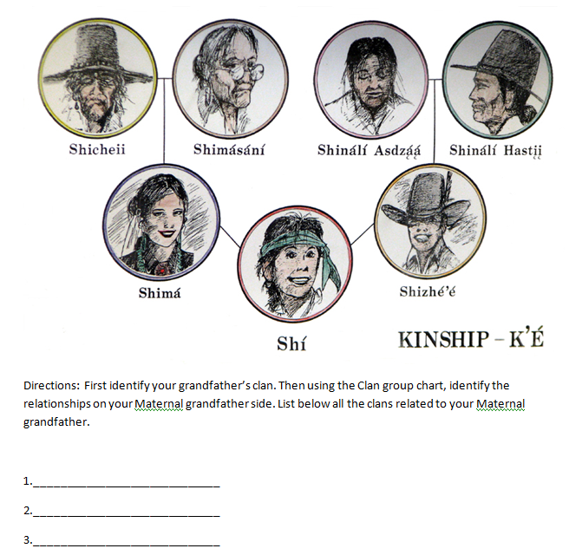
Worksheet to complete:

Slide 9
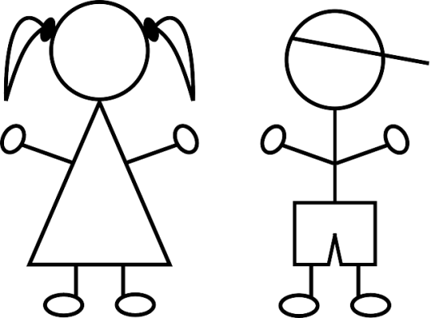
Shicheii
I will identify, recognize and name kinship through maternal grandfather’s clan group.
Your maternal Clan: 3rd Clan
You are a ts07, a maternal granddaughter or grandson
1stClan :Your Cheii
Shicheii or Shim1s1n7
2nd Clan: Your Unlce or Aunt
Shiy11zh or shim1
3rd Clan:
Your cousin
Sibling
Shideezh7, Sh1d7, Shtsil7, Sh7naa’7
4th Clan:
Your cousin
Shi[naa’aash or Shizeed7
Notes:
Peer clans worksheet from District website.

