Slide 1
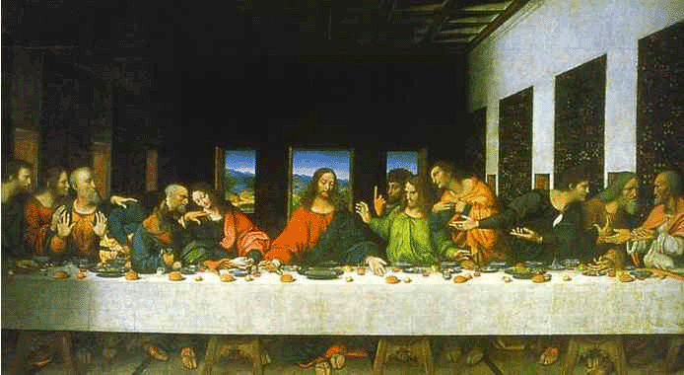
THE RENAISSANCE

Slide 2
5.2 INTELLECTUAL & ARTISTIC RENAISSANCE
5. Italian Renaissance Humanism:
- intellectual movement
- focus on secularism and the importance of the individual
- studied Greek and Roman classics
- believed their intellect should be put to the service of the state
- Petrarch:
- father of Italian humanism
- emphasized using pure classical Latin

Slide 3
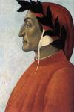
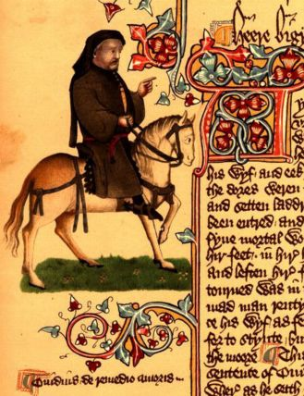
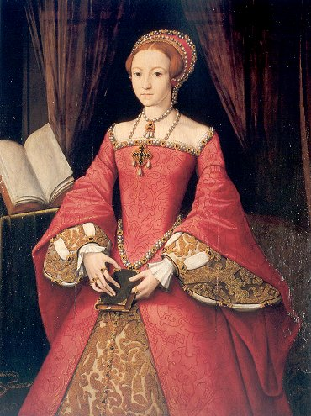
6. VERNACULAR LITERATURE
Dante wrote Divine Comedy – a short story about the soul’s journey to salvation
Geoffrey Chaucer – Canterbury Tales – collection of stories told by 29 pilgrims going to the tomb of Saint Thomas a Becket at Canterbury
Christine de Pizan – The Book of the City of Ladies – she argues women can learn equal to men if given the same educational opportunities

Slide 4
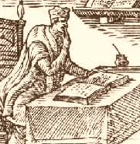
7. EDUCATION IN THE RENAISSANCE
humanist believed education was preparation for life
studied liberal arts and stressed physical education
- females – absent from these schools; their education stressed religion and morals so they would become good mothers and wives.

Slide 5
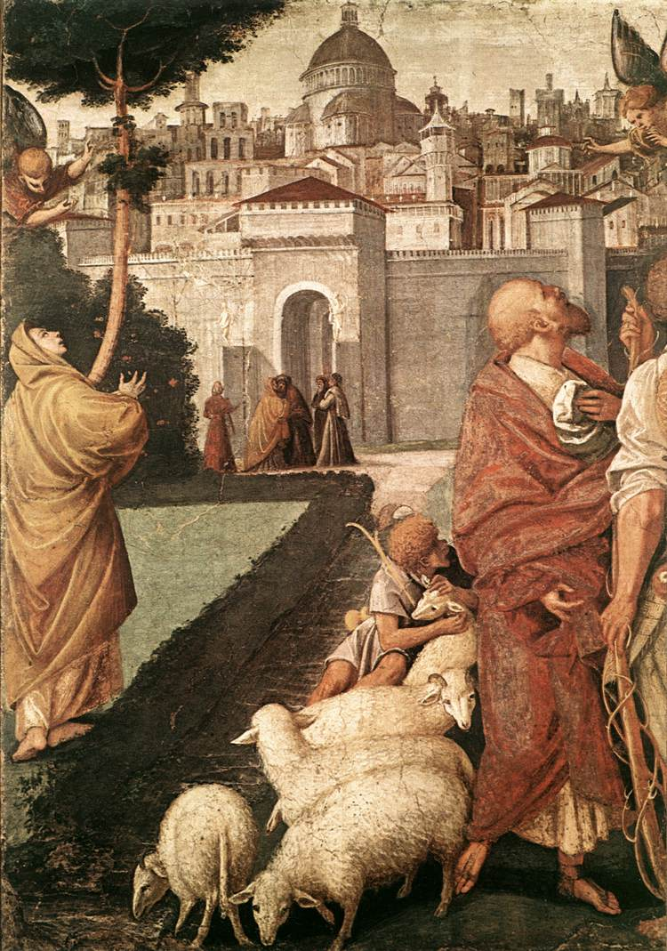
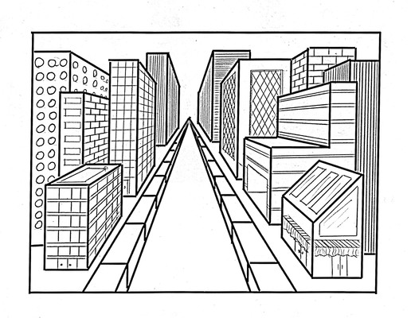
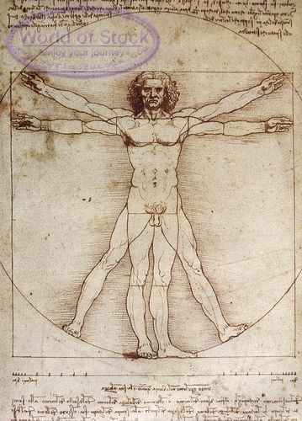
8. Artistic Renaissance in Italy
- sought to imitate nature; look realistic; 3D
New techniques:
A. Fresco – painting done on fresh wet plaster with water based paints the frescoes of Masaccio regarded as first masterpieces of early Renaissance
Understood perspective and light through geometry
C. Understood movement and human anatomy

Slide 6
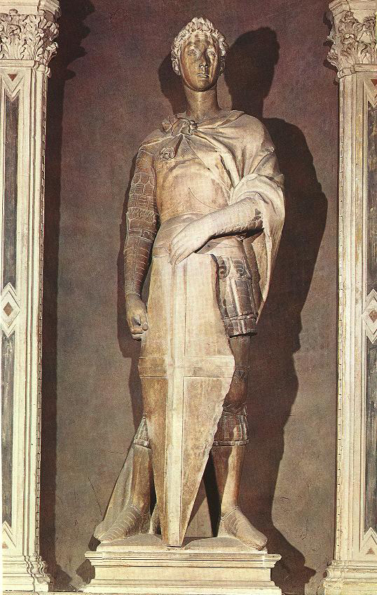
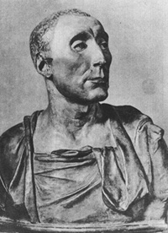
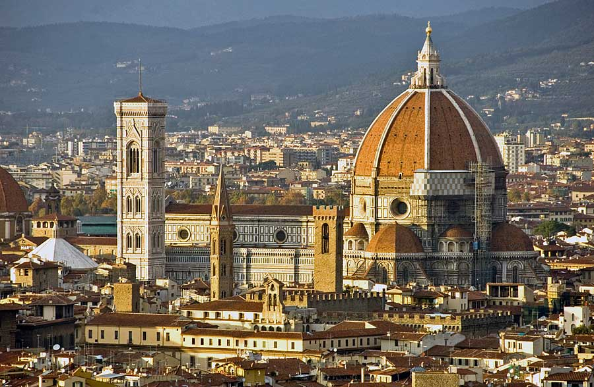
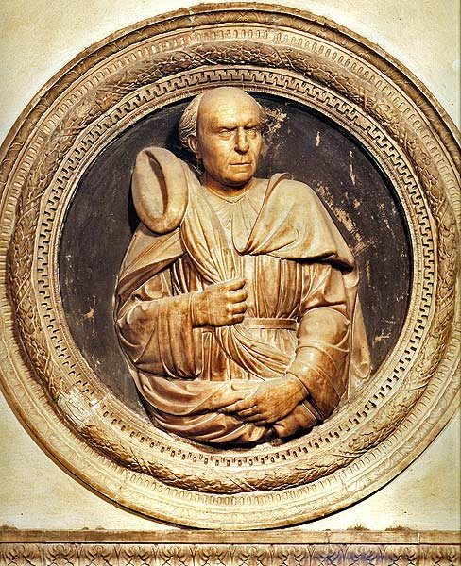
- Sculpture: Donatello – a statue of Saint George
- Architecture: Brunelleschi – designed church of San Lorenzo

Slide 7
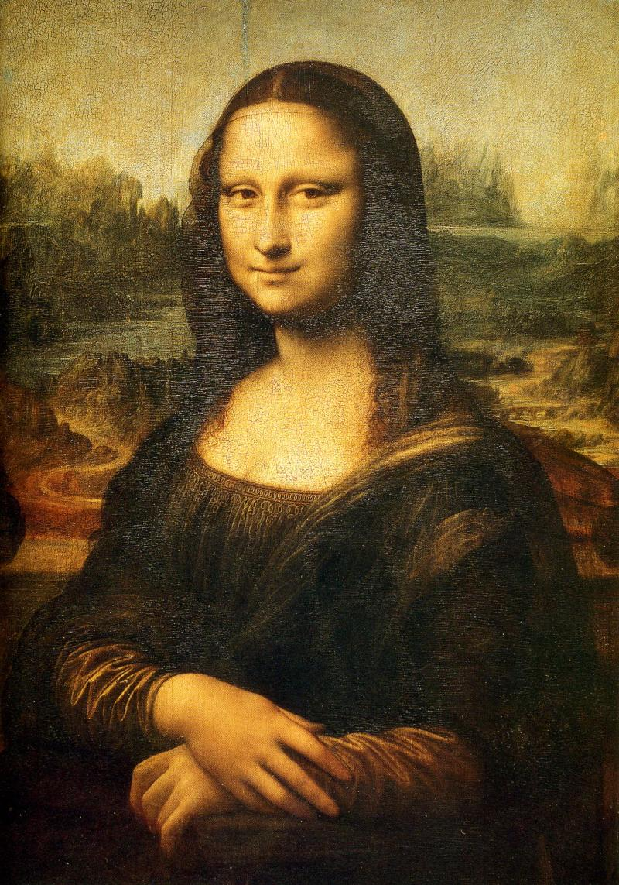
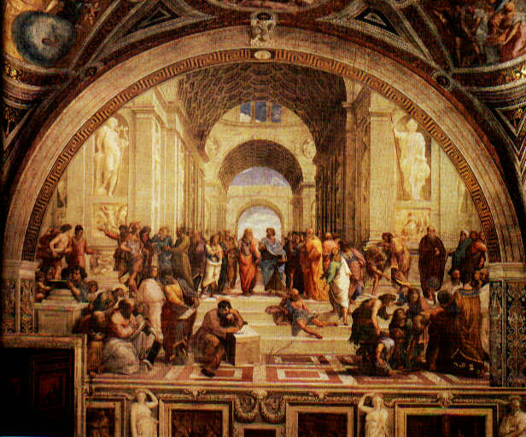
- Masters of the High Renaissance:
A. Leonardo da Vinci: painted Mona Lisa and
The Last Supper
B. Raphael: painted School of Athens, also famous for paintings of the Madonna
C. Michelangelo: Sistine Chapel; sculpted the David and the Pieta`- painted illustrations (books and wooden panels for altarpieces)

Slide 8
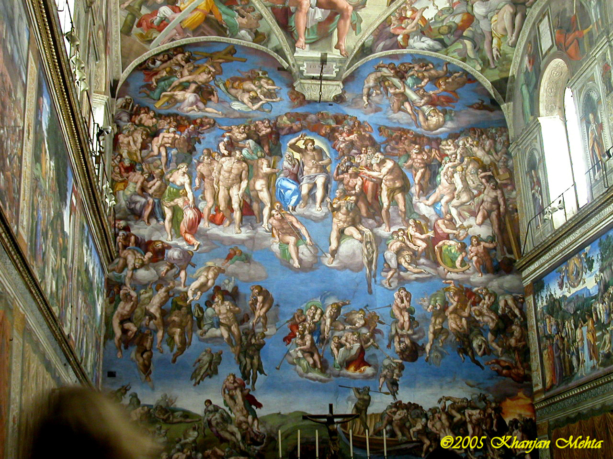
Sistine Chapel

Slide 9
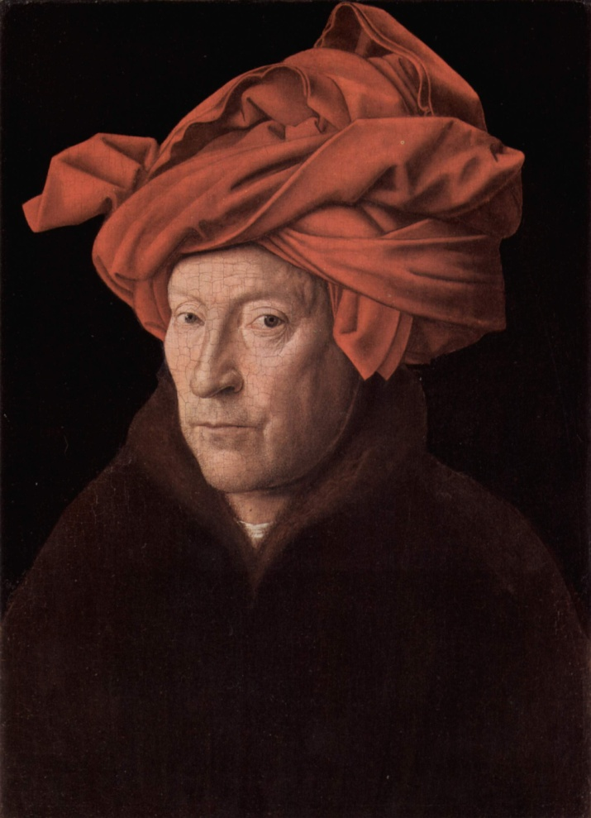
9. The Northern Artistic Renaissance:
Jan van Eyck: painted Giovanni Arnolfini and His Bride

Slide 10
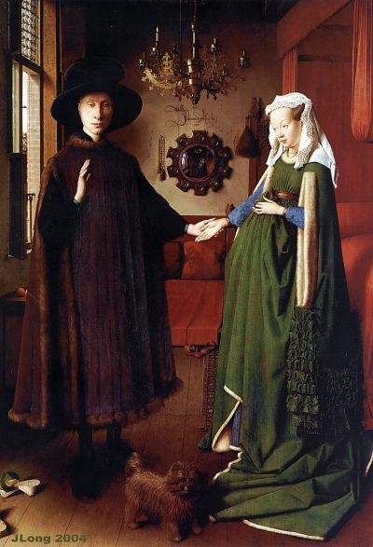
Giovanni Arnolfini and His Bride

Slide 11
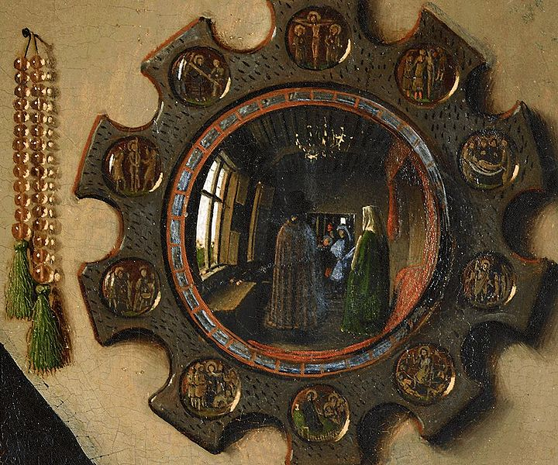

Slide 12
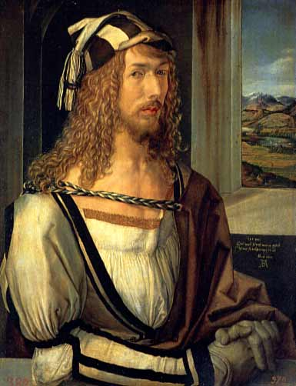

Albrecht Durer: studied in Italy – painted the Adoration of the Magi
“The Praying Hands”

Slide 13
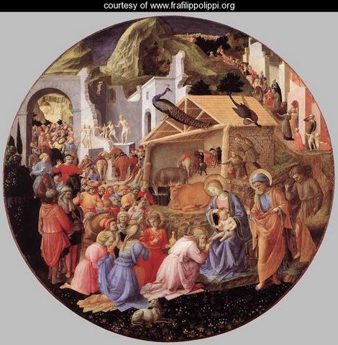
Adoration of the Magi

Slide 14
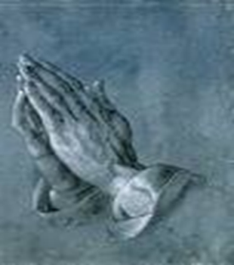
The Praying Hands
Back in the fifteenth century, in a tiny village near Nuernberg, lived a family with eighteen children. Eighteen! In order merely to keep food on the table for this mob, the father and head of the household, a goldsmith by profession, worked almost eighteen hours a day at his trade and any other paying chore he could find in the neighborhood.
Despite their seemingly hopeless condition, two of Albrecht Dürer the Elder's children had a dream. They both wanted to pursue their talent for art, but they knew full well that their father would never be financially able to send either of them to Nuernberg to study at the Academy. After many long discussions at night in their crowded bed, the two boys finally worked out a pact. They would toss a coin. The loser would go down into the nearby mines and, with his earnings, support his brother while he attended the academy. Then, when that brother who won the toss completed his studies, in four years, he would support the other brother at the academy, either with sales of his artwork or, if necessary, also by laboring in the mines.

Slide 15
They tossed a coin on a Sunday morning after church. Albrecht Dürer won the toss and went off to Nuernberg. Albert went down into the dangerous mines and, for the next four years, financed his brother, whose work at the academy was almost an immediate sensation. Albrecht's etchings, his woodcuts, and his oils were far better than those of most of his professors, and by the time he graduated, he was beginning to earn considerable fees for his commissioned works.
When the young artist returned to his village, the Dürer family held a festive dinner on their lawn to celebrate Albrecht's triumphant homecoming. After a long and memorable meal, punctuated with music and laughter, Albrecht rose from his honored position at the head of the table to drink a toast to his beloved brother for the years of sacrifice that had enabled Albrecht to fulfill his ambition. His closing words were, "And now, Albert, blessed brother of mine, now it is your turn. Now you can go to Nuernberg to pursue your dream, and I will take care of you."

Slide 16
All heads turned in eager expectation to the far end of the table where Albert sat, tears streaming down his pale face, shaking his lowered head from side to side while he sobbed and repeated, over and over, "No ...no ...no ...no."
Finally, Albert rose and wiped the tears from his cheeks. He glanced down the long table at the faces he loved, and then, holding his hands close to his right cheek, he said softly, "No, brother. I cannot go to Nuernberg. It is too late for me. Look ... look what four years in the mines have done to my hands! The bones in every finger have been smashed at least once, and lately I have been suffering from arthritis so badly in my right hand that I cannot even hold a glass to return your toast, much less make delicate lines on parchment or canvas with a pen or a brush. No, brother ... for me it is too late."

Slide 17
More than 450 years have passed. By now, Albrecht Dürer's hundreds of masterful portraits, pen and silver-point sketches, watercolors, charcoals, woodcuts, and copper engravings hang in every great museum in the world, but the odds are great that you, like most people, are familiar with only one of Albrecht Dürer's works. More than merely being familiar with it, you very well may have a reproduction hanging in your home or office.
One day, to pay homage to Albert for all that he had sacrificed, Albrecht Dürer painstakingly drew his brother's abused hands with palms together and thin fingers stretched skyward. He called his powerful drawing simply "Hands," but the entire world almost immediately opened their hearts to his great masterpiece and renamed his tribute of love "The Praying Hands."
The next time you see a copy of The Praying Hands, take a second look. Let it be your reminder, if you still need one, that no one - no one - - ever makes it alone!

