Slide 1

3rd and 4th Grade Summer Math Assignment
2021

Slide 2
What is the Summer Assignment?
The summer assignment is using IXL to ensure your math skills stay sharp over the summer. It consists of different IXL tasks for each student based upon what you complete in the diagnostic arena of IXL.
The assignment is in IXL.
You will complete the assignment online and complete a math log.
*The math log must be turned in to your teacher next year.

Slide 3
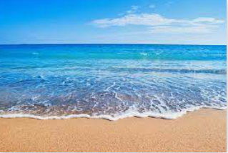
What am I expected to do?
To begin, you will work in the IXL Diagnostic Arena for a total of one hour, preferably in two 30-minute sessions, by July 11th.
IXL will identify “Recommended Skills” for you. Starting on July 12th, you will complete any 2 of the skills recommended per week. You needs to get a SmartScore of 80 or higher.
In addition to working on the two recommended skills per week, please practice 10-15 questions in the Diagnostic per week. They can track their progress throughout the summer using the

Slide 4

How to enter the diagnostic arena...
Watch as I show you how to enter the diagnostic arena on a student account.

Slide 5
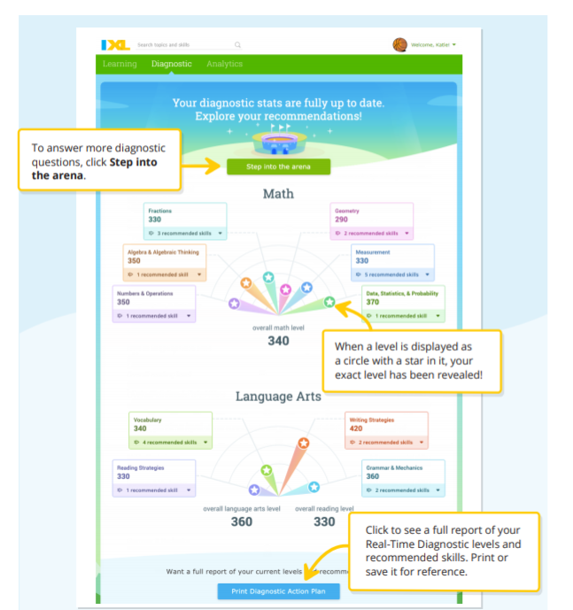

Slide 6
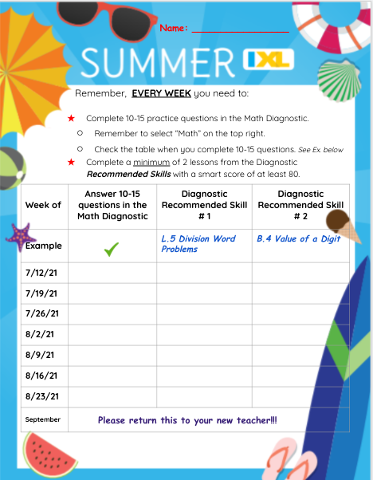
The Summer Math Log
You will use this to keep track of your work.

Slide 7

Let’s recap….
Before July 11th, complete your work in the Diagnostic Arena.
Each week beginning July 12th:
*Complete 2 recommended skills
and
*10 -15 questions in the diagnostic arena.
Write down your skills on the math log to hand in to your teacher next year.
Have a great summer!

