Slide 1
Clans !doone’4
4th Grade: Maternal and Paternal Clan

Slide 2

Kid Friendly Objective
I will identify and name maternal/paternal family clan group.(sub clans/ extended clan)

Slide 3
I will identify and name maternal and paternal clan.
Shim1 Nish[9
Shizh4’4 B1sh7shch99n
Shim1s1n7
Shin1l7 asdz33

Slide 4

Shim1 Shizh4’4
Maternal Clan
Nil9
Nish[9
Shim1s1n7
Paternal Clan
Nil9
B1sh7shch99n
Shin1l7 Asdz33
Sh7

Slide 5
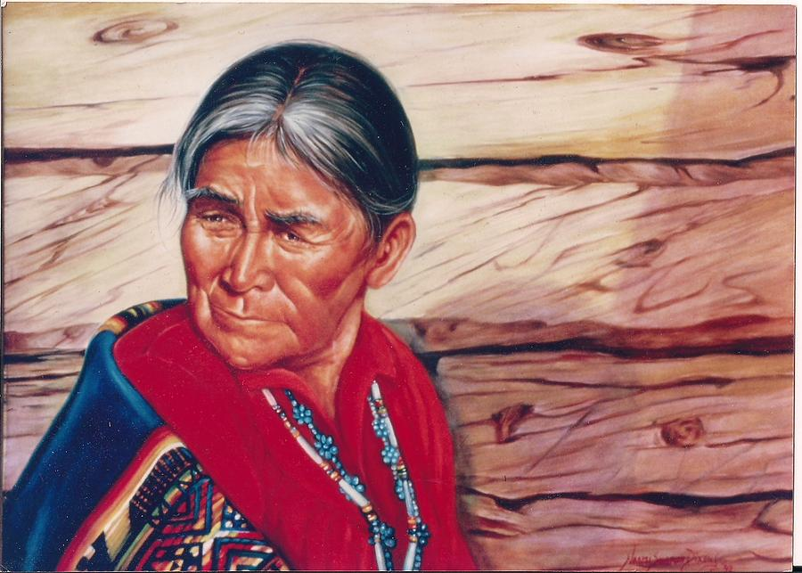
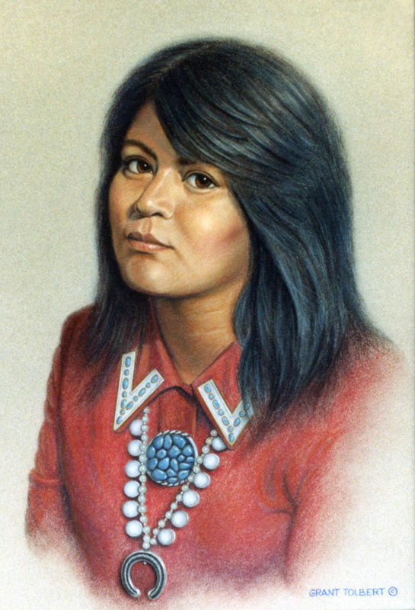
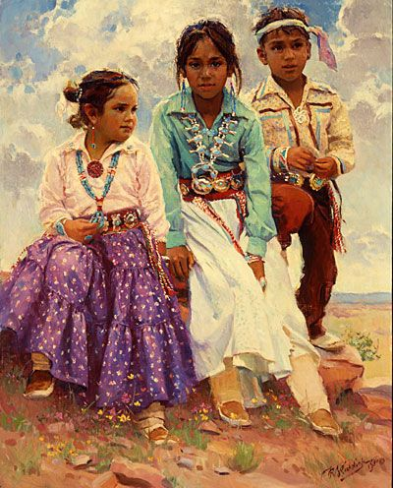
Maternal Clan
Shim1s1n7
Shim1
Maternal Clan
Shim1s1n7 _______ nil9.
Shim1 _______ nil9.
Sh7 47 _______ nish[9.
Sh7
Notes:
Use the Maternal worksheet with students for students to identify the relationship between their mother to their grandmother.

Slide 6
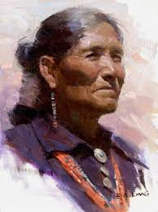
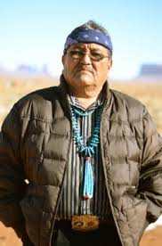
Paternal Clan
Shin1l7 asdz33
Shizh4’4
Sh7
Paternal Clan
Shin1l7 ‘asdz33 _______ nil9.
Shizh4’4 _______ nil9.
Sh7 47 _______ b1sh7shch99n.
Notes:
Use the Paternal worksheet with students for students to identify the relationship between their father to their paternal grandmother.

Slide 7
Kid Friendly Objective: I will identify and name maternal/paternal family clan group.(sub clans/ extended clan)
Shim1 Nish[9
Shizh4’4 B1sh7shch99n
Shim1s1n7
Shin1l7 asdz33
K’4 ts’0s7 Yi[k’4h da’ahidi’n7n7g77

Slide 8
Maternal Clan
Shim1s1n7
Shim1
Sh7
Maternal Clan Ma’ii Deeshgiizhnii
Shim1s1n7 _______ nil9. Ts4nj7kin7
Shim1 _______ nil9. !sh99h7
Sh7 47 _______ nish[9. Dib4 {izhin7
D77 ‘ Kin {itsonii
Dzi[ N1’oodi[nii
!sh88hnii
Notes:
The sub clans/ family clan chart on the website will be used for this slide and the next slide.

Slide 9
Paternal Clan
Shin1l7 asdz33
Shizh4’4
Sh7
Paternal Clan !sh99h7
Shin1l7 asdz33 _______ nil9. Ts4nj7kin7
Shizh4’4 _______ nil9. Ma’ii Deeshgiizhnii
Sh7 47 _______ b1sh7shch99n. Dib4 {izhin7
Kin {itsonii
Dzi[ N1’oodi[nii
!sh88hnii

