Slide 1
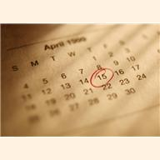
El Calendario
4^{to} Grado
Lección 1: Los Días y Meses del Año
Lección 2: Los Números
Lección 3: El Tiempo

Slide 2
LCPS FLES Linguafolio
My Self-Assessment Checklist: 4th Grade
Use this checklist to record what you think you can do. In the columns to the right, indicate
your ability by writing the date for what you can easily do (column 1), what you can do somewhat (column 2) and what you cannot do but want to learn (column 3).
Language proficiency is developed over an extended period of study and practice.
This checklist will change over time.
Level: Novice Low I can understand a few familiar words. I can understand some words that are similar to those in my own language. Listening: Calendar | I can do this well | I can do this somewhat | This is my goal
I can recognize the days of the week.
I can recognize months of the year.
I can recognize numbers up to 31.
I can recognize weather words.
Level: Novice Low I can communicate using single words and memorized phrases. Communication: Calendar | I can do this well | I can do this somewhat | This is my goal
I can say the days of the week.
I can say the months of the year.
I can say the numbers from 1-31
I can say what the weather is today.

Slide 3
Vocabulario
Lección 1
Nombre: ____________
Los días de la semana
This is the vocabulary you are exposed to in this lesson
días de la semana Days of the Week
lunes Monday
martes Tueday
miércoles Wednesday
jueves Thursday
viernes Friday
sábado Saturday
domingo Sunday
calendario calendar
hoy today
ayer yesterday
mañana tomorrow
¿Qué dia es hoy? What day is today?
meses del año months of the year
enero January
febrero February
marzo March
abril April
mayo May
junio June
julio July
agosto August
septiembre September
octubre October
noviembre November
diciembre December
¿Qué mes es? What month is it?
¿Dónde está? Where is it?

Slide 4
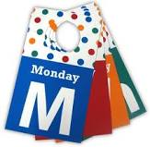
Lección 1
Nombre: ____________
Los días de la semana
¿Qué es?
Match the Spanish word to the English word
lunes Sunday
martes Friday
miércoles Monday
jueves Tuesday
viernes Saturday
sábado Wednesday
domingo Thursday
¿Qué día es?
Ayer – Hoy – Mañana
Fill in the blank.
Ayer fue | Hoy es | Mañana será
 | miércoles
 | viernes
 | domingo
 | sábado
 | martes
 | jueves
 | lunes

Slide 5
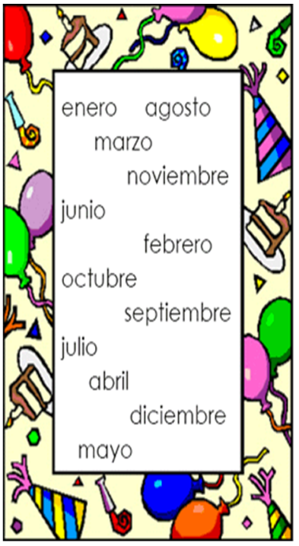
Los meses del año
Place the months in order and fill in the missing letter
Lección 1
Nombre: ____________
Extra Activity
1. e n e r _
2. f _ b r e r _
3. m _ r z _
4. _ b r _ l
5. m _ y _
6. j _ n _ o
7. j _ l _ o
8. a g _ s t _
9. s _ p t _ e m b r _
10. _ c t _ b r e
11. n _ v _ e m b r _
12. d _ c i _ m b r _

Slide 6
Vocabulario
Lección 2
Nombre: ____________
Los Números
This is the vocabulary you are exposed to in this lesson
1=uno
2=dos
3=tres
4=cuatro
5=cinco
6=seis
7=siete
8=ocho
9=nueve
10=diez
11=once
12=doce
13=trece
14=catorce
15=quince
16=dieciséis
17=diecisiete
18=dieciocho
19=diecinueve
20=veinte
21=veintiuno
22=veintidos
23=veintitres
24=veinticuatro
25=veinticinco
26=veintiseis
27=veintisiete
28=veintiocho
29=veintinueve
30=treinta

Slide 7
Lección 2
Nombre: ____________
Los Números
Write the number
veinte
cero
catorce
dieciséis
diecisiete
diecinueve
tres
siete
quince
seis
cuatro
nueve
dos
treinta
trece
doce
once
ocho

Slide 8
Vocabulario
Lección 3
Nombre: ____________
El tiempo
This is the vocabulary you are exposed to in this lesson
Hace sol It is sunny
Hace calor It is hot
Hace frío It is cold
Hace viento It is windy
Está lloviendo It is raining
Está nublado It is cloudy
Está nevando It is snowing
¿Qué tiempo hace hoy? What is the weather like today?

Slide 9

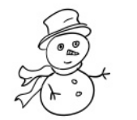

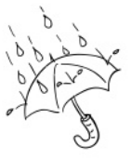
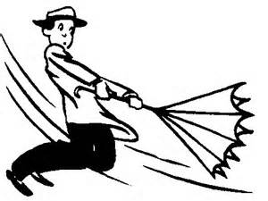

Lección 3
Nombre: ____________
El tiempo
Describe el tiempo
Look at the drawings below. Describe the weather for each. Find a partner. Take turns pointing to a picture and tell your partner a sentence in Spanish for each drawing. Here are some examples: hoy hace calor, hoy no hace frío…
Hoy ___________ ____________________________
Hoy no __________ ___________________________

Slide 10
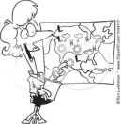
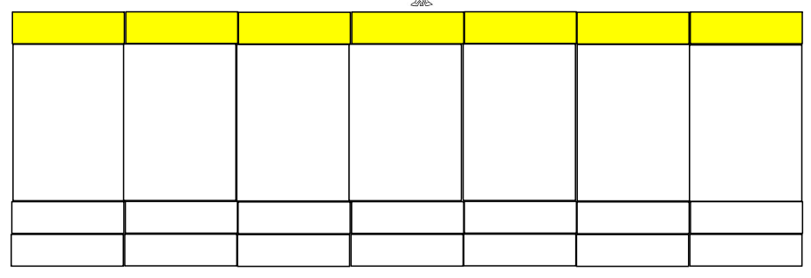

Proyecto: El calendario
Draft
Nombre: ________________________________________ Maestro/a: _______________________________________
You are a weather person. Fill in the weather chart for the city of your choice. When presenting, you will need to greet your audience (hola…), state your name (me llamo…), choose a day (hoy es…), and tell the weather for that day based on the visual you create.
lunes
martes
miércoles
jueves
viernes
sábado
domingo
-----------------------------------------------------------------------------------------------
¡Hola! Me llamo __________________________________. Hoy es ____________________________________. En _______________ hace/ está ________________. place weather Optional: a. Discuss tomorrow’s weather. b. You may use numbers when telling the date or the weather of a specific day and place.

Slide 11
PROYECTO: El calendario Me llamo: __________________________ Maestra __________________________
Rubrica
CATEGORY | 4 | 3 | 2 | 1
Requirements | All requirements are met and exceeded. | All requirements are met. | One requirement was not completely met. | More than one requirement was not completely met.
Organization | Content is well organized and interesting using headings or bulleted lists to group related material. | Uses teacher given headings or bulleted lists to organize. | Content is logically organized for the most part. | There was no clear or logical organizational structure, just lots of facts.
Attractiveness | Makes excellent use of font, color, graphics, effects, etc. to enhance the presentation. | Makes good use of font, color, graphics, effects, etc. to enhance to presentation. | Makes use of font, color, graphics, effects, etc. but occasionally these detract from the presentation content. | Does not use font, color, graphics, effects etc, or the ones used are extremely distracting to the presentation.
Mechanics | No misspellings or grammatical errors. | Three or fewer misspellings and/or mechanical errors. | 4-10 misspellings and/or grammatical errors. | More than 10 errors in spelling or grammar.
Oral Presentation | Interesting, well-rehearsed with smooth and clear delivery that holds audience attention. Uses direct eye contact. | Relatively interesting, rehearsed with a fairly smooth delivery that usually holds audience attention. Uses direct eye contact, but still returns to notes. | Delivery not smooth, but able to hold audience attention most of the time. Uses minimal eye contact, while reading mostly from notes. Uses English | Delivery not smooth and audience attention lost. No eye contact with audience. Uses English on more than one occasion.

