Slide 1
4.1 Translations

Slide 2
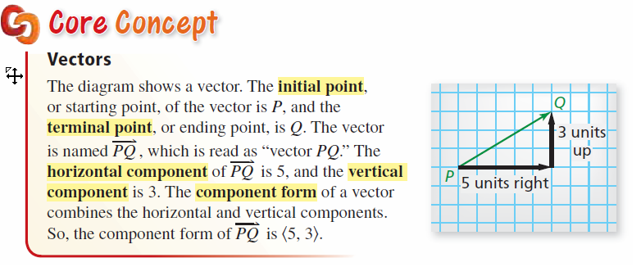

Slide 3


Slide 4
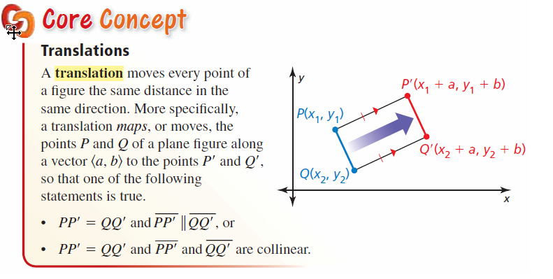

Slide 5


Slide 6
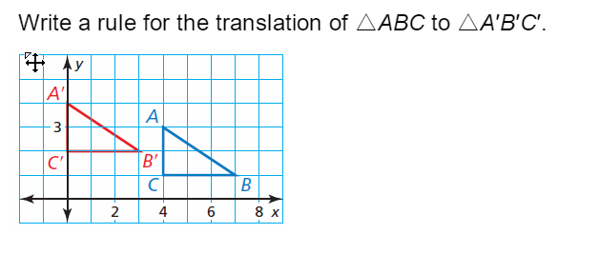

Slide 8



Slide 9
A RIGID MOTION is movement that does not change the pre-image, it simply changes location. Another word for Rigid Motion is ISOMETRIC.
A COMPOSITION is two or more rigid motions in one plane.

Slide 10


Slide 11
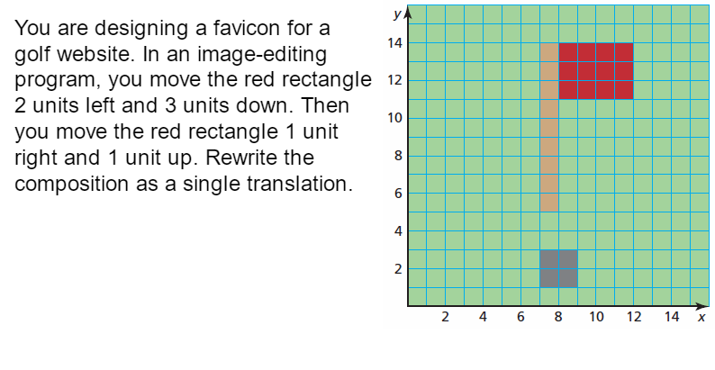

Slide 12


