Slide 1
Multiply Decimals Numberless Word Problems
Student Numberless Word Problems Recording Sheet

Slide 2
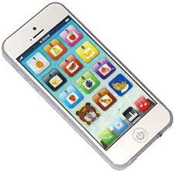
Read the numberless word problem. Determine what operation you will need to do to solve the problem. Some of them may need more than one operation. Then move to the next slide & solve before checking your final answer.
Jackie downloaded 14 songs priced at $0.99 each and 1 song for $1.29. She had a coupon for $2.50 What was the total amount Jackie paid?

Slide 3
Read the numberless word problem. Determine what operation you will need to do to solve the problem. Some of them may need more than one operation. Then move to the next slide & solve before checking your final answer.
Jackie downloaded 14 songs priced at $0.99 each and 1 song for $1.29. She had a coupon for $2.50 What was the total amount Jackie paid?

Slide 4
Answer
$12.65

Slide 5
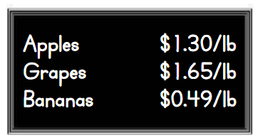
Read the numberless word problem. Determine what operation you will need to do to solve the problem. Some of them may need more than one operation. Then move to the next slide & solve before checking your final answer.
George bought 2.5 pounds of each type of fruit show on the sign. What was the total cost of the fruit he bought?

Slide 6
Read the numberless word problem. Determine what operation you will need to do to solve the problem. Some of them may need more than one operation. Then move to the next slide & solve before checking your final answer.
George bought 2.5 pounds of each type of fruit show on the sign. What was the total cost of the fruit he bought?

Slide 7
Answer
$8.60

Slide 8
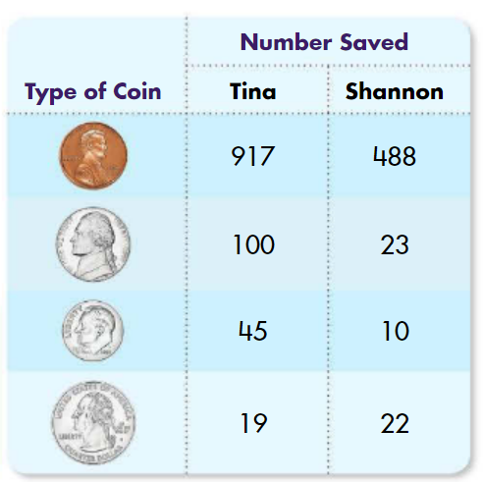
Read the numberless word problem. Determine what operation you will need to do to solve the problem. Some of them may need more than one operation. Then move to the next slide & solve before checking your final answer.
Tina & Shannon counted the coins in their coin collections. Tina discovered that she had 538 coins more than Shannon. Whose collection is worth more? How much more?

Slide 9
Read the numberless word problem. Determine what operation you will need to do to solve the problem. Some of them may need more than one operation. Then move to the next slide & solve before checking your final answer.
Tina & Shannon counted the coins in their coin collections. Tina discovered that she had 538 coins more than Shannon. Whose collection is worth more? How much more?

Slide 10
Answer
Tina by $10.89

Slide 11
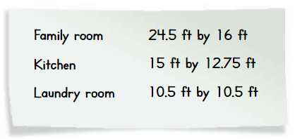
Read the numberless word problem. Determine what operation you will need to do to solve the problem. Some of them may need more than one operation. Then move to the next slide & solve before checking your final answer.
Mrs. Gordon measured three rectangular rooms she wants to tile. What is the total area of the rooms?

Slide 12
Read the numberless word problem. Determine what operation you will need to do to solve the problem. Some of them may need more than one operation. Then move to the next slide & solve before checking your final answer.
Mrs. Gordon measured three rectangular rooms she wants to tile. What is the total area of the rooms?

Slide 13
Answer
693.5 sq. ft.

Slide 14
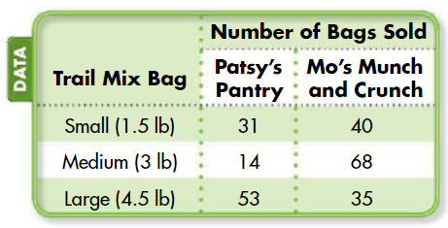
Read the numberless word problem. Determine what operation you will need to do to solve the problem. Some of them may need more than one operation. Then move to the next slide & solve before checking your final answer.
The table shows the number of bags of trail mix sold last month at Patsy’s Pantry and Mo’s Munch-and-Crunch. Each small bag of trail mix sells for $5.87 at Patsy’s and $4.59 at Mo’s. Which store earned more money from the sales of small bags of trail mix? How much more?

Slide 15
Read the numberless word problem. Determine what operation you will need to do to solve the problem. Some of them may need more than one operation. Then move to the next slide & solve before checking your final answer.
The table shows the number of bags of trail mix sold last month at Patsy’s Pantry and Mo’s Munch-and-Crunch. Each small bag of trail mix sells for $5.87 at Patsy’s and $4.59 at Mo’s. Which store earned more money from the sales of small bags of trail mix? How much more?

Slide 16
Mo’s $1.63
Answer

