Slide 1
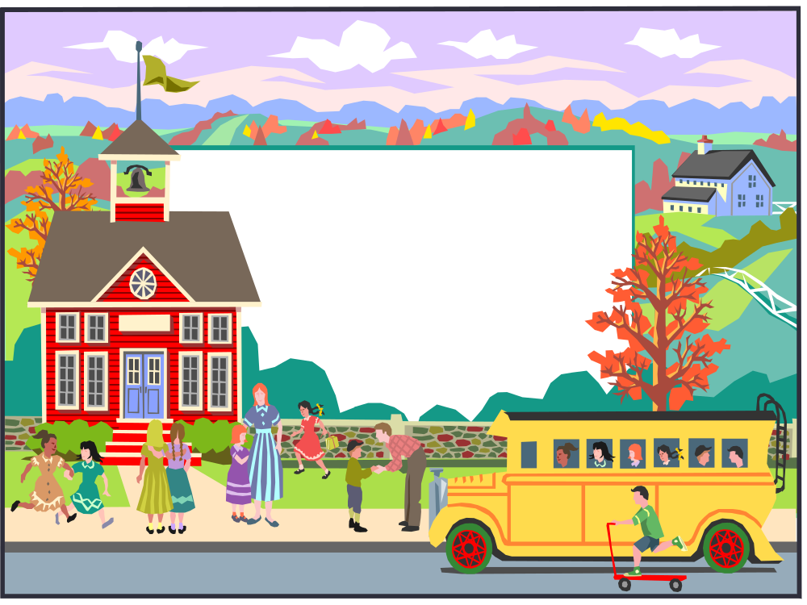
Welcome to
Hawks Nest’s
4th Grade
Curriculum Night

Slide 2
Daily Schedule
7:50 Unpack and complete Daily Reading Comprehension passage
8:15 Itinerant classes – Music, P.E., Library, Guidance, and Art
9:00 Shared Reading (Science and Social Studies Content Integration)
9:20 Reader’s Workshop (involves mini-lesson, guided reading groups,
conferencing, independent reading, progress
assessment and monitoring)
10:05 Writer’s Workshop (mini-lesson and student use of writing process)
10:30 Math Investigations (Teacher led instruction followed by
independent and cooperative group
problem solving)
11:30, 11:35, 11:40 Lunch/Recess
12:30 Math Core Bites practice
12:45 BAM/small math groups
1:15 S.T.E.M.
1:45 Word Study
2:15 Read Aloud
2:25 Dismissal

Slide 3
Nuts and Bolts
http://www.gaston.k12.nc.us/hawksnest
To Contact
  Mrs. Gerringer jlgerringer@gaston.k12.nc.us
  Mrs. Hunnicutt jhhunnicutt@gaston.k12.nc.us
  Mrs. Lassiter rblassiter@gaston.k12.nc.us

Slide 4

English Language Arts
Readers’ and Writers’ Workshops

Slide 5
Math
Quarter 1: Multiples, Factors, Smaller Multiplication & Division, Addition & Subtraction up to 10,000
Quarter 2: Addition & Subtraction up to 10,000, Geometry (Shapes & Angles), Measurement

Slide 6
Math
Quarter 3: Larger Multiplication & Division, Fractions & Decimals
Quarter 4: Larger Multiplication & Division, EOG Review

Slide 7
Science and Social Studies
Science and Social Studies Snapshot

Slide 8
Shared Reading
Read Paragraphs 3&4 of the article on your table quietly to yourself.

Slide 9
Shared Reading
Why do the Appalachians have a wide range of temperatures?
Why did the forested area of the Appalachians get smaller after settlers arrived?
Name some birds and mammals that make their homes in the Appalachian Mountains.

Slide 10
Your Child’s Reading Responsibilities
40 Book Reading Challenge
AR Contracts
Monthly Book Assignment
**These responsibilities are overlapping!**

Slide 11
Thank You for coming this evening

Slide 12
Let’s Have a
Great Year Together!

