Slide 1
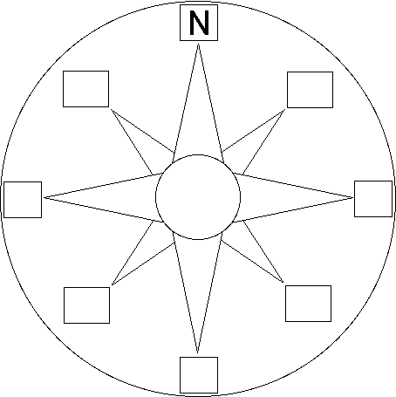
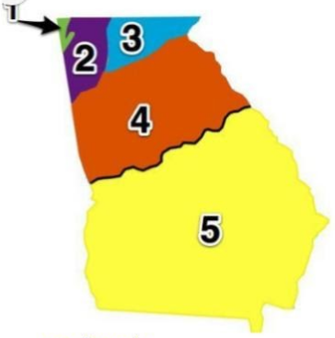
3rd Grade Emergency COVID-19 Plan Name: _________
Reading/ELA Reading: Read 20 min. and write a summary about what you read. ELA: Underline the nouns once and verbs twice. Circle the adjectives in the sentences below. I go to the store with my mom to get delicious snacks. Kelsey ran 12 miles with her cute dog at the park last weekend. | Math There were 386 people at the play Friday night. There were 557 people at the play on Saturday. What is the total number of people that came on both nights? E-Equation: A-Answer: The bakery made cupcakes for James’ birthday. There were 4 rows with 7 in each row. How many cupcakes will there be in all? E-Equation: A-Answer:
Social Studies Label the Compass Rose: | Science - Label the Georgia Regions
1._______________________
2._______________________
3._______________________
4._______________________
5._______________________
Coastal Plains, Blue Ridge, Appalachian Plateau, Piedmont, Ridge and Valley

