Slide 1
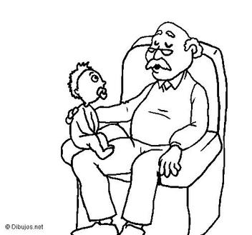
Cheii
2nd Grade

Slide 2
Kid Friendly Objective
I will Identify, name and use correct kinship terminology to address maternal grandfather’s clan using the target language.
I will read and comprehend story elements about Cheii stories.

Slide 3
Cheii
Shicheii
Shim1
Shim1 bizh4’4
Shicheii ____________ nil9.
Shim1 ___________ y1shch99n.
___________ dah shicheii.

Slide 4
Cheii
Your mother’s father is your Cheii. He is your maternal Grandfather. Your mother will not be here without her parents and therefore one should always respect and honor their elders.

Slide 5
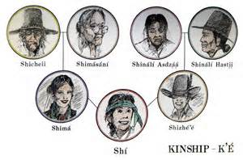
One should use proper kinship terms by expressing “Shicheii” and he will appreciate your conveying of K’4

Slide 6
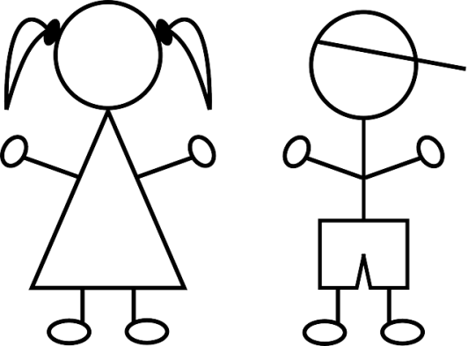
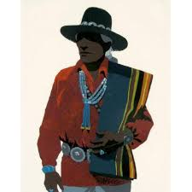
Shicheii
I will identify, recognize and name kinship through maternal grandfather’s clan group.
Your maternal Clan: 3rd Clan
You are a ts07, a maternal granddaughter or grandson
1stClan :Your Cheii
Shicheii or Shim1s1n7
2nd Clan: Your Unlce or Aunt
Shiy11zh or shim1
3rd Clan:
Your cousin
Sibling
Shideezh7, Sh1d7, Shtsil7, Sh7naa’7
4th Clan:
Your cousin
Shi[naa’aash or Shizeed7
Notes:
Peer clans worksheet from District website.

Slide 7
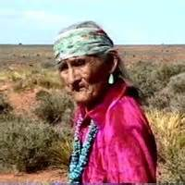
Most Cheiis have lived a long life and have experience many trials and errors, especially when he was young. However, Cheiis are wise because of over coming many obstacles and he has many stories to tell. He has earned the right to be respected. Be respectful to your elders.

Slide 8
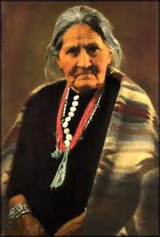
Shimasani
One should not forget Shimasani because she is Shicheii’s complement for many years. She is the mother of your mom. She is a strong woman with many roles to fill and without her, she would not have a strong family. We should also give her much respect and thankfulness for her nurturing energy.

