Slide 1
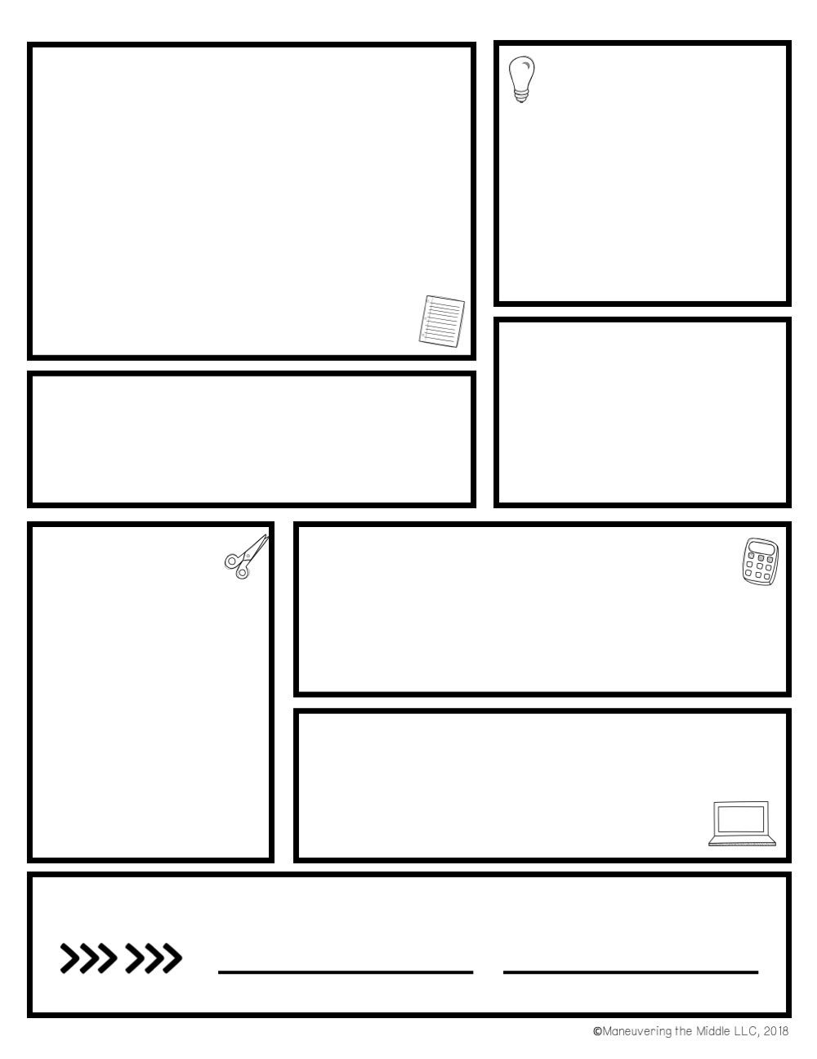

Class information and grades are kept up to date on Microsoft TEAMS and PowerSchool. It is your responsibility to check both programs and communicate any questions you may have for me. I am available through email, TEAMS and remind.
Late Work Policy: Students are expected to complete assignments by the due date. Students have up to 5 days to submit late work for credit. Teachers are not required to accept late work after the 5 days.
Content
Geometry
Algebra
Algebraic Thinking
Expressions
Measurement
Data
Numbers and Operations
REMIND
Stay in touch using the free Remind app.
text 81010
Math: @mylarmath
** If you have a student in my enrichment class, also join: Enrichment: @mylarhroom
MATH- Room 322
Mrs. Julia Mylar
julia.mylar@onslow.k12.nc.us
Supply List
Weighted Categories
Assessments/ Projects- 30%
Homework- 20%
Notebook/Classwork- 30%
I-Ready Lessons- 20%
2-inch binder
Loose-leaf paper
7 dividers with tabs
Pencil pouch
Clear sheet protectors
Ink pens
Pencils
Highlighters
Colored pencils
Glue sticks
Scissors
***WIRED earbuds***
End of Grade testing will be 20% of your final grade.
Grading
Expectations
All students are expected to follow the
DMS BARK expectations.
Be Prepared, Act Responsibly,
Respect Others. & Keep Safe
Sign here Student Name:________________
Homework/Classwork Expectations
All assignments/homework are expected to be turned in on the due date. Please see late work policy. If you are absent, please check teams for the assignment. Test and quizzes can not be retaken. If you score below an 80%, you may do test corrections for a higher grade. Corrections must be completed within 10 days after the test/quiz is returned
Parent signature
Student signature
#BulldogLIFE

