Slide 1

Incoming Freshman Information Meeting

Slide 2

What is a 3 X 5 Trimester?
5 periods per day approximately 70 minutes each
1/2 credit courses meet for one 12-week trimester
1 credit courses meet for two 12-week trimesters
Three 12-week trimester terms per year

Slide 3
THE BEST SCHEDULE?
NO SILVER BULLET!
Every schedule has good points and bad. We are looking for a schedule that can allow the flexibility to give students what they need and still be able to take some of what they want.

Slide 4
C.H.H.S. Graduation Requirements
4 .5 English
  4 Math
  *Must have a math Credit Every year
  3 Science
  3 Social Studies
.5 Health
.5 P.E.
  1 Arts & Humanities
9-11 Electives

Slide 5
Required Courses in order taken
English: 9 - 12 We offer Honors level all years and Dual credit options grade 11 & 12. Grade 11 is all year course
Math: Algebra 1, Geometry, Algebra 2 Honors level all years and Dual credit options grade 12. Algebra 1 and 2 are all year courses
Social Studies: World Civ., Political Science (or A.P.), U.S. History (or Dual Credit US History).
Science: Int. Science, Biology, 3 Junior Science options. We offer A.P. Bio and D.C. Chemistry
Health and P.E. Grade 9
Arts & Humanities Grade 10

Slide 6
Foreign Language
Not required for graduation
BUT,
IF you plan to attend a 4-year public university such as U.K., U.L., N.K.U., Murray, Eastern, Western, …
they require 2 years of foreign language
(in the same language).

Slide 7
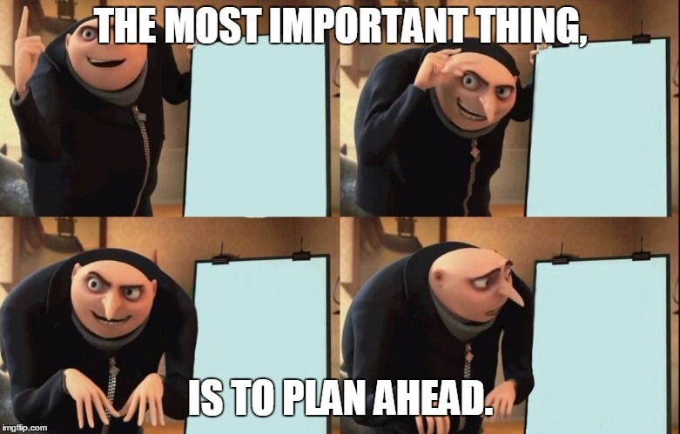

Slide 8
4 Year Plans- Health Science/Band
Trimester/ Block | 1 | 2 | 3
1 | Honors Alg. 1 A | Honors Alg. 1 B | Honors Alg. 1 C
2 | Eng. 9 A | Eng. 9 B | World Civ. B
3 | World Civ. A | Int. Science A | Int. Science B.
4 | Prn of Health A | Prn of Health B | PE
5 | Band | Band | Band
9th grade
* Health Still Needed
Trimester/ Block | 1 | 2 | 3
1 | Hon. Geo A | Hon. Geo. B | Hon. Eng. 10 B
2 | Hon. Eng. 10 A | Bio. A | Bio B
3 | AP Gov A | Pol. Science B | AP Gov B
4 | Med . Terms | Emerg Proc. | Elec.
5 | Band | Band | Band
10th Grade

Slide 9
Trimester/ Block | 1 | 2 | 3
1 | Dual Crd Eng A | Dual Crd Eng B | Public Speaking
2 | Hon Alg 2 A | Hon Alg 2 B | Hon Alg 2 C
3 | AP US Hist. A | AP US Hit B | Anatomy B
4 | Anatomy A | Spanish 1 A | Spanish 1 B
5 | Band | Band | Band
11th
Grade
Trimester/ Block | 1 | 2 | 3
1 | Dual Crd Eng A | Dual Crd Eng B | Trig.
2 | Med Math | Spanish 2 A | Spanish 2 B
3 | Med Nurse A | Elective | Elective
4 | Med Nurse B | Elective | Elective
5 | Band | Band | Band
12th
Grade

Slide 10
Early College option with three trimester elective
Trimester/ Block | 1 | 2 | 3
1 | Honors Alg. 1 C | H. Geometry A | H. Geometry B
2 | H. Eng. 9 A | H. Eng. 9 B | World Civ. B
3 | World Civ. A | Int. Science A | Int. Science B.
4 | PE | French 1 A | French 1 B
5 | Choir | Choir | Choir
9th Grade
* Health still needed
Trimester/ Block | 1 | 2 | 3
1 | H. Alg. 2 A | H. Alg 2 B | H. Alg 2 C
2 | Hon. Eng. 10 A | Hon. Eng. 10 B | French 2 B
3 | AP Gov A | Pol. Science B | AP Gov B
4 | Biology A | French 2 A | Biology B
5 | Choir | Choir | Choir
10th Grade

Slide 11
Early College additional information
Algebra 2 Must be complete
ACT benchmarks must be met: English 18, Math 22, Reading 20.
Application for program must be submitted at end of Sophomore or Junior year.
Students remain enrolled in home school and can continue to participate in extra curricular programs.
Juniors in program will remain at EC3 and take college curriculum there. Seniors go to class on ECTC campus.
Students that fail to keep up minimum GPA requirements may be removed from program.
Students can still take a class at Central if they choose, but need to keep the different schedules in mind between the college and here as they schedule. But students have taken Band or ROTC and still been a part of the Early college program.

Slide 12
Dual Credit at Central Hardin
CHHS Dual Credit Courses
ECTC
· DC AHS 115 (3 hrs) – (Medical Terminology)
· DC CIT 105 (3 hrs) – (Intro to Computers - Digital Literacy B)
· DC ENG 101 (3 hrs) – (English Language A)
· DC ENG 102 (3 hrs) – (English Language B)
· DC ENG 161 (3 hrs) - (English Literature A & B)
· DC HIS 108 (3 hrs) - (US History A)
· DC HIS 109 (3 hrs) - (US History B)
· DC MAT 150 (3 hrs) - (College Algebra)
· DC MAT 155 (3 hrs) - (Trigonometry)
· DC PHY 151 (3 hrs) - (Introductory Physics)
· DC PHY 161 (1 hr) – (Lab must be taken with PHY 151)
· DC AST 101 (3 hrs) – (Astronomy)
Campbellsville University
· DC MAC 120 (3 hrs) – (Public Speaking)
· DC ED 102 (3 hrs) – (Principles of Teaching)
· DC CHEM 111 (3hrs) – (Chemistry A & B)
· DC CHEM 113 (1 hr) – (Lab must be taken with CHEM 111)

Slide 13
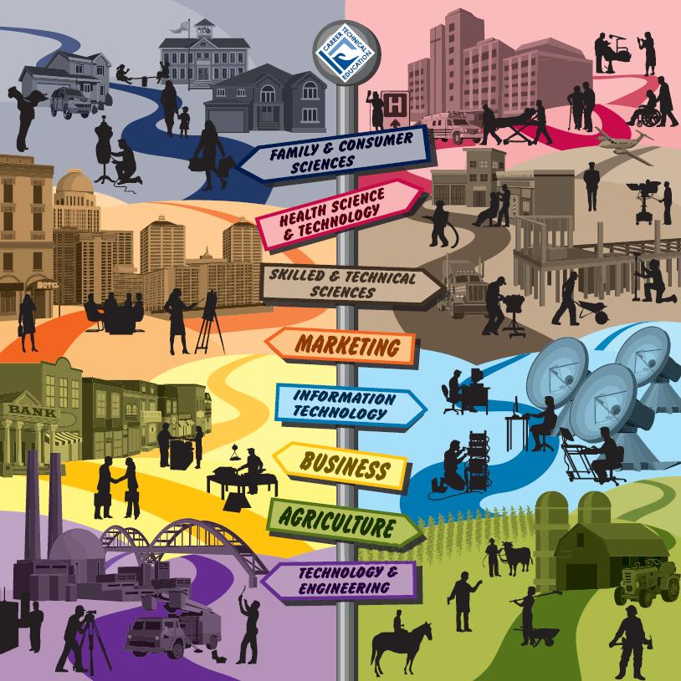
To become a career
completer a student will need 4 credits within the major. Students that are completers and pass KOSSA test will be designated as
“career ready” and receive a certificate.
Career Pathways

