Slide 1






Evaluating Federal Grant Programming to Support State and Local
Critical Infrastructure Protection
Results and Perspectives of
Qualitative-Empirical End-User Survey Research in the European Union (EU)
MMag. Andrea Jerković, Ph.D., MPA
CEUSS | Center for European Security Studies
10th Annual Homeland Defense & Security Education Summit,
George Mason University, Arlington Campus
March 24, 2017
KIRAS Project
SFI@SFU

Slide 2
Civil Security Grants in the EU
Known as funding for Security Research, multipurpose:
  Combines research and preparedness grants
  RTD for response capabilities
  Networks of researchers and first responders
  Industrial and Technological Base
  Market and end-user demands-driven (→ must be evidence based)
European program as well as national programs in several Member States
  First national Security Research program: KIRAS (Austria), 2005
  European program: “Secure Societies” topic in Horizon 2020
Lisbon Treaty (2009):
  Legal personality for the EU
  Solidarity Clause
  Support, enhance, and coordinate Member States’ civil protection
  Internal–external security continuum, etc.
Security Union with an own Commissioner in charge in DG HOME

Slide 3
Context
Comprehensive presentation of selected main results of a series of surveys and foresight activities at Member State and EU levels (2009-2014)
  End-users form public and private sectors, identifying their perceptions and expectations as part of a comprehensive approach
  Technology, knowledge, and policy demands with regard to critical infrastructure protection at state and local levels
  Contribution to policy and program evaluation and evolution
General lessons for innovation in preparedness and collaboration
Covered in the “EU–U.S. Implementing Arrangement for Cooperative Activities in the Field of Homeland/Civil Security Research” (2009)
Recent DHS focus on working with the EU in research and policy
Homeland security can benefit from international best practices and perspectives on its mission space (e.g. Morag, Comparative Homeland Security, 2011)
President Trump’s FY18 budget request may bring increased discussion of HLS grants between the federals and state and local partners
  Need for good understanding of state and local perception of grant programming and expectations in the federal government

Slide 4
Projects Covered
The research leading to these results has received funding from:
Austrian Ministry of Technology, Transport and Innovation (bmvit),
  Contract to populate the Austrian Security Research Map (http://landkarte.kiras.at/en)
  SFI@SFU: “Development of an Austrian Centre for Comprehensive Security Research at Sigmund Freud Private University Vienna” in the Austrian Security Research Program KIRAS
European Union Seventh Framework Program (FP7/2007-2013)
  CPSI: “Changing Perceptions of Security and Interventions; the European Union 7th Framework Program (Grant Agreement n° 217881)
  VITRUV: “Vulnerability Identification Tools for Resilience Enhancements of Urban Environments” (Grant Agreement n° 261741)
  FOCUS: “Foresight Security Scenarios: Mapping Research to a Comprehensive Approach to Exogenous EU Roles” (Grant Agreement n° 261633).
This presentation reflects only the author’s views and the Union is not liable for any use that may be made of the information contained therein.

Slide 5
Approach
Semi-structured end-user surveys (interviews and questionnaires)
  Based on program objectives analysis
  In formed by horizon scanning of emerging challenges and needs
  Action research component: Increase awareness of being an end-user in civil security/stakeholder in the European Security Model
First used in a survey research study commissioned by the Ministry of Transport, Innovation and Technology (bmvit), Vienna in 2009
  40 interviews completed
  Results populated the Austrian Security Research Map
Expanded on in KIRAS project SFI@SFU (Austrian CoE)
  90 end-users in a structured dialogue series
Use in EU projects up to 2014, including the FOCUS project
  Scenario foresight to identify futuristic threats, demands, and requirements
  Collaboration with FEMA’s Strategic Foresight Initiative and DHS S&T projects
  Multiple information collection methods used
  Total participation: approx. 600 experts from 20 countries

Slide 6
Critical Infrastructure Protection
First mission in the EU’s civil security acquis and related research programming:
  European Programme for Critical Infrastructure Protection (2006)
  Requires a common European risk assessment methodology focusing on cascading effects of systemic risks and a coherent European response during crisis and emergencies (European Agenda on Security, 2015)
Thematic focus area in the Austrian Security Research Program KIRAS
  Based on OECD classification of critical infrastructures
OECD screening study (2008): Significant commonalities in CIP challenges across Europe and North America, as well as around the world
National specifics remain, for example:
  Challenge of aged infrastructure (U.S.)
  Focus on energy and transport sectors (EU)
Main characteristics converge, such as the private sector as the main owner of, and investor in, critical infrastructure.

Slide 7
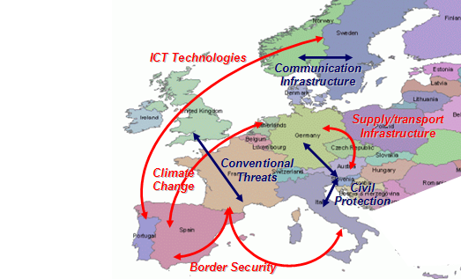
European CIP Programming Map
Critical infrastructure (protection) is what states make of it
Ownership of risks is an important aspect of security culture
A comprehensive/whole-community approach
must respect and integrate security cultures
Risk assessment vs.
cultural selection of risk
(Douglas & Wildavsky,
Risk and Culture, 1983)
CPSI/
ESRIF
Horizon Scanning
Security Research program analysis
2009

Slide 8
Austria/KIRAS: Response Rates
 | n | %
Public Administration | 3 | 30%
Home affairs | 6 | 75%
First responder organizations | 12 | 39%
Civil protection | 6 | 40%
Health | 4 | 40%
Utilities | 5 | 38%
Transport | 4 | 50%
Communication | 0 | 0%
AUSTRIA | 40 | 40%

Slide 9
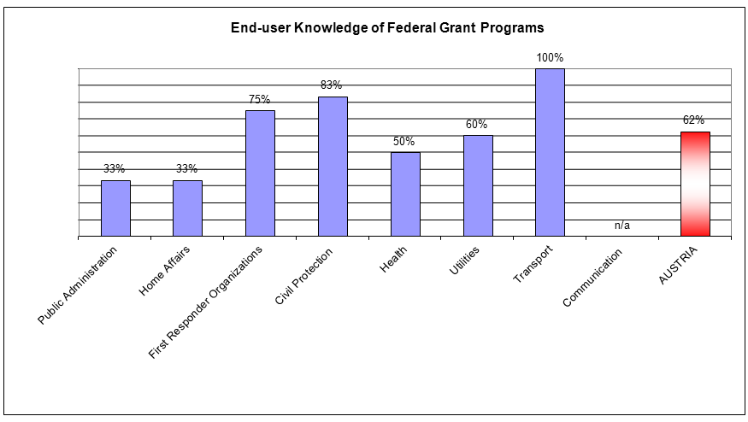
Austria/KIRAS: Program Awareness

Slide 10
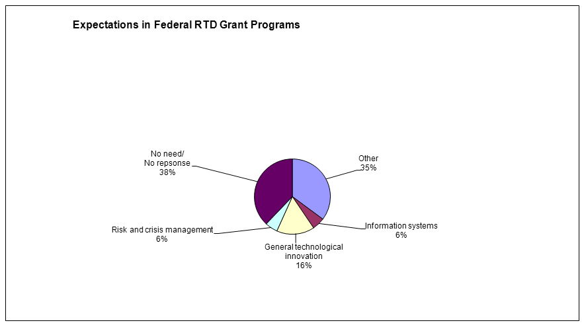
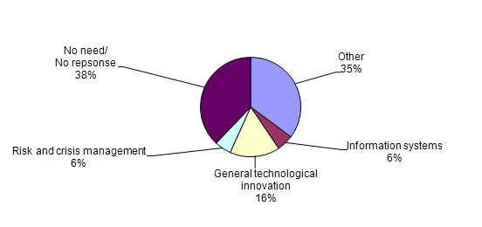
Austria/KIRAS: Expectations in Grants
Risk and vulnerability assessment
ICT solutions
Simulation tools
S-T-L information management
Functional support for state policies
Little need for specific products
Citizen-involving programs

Slide 11
EU/VITRUV: Urban Resilience
How can security research programming better respond to urban planners needs to consider resilience aspects in urban infrastructure?
Demand for studies higher then for concrete products, capabilities, or infrastructure projects funded by federal and EU grants:
  International state of the art and how prescriptive findings translate into different countries and jurisdictions
  Plans and models for Crime Protection Through Environmental Design, including addressing of ethics, legal and social issues (ELSI)
  Matching of protective measures for critical infrastructure with:
    Citizens’ perceptions of criticality
    Cultural patters of infrastructure use
    Potential for social acceptance of technological solutions
  Sustainability of urban processes/COB doctrine for the city
  Coordination of risk management and emergency management plans and practices with specific critical infrastructure protection needs

Slide 12
EU/FOCUS: Security Union “2035”
In order to support preparedness for a resilient EU and Security Union to comprehensively deliver security to its citizens, EU grant programs should focus on topics and projects that:
  Facilitate information sharing
  Facilitate anticipation and foresight of threats in line with the objectives of the European Security Model (anticipate, prevent, protect)
  Address the internal–external continuum in critical infrastructure protection
  Raise awareness and increase broad sense of ownership in the European Security Model and protection of critical infrastructure across levels of designation (National Critical Infrastructure, or NCI, and European Critical Infrastructure, or ECI)
  Support evidence-based and effects-based approaches, for example:
    Socio-technical analyses of cross-sector threats to critical infrastructures
    Wider impact scenarios

Slide 13
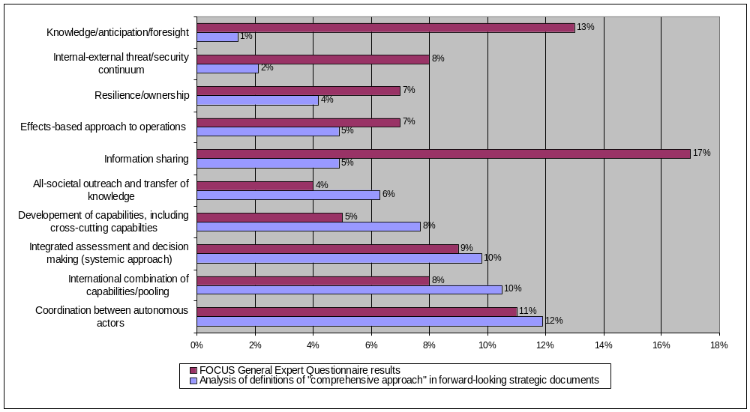
EU/FOCUS Foresight vs. Current
The following chart illustrates anticipated needs for “Preparedness 2035” (purple) vs. current strategies and programs focus in the EU (blue)

Slide 14
Cross-Findings
Lowest awareness and acceptance of initiatives and grants for infrastructure protection: Public Administration
Highest awareness and acceptance of initiatives and grants for infrastructure protection: Transportation Sector
Strong demand for infrastructure assessment studies
Reactivity analysis: Need for improved recognition of state and local security cultures
  State and local authorities have vested interests in their specific risks and emergencies, take ownership in them, and make them part of their identity (cf. Wuthnow, Be Very Afraid, 2010)
  Tunnel effect related to state-specific types of infrastructure and related issues; strong sense of ownership
  Identity-shaping effect of infrastructure and risks, where preparedness can be threatening
Need to analyze risks comprehensively and to involve all parts and levels of society involved in the production of security as a public good

Slide 15
Utility of Studies Results
Austria & Security Research Program KIRAS
  Support development of a related nation-wide database and map
  Propose additional policy and program evaluation criteria
  Raise awareness to increase active end-user community
  Identify topics for calls to increase program responsiveness to state and local demands
  Increase chances for take-up of results and marketability of products
EU Security Research
  Identify topics for calls in Horizon 2020
  Support EU agencies such as FRONTEX and EDA in strategic prioritization
EU and Member State Civil Security
  Contribute content to Urban Securipedia, a knowledge base to support risk assessment for resilience-enhancing urban planning
  Raise awareness of stakeholdership in security research and the European Security Model

Slide 16
Possible Next Steps in U.S. Context
Expanding on the 2009 U.S.-EU Implementing Arrangement:
  Empower subsequent-tier actors to reach their mission goals, while fostering state and local ownership
  Scalable, adaptable ways of studying risk perception of end-users and practitioners at state, and local levels, and related expectations in homeland security policy and programs
Contexts and practices across SLTT: Treatment-as-a-State (TAS) has put responsibility for federal grants in the hand of tribes
  Studies to assess perceptions, needs, and expectations within a context that affirms cultural diversity
Recent Executive Orders on Protecting the Homeland and subsequent DHS Implementation Memoranda emphasize working across tiers of government, from federal to local:
  Improved connection of federal with state and local implementing action, as well as a more direct role of the U.S. Department of Homeland Security in enabling state and local actors
  Some criticism regarding state and local sovereignty and ownership
  Presented studies’ action research component can be of value

Slide 17

Thank you!
Contact:
jerkovic@european-security.info
Institutions where work was completed:
CEUSS | Center for European Security Studies
http://www.european-security.info
SFI | Institute for Security Research, Sigmund Freud University, Vienna, Austria
http://www.esci.at/sfi-sfu
Security Research Map―Austrian Security Research Program KIRAS
http://landkarte.kiras.at/en

