Slide 1
Third Grade Math
EngageNY Application Problems
goo.gl/avSUSP

Slide 2
5.2 Specify and partition a whole into equal parts, identifying and counting unit fractions by folding fraction strips.
Anu needs to cut a piece of paper into 6 equal parts. Draw at least 3 pictures to show how Anu can cut her paper so that all the parts are equal. (Early finishers can do the same thing with halves, fourths, or eighths.)
Draw a model, and then use numbers, labels, and a sentence to explain your thinking.

Slide 3
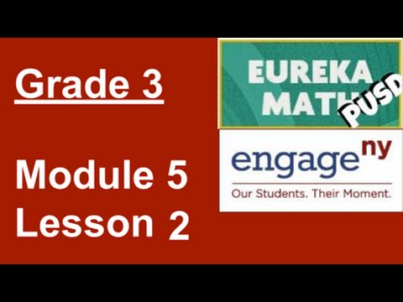
5.2 Specify and partition a whole into equal parts, identifying and counting unit fractions by folding fraction strips.

Slide 4

Today’s Lesson

Slide 5
5.1 Specify and partition a whole into equal parts, identifying and counting unit fractions using concrete models.
Measure the length of your paper or math book using a ruler. Your teacher will tell you whether to measure in inches or centimeters. Assign partners different units. After students complete the measurement individually and compare answers with a partner, facilitate a discussion using the following suggestions.
a. Which is a larger unit—an inch or a centimeter?
b. Which would yield a greater number when measuring the book—inches or centimeters?
c. Measure at least 2 different items with your partner, again using different units. What do you notice?
d. Change units with your partner. Measure different items again.
Draw a model, and then use numbers, labels, and a sentence to explain your thinking.

Slide 6

5.1 Specify and partition a whole into equal parts, identifying and counting unit fractions using concrete models.

Slide 7
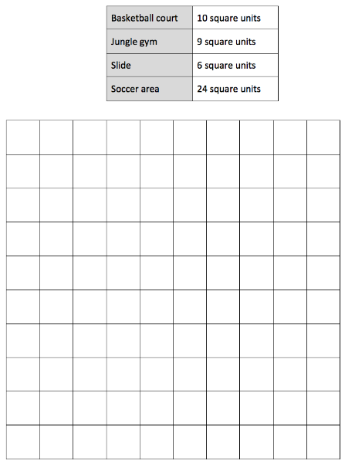
4.16 Apply knowledge of area to determine areas of rooms in a given floor plan.
Jeremy plans and designs his own dream playground on grid paper. His new playground will cover a total area of 100 square units. The chart shows how much space he gives for each piece of equipment, or area. Use the information in the chart to draw and label a possible way Jeremy can plan his playground.
Draw a model, and then use numbers, labels, and a sentence to explain your thinking.

Slide 8
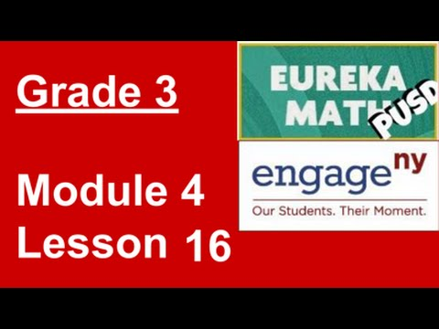
4.16 Apply knowledge of area to determine areas of rooms in a given floor plan.

Slide 9
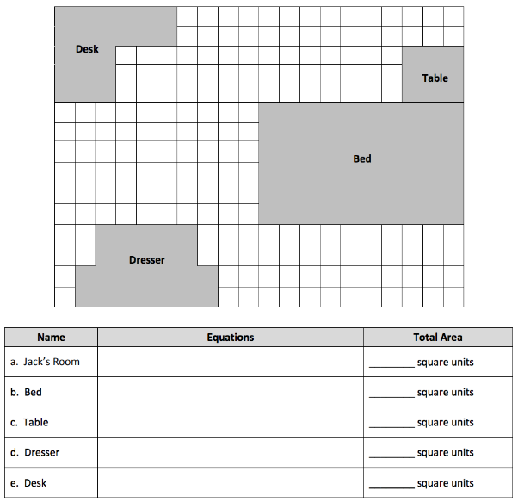
4.15 Apply knowledge of area to determine areas of rooms in a given floor plan.
Jack uses grid paper to create a floor plan of his room. Label the unknown measurements, and find the area of the items listed below.
Draw a model, and then use numbers, labels, and a sentence to explain your thinking.

Slide 10

4.15 Apply knowledge of area to determine areas of rooms in a given floor plan.

Slide 11
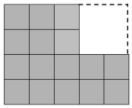
4.14 Find areas by decomposing into rectangles or completing composite figures to form rectangles.
a. Break apart the shaded figure into 2 rectangles. Then, add to find the area of the shaded figure below.
b. Subtract the area of the unshaded rectangle from the area of the large rectangle to check your answer in Part (a).
Draw a model, and then use numbers, labels, and a sentence to explain your thinking.

Slide 12

4.14 Find areas by decomposing into rectangles or completing composite figures to form rectangles.

Slide 13
4.13 Find areas by decomposing into rectangles or completing composite figures to form rectangles.
Anil finds the area of a 5-inch by 17-inch rectangle by breaking it into 2 smaller rectangles. Show one way that he could have solved the problem. What is the area of the rectangle?
Draw a model, and then use numbers, labels, and a sentence to explain your thinking.

Slide 14

4.13 Find areas by decomposing into rectangles or completing composite figures to form rectangles.

Slide 15
4.12 Solve word problems involving area.
a. Find the area of a 6 meter by 9 meter rectangle.
b. Use the side lengths, 6 m × 9 m, to find different side lengths for a rectangle that has the same area. Show your equations using parentheses. Then estimate to draw the rectangle and label the side lengths.
Draw a model, and then use numbers, labels, and a sentence to explain your thinking.

Slide 16

4.12 Solve word problems involving area.

Slide 17
4.11 Demonstrate possible whole number side lengths of rectangles with areas of 24, 36, 48, or 72 square units using the associative property.
The banquet table in a restaurant measures 3 feet by 6 feet. For a large party, workers at the restaurant place 2 banquet tables side by side to create 1 long table. Find the area of the new, longer table.
Draw a model, and then use numbers, labels, and a sentence to explain your thinking.

Slide 18
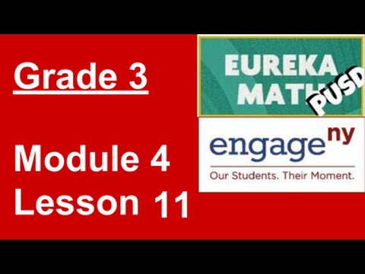
4.11 Demonstrate possible whole number side lengths of rectangles with areas of 24, 36, 48, or 72 square units using the associative property.

Slide 19

4.10 Apply the distributive property as a strategy to find the total area of a large rectangle by adding two products.
Sonya folds a 6-inch by 6-inch piece of paper into 4 equal parts (shown below). What is the area of 1 of the parts?
Draw a model, and then use numbers, labels, and a sentence to explain your thinking.

Slide 20

4.10 Apply the distributive property as a strategy to find the total area of a large rectangle by adding two products.

Slide 21
4.9 Analyze different rectangles and reason about their area.
Mario plans to completely cover his 8-inch by 6-inch piece of cardboard with square inch tiles. He has 42 square inch tiles. How many more square inch tiles does Mario need to cover the cardboard without any gaps or overlap? Explain your answer.
Draw a model, and then use numbers, labels, and a sentence to explain your thinking.

Slide 22
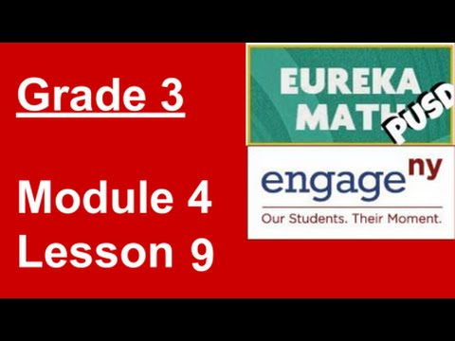
4.9 Analyze different rectangles and reason about their area.

Slide 23
4.8 Find the area of a rectangle through multiplication of the side lengths.
Marnie and Connor both skip-count square units to find the area of the same rectangle. Marnie counts, “3, 6, 9, 12, 15, 18, 21.” Connor counts, “7, 14, 21.” Draw what the rectangle might look like, and then label the side lengths and find the area.
Draw a model, and then use numbers, labels, and a sentence to explain your thinking.

Slide 24

4.8 Find the area of a rectangle through multiplication of the side lengths.

Slide 25
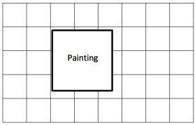
4.7 Interpret area models to form rectangular arrays.
Lori wants to replace the square tiles on her wall. The square tiles are sold in boxes of 8 square tiles. Lori buys 6 boxes of tiles. Does she have enough to replace all of the tiles, including the tiles under the painting? Explain your answer.
Draw a model, and then use numbers, labels, and a sentence to explain your thinking.

Slide 26
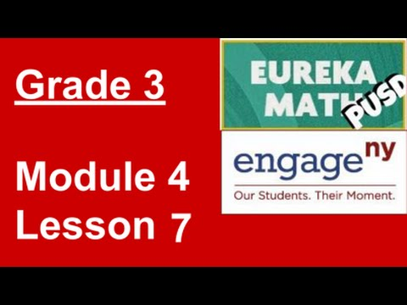
4.7 Interpret area models to form rectangular arrays.

Slide 27
4.6 Draw rows and columns to determine the area of a rectangle, given an incomplete array.
Huma has 4 bags of square inch tiles with 6 tiles in each bag. She uses them to measure the area of a rectangle on her homework. After covering the rectangle, Huma has 4 tiles left. What is the area of the rectangle?
Draw a model, and then use numbers, labels, and a sentence to explain your thinking.

Slide 28

4.6 Draw rows and columns to determine the area of a rectangle, given an incomplete array.

Slide 29
4.5 Form rectangles by tiling with unit squares to make arrays.
Candice uses square centimeter tiles to find the side lengths of a rectangle as shown on the right. She says the side lengths are 5 centimeters and 7 centimeters. Her partner, Luis, uses a ruler to check Candice’s work and says that the side lengths are 5 centimeters and 6 centimeters. Who is right? How do you know?
Draw a model, and then use numbers, labels, and a sentence to explain your thinking.

Slide 30

4.5 Form rectangles by tiling with unit squares to make arrays.

Slide 31
4.4 Relate side lengths with the number of tiles on a side.
Mara uses 15 square-centimeter tiles to make a rectangle. Ashton uses 9 square-centimeter tiles to make a rectangle.
a. Draw what Mara and Ashton’s rectangles might look like. b. Whose rectangle has a bigger area? How do you know?
Draw a model, and then use numbers, labels, and a sentence to explain your thinking.

Slide 32

4.4 Relate side lengths with the number of tiles on a side.

Slide 33
4.3 Model tiling with centimeter and inch unit squares as a strategy to measure area.
Jace uses paper squares to create a rectangle. Clary cuts all of Jace’s squares in half to create triangles. She uses all the triangles to make a rectangle. There are 16 triangles in Clary’s rectangle. How many squares were in Jace’s shape?
Draw a model, and then use numbers, labels, and a sentence to explain your thinking.

Slide 34

4.3 Model tiling with centimeter and inch unit squares as a strategy to measure area.

Slide 35
4.2 Decompose and recompose shapes to compare areas.
Wilma and Freddie use pattern blocks to make shapes as shown. Freddie says his shape has a bigger area than Wilma’s because it is longer than hers. Is he right? Explain your answer.
Draw a model, and then use numbers, labels, and a sentence to explain your thinking.

Slide 36

4.2 Decompose and recompose shapes to compare areas.

Slide 37
4.1 Understand area as an attribute of plane figures.
Eric makes a shape with 8 trapezoid pattern blocks. Brock makes the same shape using triangle pattern blocks. It takes 3 triangles to make 1 trapezoid. How many triangle pattern blocks does Brock use?
Draw a model, and then use numbers, labels, and a sentence to explain your thinking.

Slide 38

4.1 Understand area as an attribute of plane figures.

Slide 39
3.21 Solve two-step word problems involving multiplying single-digit factors and multiples of 10.
Frederick buys a can of 3 tennis balls. The empty can weighs 20 grams, and each tennis ball weighs 60 grams. What is the total weight of the can with 3 tennis balls?
Draw a model, and then use numbers, labels, and a sentence to explain your thinking.

Slide 40
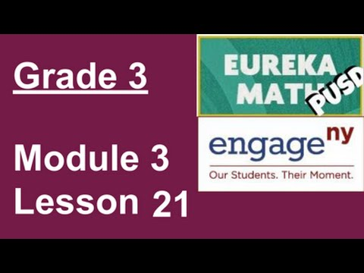
3.21 Solve two-step word problems involving multiplying single-digit factors and multiples of 10.

Slide 41
3.20 Use place value strategies and the associative property n x (m x 10) = (n x m) x 10 (where n and m are less than 10) to multiply multiples of 10.
Model 3 × 4 on a place value chart. Then, explain how the array can help you solve 30 × 4.
Draw a model, and then use numbers, labels, and a sentence to explain your thinking.

Slide 42

3.20 Use place value strategies and the associative property n x (m x 10) = (n x m) x 10 (where n and m are less than 10) to multiply multiples of 10.

Slide 43
3.19 Multiply by multiples of 10 using the place value chart.
Mia has 152 beads. She uses some to make bracelets. Now there are 80 beads. If she uses 8 beads for each bracelet, how many bracelets does she make?
Draw a model, and then use numbers, labels, and a sentence to explain your thinking.

Slide 44

3.19 Multiply by multiples of 10 using the place value chart.

Slide 45
3.18 Solve two-step word problems involving all four operations and assess the reasonableness of solutions.
On Saturday, Warren swims laps in the pool for 45 minutes. On Sunday, he runs 8 miles. It takes him 9 minutes to run each mile. How long does Warren spend exercising over the weekend?
Draw a model, and then use numbers, labels, and a sentence to explain your thinking.

Slide 46

3.18 Solve two-step word problems involving all four operations and assess the reasonableness of solutions.

Slide 47
3.17 Identify patterns in multiplication and division facts using the multiplication table.
Henry’s garden has 9 rows of squash plants. Each row has 8 squash plants. There is also 1 row with 8 watermelon plants. How many squash and watermelon plants does Henry have in all?
Draw a model, and then use numbers, labels, and a sentence to explain your thinking.

Slide 48

3.17 Identify patterns in multiplication and division facts using the multiplication table.

Slide 49
3.16 Reason about and explain arithmetic patterns using units of 0 and 1 as they relate to multiplication and division.
Rajan says that any number multiplied by 1 equals that number.
Write a multiplication equation using n to represent Rajan’s statement.
Using your equation, let n = 5, and draw a picture to show that the new equation is true.
Draw a model, and then use numbers, labels, and a sentence to explain your thinking.

Slide 50

3.16 Reason about and explain arithmetic patterns using units of 0 and 1 as they relate to multiplication and division.

Slide 51
3.15 Interpret the unknown in multiplication and division to model and solve problems.
Mrs. Aquino pours 36 liters of water equally into 9 containers. How much water is in each container?
Draw a model, and then use numbers, labels, and a sentence to explain your thinking.

Slide 52

3.15 Interpret the unknown in multiplication and division to model and solve problems.

Slide 53
3.14 Identify and use arithmetic patterns to multiply.
Donald writes 6 × 9 = 54. Explain two strategies you could use to check his work.
Draw a model, and then use numbers, labels, and a sentence to explain your thinking.

Slide 54

3.14 Identify and use arithmetic patterns to multiply.

Slide 55
3.13 Identify and use arithmetic patterns to multiply.
Michaela and Gilda read the same book. It takes Michaela about 8 minutes to read a chapter and Gilda about 10 minutes. There are 9 chapters in the book. How many fewer minutes does Michaela spend reading than Gilda?
Draw a model, and then use numbers, labels, and a sentence to explain your thinking.

Slide 56

3.13 Identify and use arithmetic patterns to multiply.

Slide 57
3.12 Apply the distributive property and the fact 9 = 10 -1 as a strategy to multiply.
A scientist fills 5 test tubes with 9 milliliters of fresh water in each. She fills another 3 test tubes with 9 milliliters of salt water in each. How many milliliters of water does she use in all? Use the break apart and distribute strategy to solve.
Draw a model, and then use numbers, labels, and a sentence to explain your thinking.

Slide 58

3.12 Apply the distributive property and the fact 9 = 10 -1 as a strategy to multiply.

Slide 59
3.11 Interpret the unknown in multiplication and division to model and solve problems.
Erica buys some packs of rubber bracelets. There are 8 bracelets in each pack.
How many packs of rubber bracelets does she buy if she has a total of 56 bracelets? Draw a tape diagram, and label the total number of packages as p. Write an equation, and solve for p.
After giving some bracelets away, Erica has 18 left. How many bracelets did she give away?
Draw a model, and then use numbers, labels, and a sentence to explain your thinking.

Slide 60
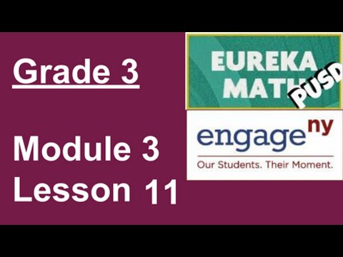
3.11 Interpret the unknown in multiplication and division to model and solve problems.

Slide 61
3.10 Use the distributive property as a strategy to multiply and divide.
Use the 5 plus something break apart and distribute strategy to solve 6 × 8. Model with a tape diagram.
Draw a model, and then use numbers, labels, and a sentence to explain your thinking.

Slide 62

3.10 Use the distributive property as a strategy to multiply and divide.

Slide 63
3.9 Model the associative property as a strategy to multiply.
Simplify to find the answer to 18 × 3. Show your work, and explain your strategy.
Draw a model, and then use numbers, labels, and a sentence to explain your thinking.

Slide 64
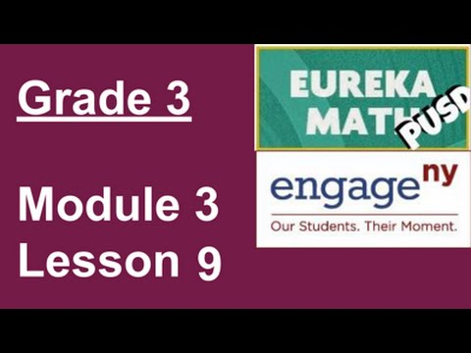
3.9 Model the associative property as a strategy to multiply.

Slide 65
3.8 Understand the function of parentheses and apply to solving problems.
Richard has 2 cartons with 6 eggs in each. As he opens the cartons, he drops 2 eggs. How many unbroken eggs does Richard have left?
Draw a model, and then use numbers, labels, and a sentence to explain your thinking.

Slide 66

3.8 Understand the function of parentheses and apply to solving problems.

Slide 67
3.7 Interpret the unknown in multiplication and division to model and solve problems using units of 6 and 7.
Three boys and three girls each buy 7 bookmarks. How many bookmarks do they buy all together?
Draw a model, and then use numbers, labels, and a sentence to explain your thinking.

Slide 68
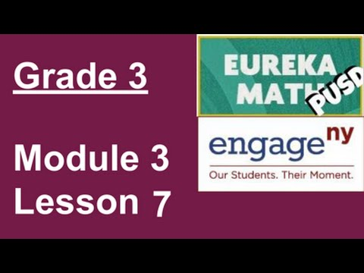
3.7 Interpret the unknown in multiplication and division to model and solve problems using units of 6 and 7.

Slide 69
3.6 Use the distributive property as a strategy to multiply and divide using units of 6 and 7.
Mabel cuts 9 pieces of ribbon for an art project. Each piece of ribbon is 7 centimeters long. What is the total length of the pieces of ribbon that Mabel cuts?
Draw a model, and then use numbers, labels, and a sentence to explain your thinking.

Slide 70

3.6 Use the distributive property as a strategy to multiply and divide using units of 6 and 7.

Slide 71
3.5 Count by units of 7 to multiply and divide using number bonds to decompose.
Gracie draws 7 rows of stars. In each row, she draws 4 stars. How many stars does Gracie draw in all? Use a letter to represent the unknown and solve.
Draw a model, and then use numbers, labels, and a sentence to explain your thinking.

Slide 72

3.5 Count by units of 7 to multiply and divide using number bonds to decompose.

Slide 73
3.4 Count by units of 6 to multiply and divide using number bonds to decompose.
Marshall puts 6 pictures on each of the 6 pages in his photo album. How many pictures does he put in the photo album in all?
Draw a model, and then use numbers, labels, and a sentence to explain your thinking.

Slide 74

3.4 Count by units of 6 to multiply and divide using number bonds to decompose.

Slide 75
3.3 Multiply and divide with familiar facts using a letter to represent the unknown.
Twenty-four people line up to use the canoes at the park. Three people are assigned to each canoe. How many canoes are used?
Draw a model, and then use numbers, labels, and a sentence to explain your thinking.

Slide 76

3.3 Multiply and divide with familiar facts using a letter to represent the unknown.

Slide 77
3.2 Apply the distributive and commutative properties to relate multiplication facts 5 x n + n to 6 x n and n x 6 where n is the size of the unit.
Jocelyn says 7 fives has the same answer as 3 sevens + 2 sevens. Is she correct? Explain why or why not.
Draw a model, and then use numbers, labels, and a sentence to explain your thinking.

Slide 78

3.2 Apply the distributive and commutative properties to relate multiplication facts 5 x n + n to 6 x n and n x 6 where n is the size of the unit.

Slide 79
3.1 Study commutativity to find known facts of 6, 7, 8, and 9.
Geri brings 3 water jugs to her soccer game to share with teammates. Each jug contains 6 liters of water. How many liters of water does Geri bring?
Draw a model, and then use numbers, labels, and a sentence to explain your thinking.

Slide 80

3.1 Study commutativity to find known facts of 6, 7, 8, and 9.

Slide 81
2.21 Estimate sums and differences of measurements by rounding, and then solve mixed word problems.
Gloria fills water balloons with 238 mL of water. How many milliliters of water are in two water balloons? Estimate to the nearest 10 mL and 100 mL. Which gives a closer estimate?
Draw a model, and then use numbers, labels, and a sentence to explain your thinking.

Slide 82
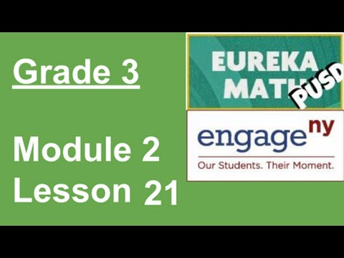
2.21 Estimate sums and differences of measurements by rounding, and then solve mixed word problems.

Slide 83
2.20 Estimate differences by rounding and apply to solve measurement word problems.
Millie’s fish tank holds 403 liters of water. She empties out 185 liters of water to clean the tank. How many liters of water are left in the tank?
Estimate how many liters are left in the tank by rounding. Estimate how many liters are left in the tank by rounding in a different way.
How many liters of water are actually left in the tank?
Is your answer reasonable? Which estimate was closer to the exact answer?
Draw a model, and then use numbers, labels, and a sentence to explain your thinking.

Slide 84

2.20 Estimate differences by rounding and apply to solve measurement word problems.

Slide 85
2.19 Decompose twice to subtract measurements including three-digit minuends with zeros in the tens and ones places.
Jolene brings an apple and an orange with her to school. The weight of both pieces of fruit together is 417 grams. The apple weighs 223 grams. What is the weight of Jolene’s orange?
Draw a model, and then use numbers, labels, and a sentence to explain your thinking.

Slide 86

2.19 Decompose twice to subtract measurements including three-digit minuends with zeros in the tens and ones places.

Slide 87
2.18 Decompose once to subtract measurements including three-digit minuends with zeros in the tens or ones place.
Tara brings 2 bottles of water on her hike. The first bottle has 471 milliliters of water, and the second bottle has 354 milliliters of water. How many milliliters of water does Tara bring on her hike?
Draw a model, and then use numbers, labels, and a sentence to explain your thinking.

Slide 88

2.18 Decompose once to subtract measurements including three-digit minuends with zeros in the tens or ones place.

Slide 89
2.17 Estimate sums by rounding and apply to solve measurement word problems.
The doctor prescribed 175 milliliters of medicine on Monday and 256 milliliters of medicine on Tuesday.
Estimate how much medicine he prescribed in both days.
Precisely how much medicine did he prescribe in both days?
Draw a model, and then use numbers, labels, and a sentence to explain your thinking.

Slide 90
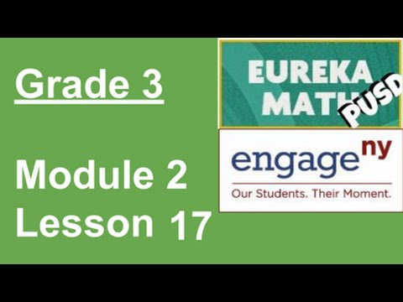
2.17 Estimate sums by rounding and apply to solve measurement word problems.

Slide 91
2.16 Add measurements using the standard algorithm to compose larger units twice.
Josh’s apple weighs 93 grams. His pear weighs 152 grams. What is the total weight of the apple and the pear?
Draw a model, and then use numbers, labels, and a sentence to explain your thinking.

Slide 92

2.16 Add measurements using the standard algorithm to compose larger units twice.

Slide 93
2.15 Add measurements using the standard algorithm to compose larger units once.
Use mental math to solve these problems. Record your strategy for solving each problem.
46 mL + 5 mL
39 cm + 8 cm
125 g + 7 g
108 L + 4 L
Draw a model, and then use numbers, labels, and a sentence to explain your thinking.

Slide 94

2.15 Add measurements using the standard algorithm to compose larger units once.

Slide 95
2.14 Round to the nearest hundred on the vertical number line.
Students model the following on the place value chart:
10 tens
10 hundreds
13 tens
13 hundreds
13 tens and 8 ones
13 hundreds 8 tens 7 ones
Draw a model, and then use numbers, labels, and a sentence to explain your thinking.

Slide 96

2.14 Round to the nearest hundred on the vertical number line.

Slide 97
2.13 Round two- and three- digit numbers to the nearest ten on the vertical number line.
The school ballet recital begins at 12:17 p.m. and ends at 12:45 p.m. How many minutes long is the ballet recital?
Draw a model, and then use numbers, labels, and a sentence to explain your thinking.

Slide 98
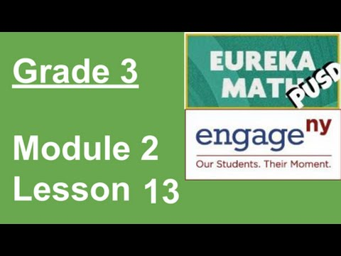
2.13 Round two- and three- digit numbers to the nearest ten on the vertical number line.

Slide 99
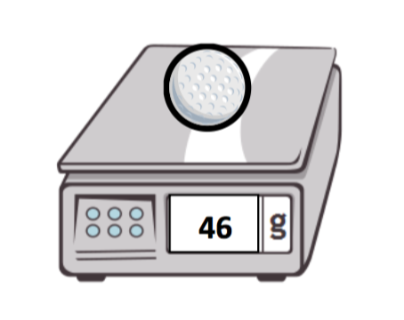
2.12 Round two-digit measurements to the nearest ten on the vertical number line.
The weight of a golf ball is shown below.
The golf ball weighs _________________.
Round the weight of the golf ball to the nearest ten grams. Model your thinking on the number line.
The golf ball weighs about _________________.
Explain how you used the halfway point on the number line to round to the nearest ten grams.
Draw a model, and then use numbers, labels, and a sentence to explain your thinking.

Slide 100

2.12 Round two-digit measurements to the nearest ten on the vertical number line.

Slide 101
2.11 Solve mixed word problems involving all four operations with grams, kilograms, liters, and milliliters given in the same units.
Together a horse and its rider weighs 729 kilograms. The horse weighs 625 kilograms. How much does the rider weigh?
Draw a model, and then use numbers, labels, and a sentence to explain your thinking.

Slide 102

2.11 Solve mixed word problems involving all four operations with grams, kilograms, liters, and milliliters given in the same units.

Slide 103
2.10 Estimate and measure liquid volume in liters and milliliters using the vertical number line.
Subha drinks 4 large glasses of water each day. How many large glasses of water does she drink in 7 days?
Draw a model, and then use numbers, labels, and a sentence to explain your thinking.

Slide 104

2.10 Estimate and measure liquid volume in liters and milliliters using the vertical number line.

Slide 105
2.9 Decompose a liter to reason about the size of 1 liter, 100 milliliters, 10 milliliters, and 1 milliliter.
Morgan fills a 1-liter jar with water from the pond. She uses a 100-milliliter cup to scoop water out of the pond and pour it into the jar. How many times will Morgan scoop water from the pond to fill the jar?
Draw a model, and then use numbers, labels, and a sentence to explain your thinking.

Slide 106
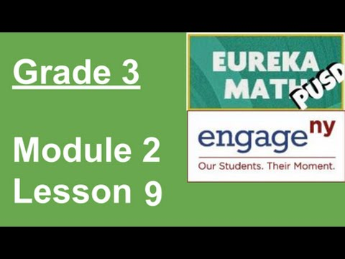
2.9 Decompose a liter to reason about the size of 1 liter, 100 milliliters, 10 milliliters, and 1 milliliter.

Slide 107
2.8 Solve one-step word problems involving metric weights within 100 and estimate to reason about solutions.
Andrea’s dad is 57 kilograms heavier than Andrea. Andrea weighs 34 kilograms.
How much does Andrea’s dad weigh?
How much do Andrea and her dad weigh in total?
Draw a model, and then use numbers, labels, and a sentence to explain your thinking.

Slide 108

2.8 Solve one-step word problems involving metric weights within 100 and estimate to reason about solutions.

Slide 109
2.7 Develop estimation strategies by reasoning about the weight in kilograms of a series of familiar objects to establish mental benchmark measures.
Justin put a 1-kilogram bag of flour on one side of a pan balance. How many 100-gram bags of flour does he need to put on the other pan to balance the scale?
Draw a model, and then use numbers, labels, and a sentence to explain your thinking.

Slide 110
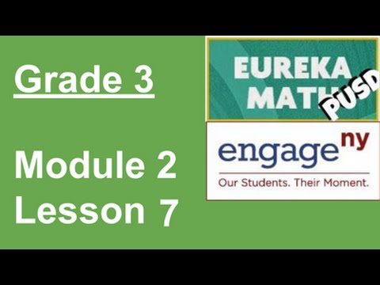
2.7 Develop estimation strategies by reasoning about the weight in kilograms of a series of familiar objects to establish mental benchmark measures.

Slide 111
2.6 Build and decompose a kilogram to reason about the size and weight of 1 kilogram, 100 grams, 10 grams, and 1 gram.
Ten bags of sugar weigh 1 kilogram. How many grams does each bag of sugar weigh?
Draw a model, and then use numbers, labels, and a sentence to explain your thinking.

Slide 112
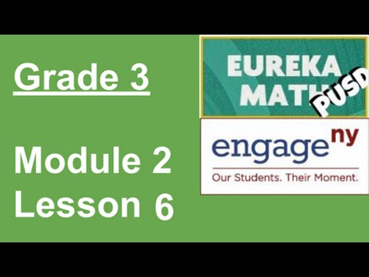
2.6 Build and decompose a kilogram to reason about the size and weight of 1 kilogram, 100 grams, 10 grams, and 1 gram.

Slide 113
2.5 Solve word problems involving time intervals within 1 hour by adding and subtracting on the number line.
Carlos gets to class at 9:08 a.m. He has to write down homework assignments and complete morning work before math begins at 9:30 a.m. How many minutes does Carlos have to complete his tasks before math begins?
Draw a model, and then use numbers, labels, and a sentence to explain your thinking.

Slide 114

2.5 Solve word problems involving time intervals within 1 hour by adding and subtracting on the number line.

Slide 115
2.4 Solve word problems involving time intervals within 1 hour by counting backward and forward using the number line and clock.
Joy’s mom begins walking at 4:12 p.m. She stops at 4:43 p.m. How many minutes does she walk?
Draw a model, and then use numbers, labels, and a sentence to explain your thinking.

Slide 116

2.4 Solve word problems involving time intervals within 1 hour by counting backward and forward using the number line and clock.

Slide 117
2.3 Count by fives and ones on the number line as a strategy to tell time to the nearest minute on the clock.
There are 12 tables in the cafeteria. Five students sit at each of the first 11 tables. Three students sit at the last table. How many students are sitting at the 12 tables in the cafeteria?
Draw a model, and then use numbers, labels, and a sentence to explain your thinking.

Slide 118

2.3 Count by fives and ones on the number line as a strategy to tell time to the nearest minute on the clock.

Slide 119
2.2 Relate skip-counting by 5 on the clock and telling time to a continuous measurement model, the number line.
Christine has 12 math problems for homework. It takes her 5 minutes to complete each problem. How many minutes does it take Christine to finish all 12 problems?
Draw a model, and then use numbers, labels, and a sentence to explain your thinking.

Slide 120

2.2 Relate skip-counting by 5 on the clock and telling time to a continuous measurement model, the number line.

Slide 121
2.1 Explore time as a continuous measurement using a stopwatch.
Ms. Bower helps her kindergartners tie their shoes. It takes her 5 seconds to tie 1 shoe. How many seconds does it take Ms. Bower to tie 8 shoes?
Draw a model, and then use numbers, labels, and a sentence to explain your thinking.

Slide 122
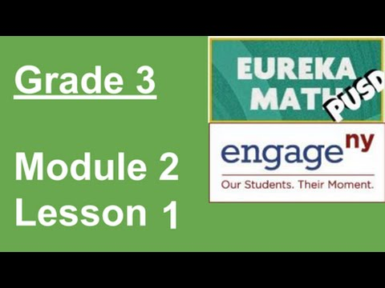
2.1 Explore time as a continuous measurement using a stopwatch.

Slide 123
1.21 Solve two-step word problems involving all four operations and assess the reasonableness of answers.
There are 4 boxes with 6 binders in each one. Three brothers share the binders. How many binders does each brother get?
Draw a model, and then use numbers, labels, and a sentence to explain your thinking.

Slide 124
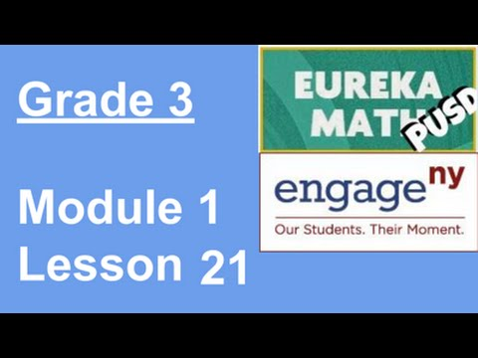
1.21 Solve two-step word problems involving all four operations and assess the reasonableness of answers.

Slide 125
1.20 Solve two step word problems involving multiplication and division and assess the reasonableness of answers.
Red, orange, and blue scarves are on sale for $4 each. Nina buys 2 scarves of each color. How much does she spend altogether?
Draw a model, and then use numbers, labels, and a sentence to explain your thinking.

Slide 126
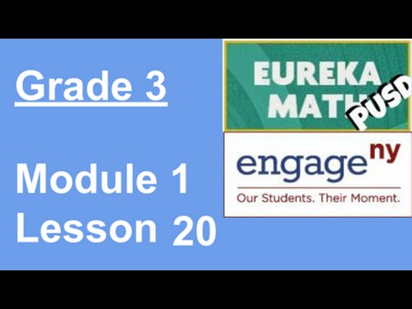
1.20 Solve two step word problems involving multiplication and division and assess the reasonableness of answers.

Slide 127
1.19 Apply the distributive property to decompose units.
Henrietta works in a shoe store. She uses 2 shoelaces to lace each pair of shoes. She has a total of 24 laces. How many pairs of shoes can Henrietta lace?
Draw a model, and then use numbers, labels, and a sentence to explain your thinking.

Slide 128
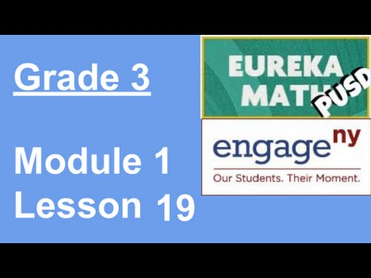
1.19 Apply the distributive property to decompose units.

Slide 129
1.18 Apply the distributive property to decompose units.
A parking structure has 10 levels. There are 3 cars parked on each level. How many cars are parked in the structure?
Draw a model, and then use numbers, labels, and a sentence to explain your thinking.

Slide 130

1.18 Apply the distributive property to decompose units.

Slide 131
1.17 Model the relationship between multiplication and division.
Mrs. Peacock bought 4 packs of yogurt. She had exactly enough to give each of her 24 students 1 yogurt cup. How many yogurt cups are there in 1 pack?
Draw a model, and then use numbers, labels, and a sentence to explain your thinking.

Slide 132

1.17 Model the relationship between multiplication and division.

Slide 133
1.16 Use the distributive property as a strategy to find related multiplication facts.
Cole spends $36 on 3 board games. Each game costs the same amount. Find the cost of each game.
Draw a model, and then use numbers, labels, and a sentence to explain your thinking.

Slide 134

1.16 Use the distributive property as a strategy to find related multiplication facts.

Slide 135
1.15 Relate arrays to tape diagrams to model the commutative property of multiplication.
John spends $44 on 2 video games. Each game costs the same amount. Find the cost of each game.
Draw a model, and then use numbers, labels, and a sentence to explain your thinking.

Slide 136

1.15 Relate arrays to tape diagrams to model the commutative property of multiplication.

Slide 137
1.14 Skip-count objects in models to build fluency with multiplication facts using units of 4.
Mark spends $28 on 4 video games. Each game costs the same amount. Find the cost of each game.
Draw a model, and then use numbers, labels, and a sentence to explain your thinking.

Slide 138

1.14 Skip-count objects in models to build fluency with multiplication facts using units of 4.

Slide 139
1.13 Interpret the quotient as the number of groups or the number of objects in each group using units of 3.
Mark spends $16 on 2 video games. Each game costs the same amount. Find the cost of each game.
Draw a model, and then use numbers, labels, and a sentence to explain your thinking.

Slide 140

1.13 Interpret the quotient as the number of groups or the number of objects in each group using units of 3.

Slide 141
1.12 Interpret the quotient as the number of groups or the number of objects in each group using units of 2.
A baker arranges 5 rows of 4 sugar cookies on a tray. She adds 3 more rows of 4 chocolate chip cookies. How many cookies are there altogether?
Draw a model, and then use numbers, labels, and a sentence to explain your thinking.

Slide 142

1.12 Interpret the quotient as the number of groups or the number of objects in each group using units of 2.

Slide 143
1.11 Model division as the unknown factor in multiplication using arrays and tape diagrams.
A chef arranges 4 rows of 3 red peppers on a tray. He adds 2 more rows of 3 yellow peppers. How many peppers are there altogether?
Draw a model, and then use numbers, labels, and a sentence to explain your thinking.

Slide 144

1.11 Model division as the unknown factor in multiplication using arrays and tape diagrams.

Slide 145
1.10 Model the distributive property with arrays to decompose units as a strategy to multiply.
72 students go to the school. There are exactly 9 students in each classroom. How many classrooms are there?
Draw a model, and then use numbers, labels, and a sentence to explain your thinking.

Slide 146

1.10 Model the distributive property with arrays to decompose units as a strategy to multiply.

Slide 147
1.9 Find related multiplication facts by adding and subtracting equal groups in array models.
81 grapes are in a bag. There are 9 grapes on each bunch. How many bunches of grapes are in the bag?
Draw a model, and then use numbers, labels, and a sentence to explain your thinking.

Slide 148

1.9 Find related multiplication facts by adding and subtracting equal groups in array models.

Slide 149
1.8 Demonstrate the commutativity of multiplication and practice related facts by skip-counting objects in array models.
64 children play a game. There are 8 children on each team. How many teams play the game?
Draw a model, and then use numbers, labels, and a sentence to explain your thinking.

Slide 150

1.8 Demonstrate the commutativity of multiplication and practice related facts by skip-counting objects in array models.

Slide 151
1.7 Demonstrate the commutativity of multiplication and practice related facts by skip-counting in array models.
56 children play a game. There are 8 children on each team. How many teams play the game?
Draw a model, and then use numbers, labels, and a sentence to explain your thinking.

Slide 152

1.7 Demonstrate the commutativity of multiplication and practice related facts by skip-counting in array models.

Slide 153
1.6 Interpret the unknown in division using the array model.
28 children play a game. There are 7 children on each team. How many teams play the game?
Draw a model, and then use numbers, labels, and a sentence to explain your thinking.

Slide 154

1.6 Interpret the unknown in division using the array model.

Slide 155
1.5 Understand the meaning of the unknown as the number of groups in division
20 children play a game. There are 5 children on each team. How many teams play the game?
Draw a model, and then use numbers, labels, and a sentence to explain your thinking.

Slide 156

1.5 Understand the meaning of the unknown as the number of groups in division

Slide 157
1.4 Understand the meaning of the unknown as the size of the group in division.
Next weekend, my friend Cynthia is having a party. 18 people are coming. I told her I’d help her set-up tables. We know that 6 people can sit at each table. How many tables do we need?
Draw a model, and then use numbers, labels, and a sentence to explain your thinking.

Slide 158

1.4 Understand the meaning of the unknown as the size of the group in division.

Slide 159
1.3 Interpret the meaning of factors-the size of the group or the number of groups.
In Trevor’s classroom, he has 6 caddies with 8 pencils in each one. How many pencils are there?
Draw a model, and then use numbers, labels, and a sentence to explain your thinking.

Slide 160

1.3 Interpret the meaning of factors-the size of the group or the number of groups.

Slide 161
1.2 Relate multiplication to the array model.
Jordan uses 3 lemons to make 1 pitcher of lemonade. He makes 4 pitchers. How many lemons does he use altogether?
Draw a model, and then use numbers, labels, and a sentence to explain your thinking.

Slide 162

1.2 Relate multiplication to the array model.

Slide 163
1.1 Understand equal groups of multiplication.
12 students stand in front of the class and raise both of their arms to skip count them by 2’s.
Draw a model, and then use numbers, labels, and a sentence to explain your thinking.

Slide 164

1.1 Understand equal groups of multiplication.

