Slide 1
Add & Subtract Decimals Numberless Word Problems
Student Numberless Word Problems Recording Sheet

Slide 2

Read the numberless word problem. Determine what operation you will need to do to solve the problem. Some of them may need more than one operation. Then move to the next slide & solve before checking your final answer.
Nate has $30.50. He wants to buy his dog a sweater that costs $15, a toy that costs $3.79, and a leash that costs $14.79. How much more money does he need?

Slide 3
Read the numberless word problem. Determine what operation you will need to do to solve the problem. Some of them may need more than one operation. Then move to the next slide & solve before checking your final answer.
Nate has $30.50. He wants to buy his dog a sweater that costs $15, a toy that costs $3.79, and a leash that costs $14.79. How much more money does he need?

Slide 4
He needs $3.08.
Answer

Slide 5
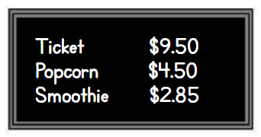
Read the numberless word problem. Determine what operation you will need to do to solve the problem. Some of them may need more than one operation. Then move to the next slide & solve before checking your final answer.
Luz Maria has $15. She buys a ticket to a movie and a smoothie. How much money does she have left?

Slide 6
Read the numberless word problem. Determine what operation you will need to do to solve the problem. Some of them may need more than one operation. Then move to the next slide & solve before checking your final answer.
Luz Maria has $15. She buys a ticket to a movie and a smoothie. How much money does she have left?

Slide 7
Answer
She has $2.65 left.

Slide 8
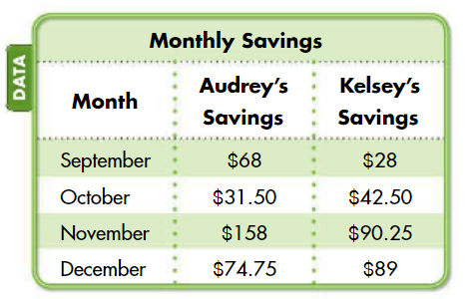
Read the numberless word problem. Determine what operation you will need to do to solve the problem. Some of them may need more than one operation. Then move to the next slide & solve before checking your final answer.
Audrey is saving for a school trip. She needs $180 for the bus ticket, $215 for the hotel, and $80 for meals. The table shows how much money she and her sister Kelsey have saved over a 4-month period.
How much more money does Audrey
need for the trip?

Slide 9
Read the numberless word problem. Determine what operation you will need to do to solve the problem. Some of them may need more than one operation. Then move to the next slide & solve before checking your final answer.
Audrey is saving for a school trip. She needs $180 for the bus ticket, $215 for the hotel, and $80 for meals. The table shows how much money she and her sister Kelsey have saved over a 4-month period.
How much more money does Audrey
need for the trip?

Slide 10
Answer
She needs $142.75.

Slide 11

Read the numberless word problem. Determine what operation you will need to do to solve the problem. Some of them may need more than one operation. Then move to the next slide & solve before checking your final answer.
Jeffrey earned $65 doing yard work. He bought a pair of jeans for $31.25 and a sweatshirt for $16.50. He set aside the money left from his shopping trip to buy a gift for his cousin. How much money did he set aside for the gift?

Slide 12
Read the numberless word problem. Determine what operation you will need to do to solve the problem. Some of them may need more than one operation. Then move to the next slide & solve before checking your final answer.
Jeffrey earned $65 doing yard work. He bought a pair of jeans for $31.25 and a sweatshirt for $16.50. He set aside the money left from his shopping trip to buy a gift for his cousin. How much money did he set aside for the gift?

Slide 13
Answer
He has $17.25 left.

Slide 14
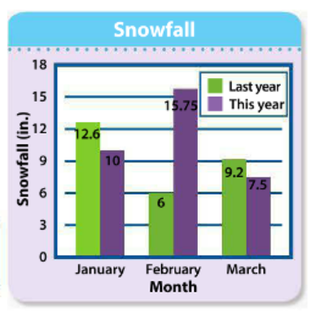
Read the numberless word problem. Determine what operation you will need to do to solve the problem. Some of them may need more than one operation. Then move to the next slide & solve before checking your final answer.
The total snowfall for the last year was 36.4 inches. The graph shows snowfalls for the 3 months last year and for the same 3 months this year. Find how much greater this year’s 3-month snowfall was than last year’s.

Slide 15
Read the numberless word problem. Determine what operation you will need to do to solve the problem. Some of them may need more than one operation. Then move to the next slide & solve before checking your final answer.
The total snowfall for the last year was 36.4 inches. The graph shows snowfalls for the 3 months last year and for the same 3 months this year. Find how much greater this year’s 3-month snowfall was than last year’s.

Slide 16
This year is 4.15 inches more.
Answer

