Slide 1
1st Grade
Storytelling/Recreation
Unit

Slide 2
Kid Friendly Objectives:
I will…
Name the appropriate season to create na’at[’o’ designs.
Associate na’at[’o’ to the appropriate season.

Slide 3
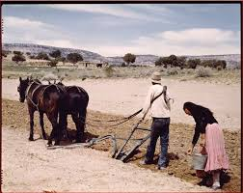
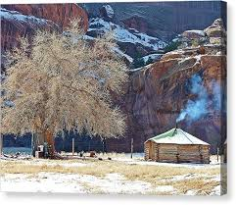
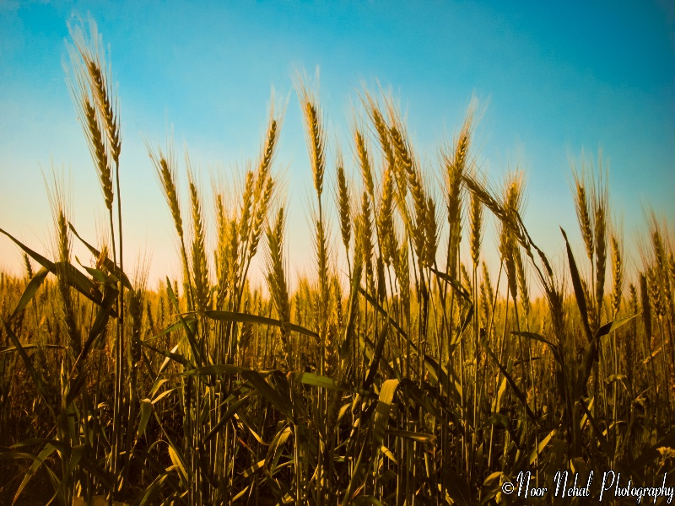
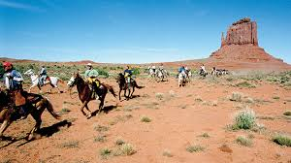
Name the appropriate season to create na’at[’o’ designs.
Daan - Spring
The Seasons
of the Navajo People
Aak’eeh – Harvesting
Hai – Winter Stories
Daan – Planting
Sh9 – Outdoor Activities
Hai - Winter
Sh9 - Summer
Aak’eeh - Autumn

Slide 4
Name the appropriate season to create na’at[’o’ designs.
The Seasons
of the Navajo People
Name the season
with the correct picture:
Aak’eeh
Hai
Daan
Sh9

Slide 5
Name the appropriate season to create na’at[’o’ designs.
What occurs in each season?
Aak’eeh -
Hai -
Daan -
Sh9 -

Slide 6
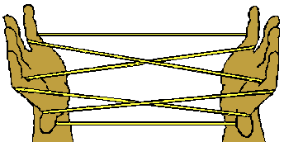
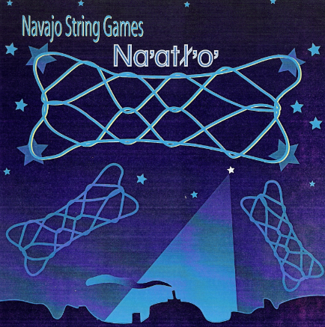
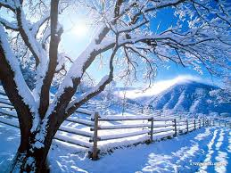
Associate na’at[’o’ to the appropriate season.
A Winter Game created by our Diyin Dine’4, Spider People.
The string is the web of the Spider. The string is to be taken
care of and not missed used. The string is put away properly
when the winter season ends.

Slide 7
Associate na’at[’o’ to the appropriate season.
What Diyin Dine’4 Created String game? __________________________________
In what Season was this particular game played?__________________________
What does the string represent?___________________________________________

