Slide 1
1st Grade
Weaving unit
I will Identify and name weaving tools.

Slide 2

Vocabulary
Dahyist[‘=h-(Loom)
Nanoolzhee’-(Warp)
Bee’adzo7-(Weaving Comb)
Bee ak’7n7lt[ish-(Batten)
Ii’sinil-( Heddle rods)

Slide 3
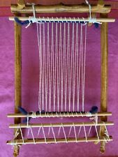
Dahyiist[‘=
Loom

Slide 4
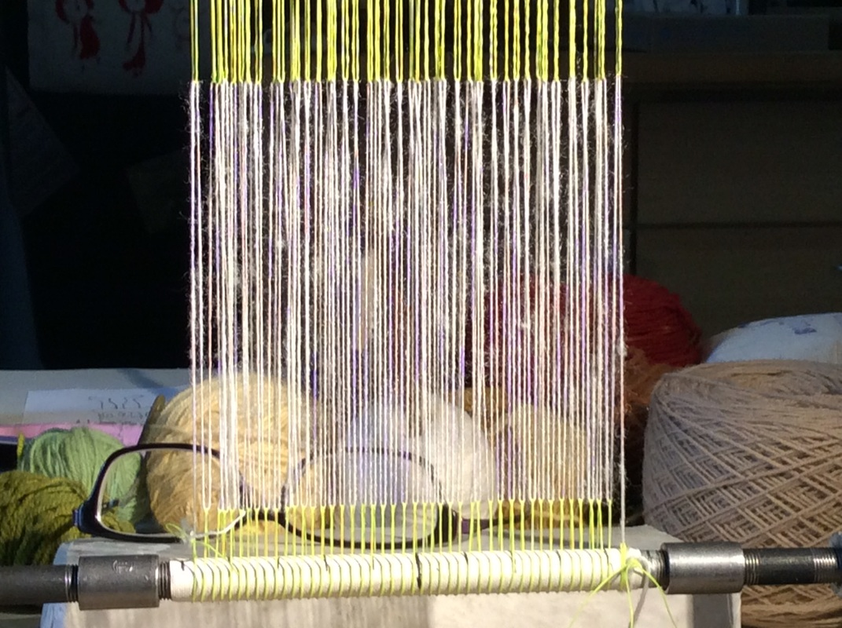
Nanoolzhee’
Warp

Slide 5
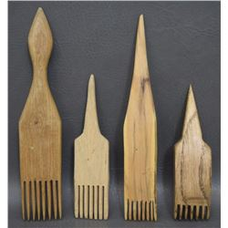
Bee’adzoo’7
Weaving comb

Slide 6
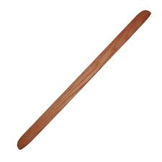
Bee’ak’7n7lt[ish
Batten

Slide 7
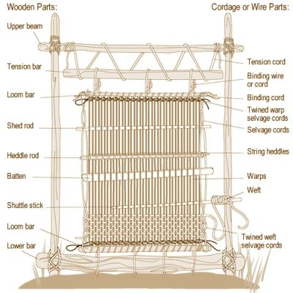
Ii’sinil
Heddle rods

