Slide 1

K’4 Clans
1st Grade

Slide 2
Kid Friendly Objective:
I will identify, name and verbally introduce self, using maternal and paternal clans.
I will introduce family kinship.

Slide 3

Shim1
Maternal Clan
Shizh4’4
Paternal
Clan

Slide 4
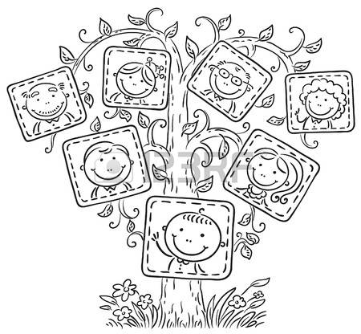
Family Tree
Shim1
Maternal Clan
Shizh4’4
Paternal
Clan

Slide 5
Kid Friendly Objective:
I will identify, name and verbally introduce self, using maternal and paternal clans.
I will introduce family kinship.
Y1’1t’44h
Sh7 ‘47 ___________ yinishy4.
_________________ nish[9.
_________________ b1sh7shch99n.

Slide 6
