Slide 1
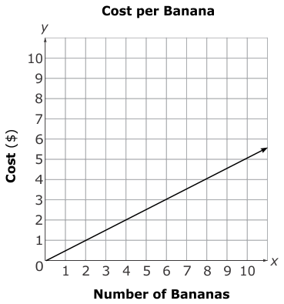
Be Rational!
What is the slope of the line?

Slide 2
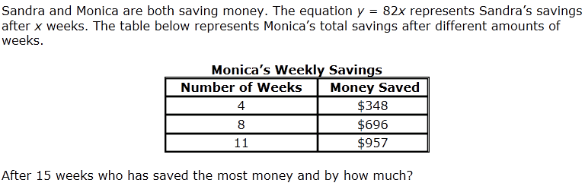
Extreme Exponents and Radical Radicals
***Please show work to receive credit.

Slide 3
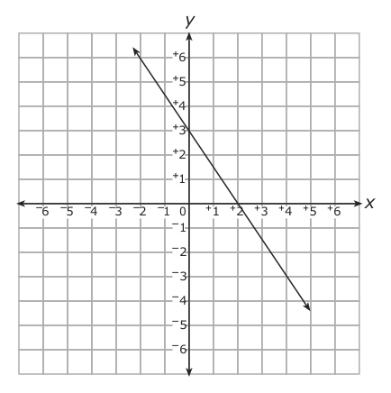
Scientific Notation
What is the equation of the line graphed below?

Slide 4
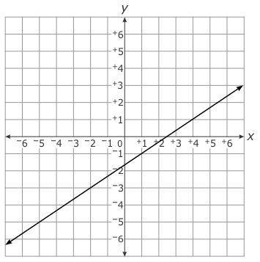
Slippery Slope
What is the equation of the line graphed below?

Slide 5
Balance those Equations
Research shows that the number of years of college education that a person earns, x, the higher that person’s salary will be, y. Using the linear model y = 5,000x + 20,000, what is the value of the y-intercept and what does the y-intercept represent?

Slide 6
Two Variable Problems
What is (3⁻²) (9⁻¹) (3³)?
Write your answer in exponential form.

Slide 7
Funky Functions
The volume of a cube is 64 cm³. What is the length of one side of the cube?

Slide 8
Modeling Relationships
What is the value of n in the equation
n² = 4/25 ?

Slide 9
Graph This!
Write your answer in standard form.
(8 x 10²)(12)

Slide 10
Transforming Transformations
Write an equation of a line that has a slope of 1.5 and passes through the points (-8, -9).
***Please show work to receive credit.

Slide 11
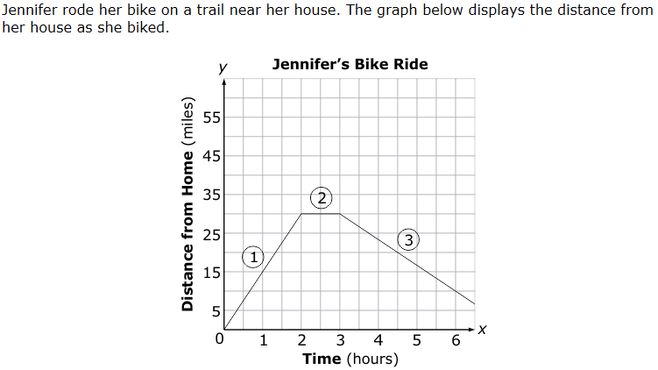
Geometry Gems
Which statement is true?
Jennifer biked up a steep hill in section 1.
Jennifer biked back to her house in section 3.
Jennifer biked at a constant rate in section 2.
Jennifer biked at the same rate to and from her home.

Slide 12
Pythagorean Theorem
What is the value of (4.6 × 10⁵)(5.2 × 10^{–2})?

Slide 13
Formula, Formula, Formula
The speed of light is about 3.0 x 10⁸ meters per second. The speed of sound at sea level is about 3.0 x 10² meters per second. About how many times faster is the speed of light than sound?
***Please show work to receive credit.

Slide 14
Scatterbrained
What is the solution to the equation 8 – 7(4x – 2) = -28x + 6
***Please show work to receive credit.

Slide 15
Data, Data, Data
The graph below displays the value of a computer after so many years.
What is the approximate volume of a cone with height 10 cm and radius 4 cm?

Slide 16
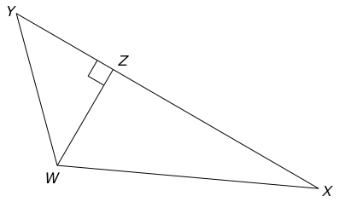
BONUS
In triangle WXY below, XY measures 16 cm, YZ measures 4 cm, and WX measures 13 cm.
What is the area of triangle WXY? Please show work to receive credit.

