Slide 1
Sexual Health Education Workgroup
Meeting #2
August 27, 2019
9 am – 12 pm
Office of Superintendent of Public Instruction
Chris Reykdal, State Superintendent

Slide 2
Welcome/Introductions
Who’s in the Virtual Room? Name, Organization, 1-3 words to describe your thoughts since our first meeting
3 School District Representatives (WSSDA)
3 School Principals (AWSP)
3 Public School Health Educators (WEA)
3 Public Health Officials, 1 State & 2 Local (DOH)
3 Parents
Superintendent of Public Instruction/Designee

Slide 3

Group Agreements
Respectful Listening
Assume Positive Intent
Step Up, Step Back
Speak Your Truth
Seek to Understand

Slide 4
Welcome/Overview of Tasks - ESHB 1109, Sec. 501 (3)(h)
Review provisions related to sexual health education in the 2016 Health Education K-12 Learning Standards
Review existing sexual health education curricula in use in the state for the purpose of identifying gaps or potential inconsistencies with the learning standards
Review data

Slide 5
Welcome/Overview of Tasks
Consider revisions to sexual health provisions in statute
Consider the merits and challenges associated with requiring all schools to offer comprehensive sexual health education to students in all grades by September 1, 2022
Submit report to the Legislature, State Board of Education and DOH by Dec. 1, 2019

Slide 6
Timeline
Meeting #1 – Statutes, Data, Research Reviews
Meeting #2 – Standards, Youth Voice
Meeting #3 – Curricula, District Successes & Challenges
Meeting #4 – Gaps and Equity Issues, Merits and Challenges Summary, Findings/Recommendations
Oct. 15 – Draft report to OSPI Cabinet
Dec. 1 – Report to Legislature, DOH, State Board of Health

Slide 7
Agenda Highlights
Agenda:
Health Education Standards/Grade-level Outcomes
Youth Voice:
  HYS and WYSH Survey Results
  LYAC Presentation
  Youth Online Public Comments
Public Comments Report

Slide 8
Health Education K-12 Learning Standards
1. Comprehend concepts related to health promotion and disease prevention to enhance health.
2. Analyze the influence of family, peers, culture, media, technology, and other factors on health behaviors.
3. Demonstrate the ability to access valid information and products and services to enhance health.
4. Demonstrate the ability to use interpersonal communication skills to enhance health and avoid or reduce health risks.
5. Demonstrate the ability to use decision-making skills to enhance health.
6. Demonstrate the ability to use goal-setting skills to enhance health.
7. Demonstrate the ability to practice health-enhancing behaviors and avoid or reduce health risks.
8. Demonstrate the ability to advocate for personal, family, and community health.
Notes:
Marissa
1 – knowledge 2-8 – Skill-building
Not topic specific

Slide 9
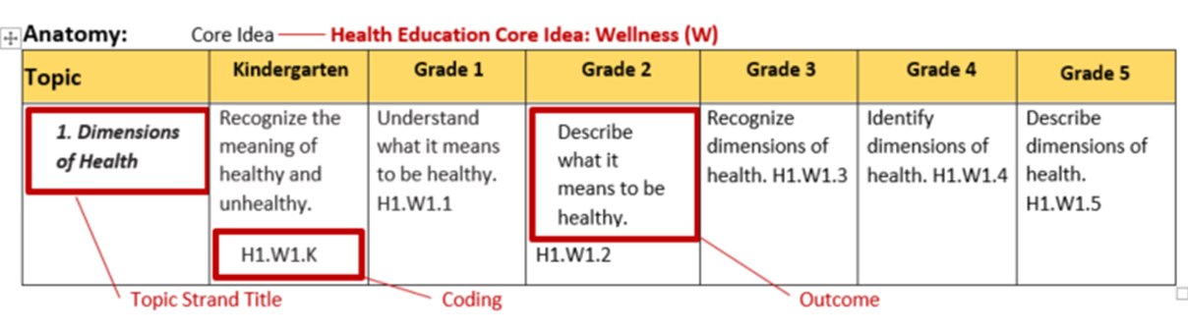
Format and Outcomes
1. Dimensions of Health
Describe what it means to be healthy.
1. Dimensions of Health
Describe what it means to be healthy.
H1.W1.K
H1.W1.K
Notes:
Lisa
Anatomy of a topic strand and outcome

Slide 10
Health Education Core Ideas
1. Wellness (W)
2. Safety (Sa)
3. Nutrition (N)
4. Sexual Health (Se)
5. Social Emotional Health (So)
6. Substance Use and Abuse (Su)

Slide 11
Health Education Standards:
Sexual Health Education Topic Strands
Anatomy, Reproduction and Pregnancy
Puberty and Development
Self-Identity
HIV Prevention (K-5)
Prevention (6-12)
Healthy Relationships
WA State Laws (6-12)
Notes:
Prevention – STDs, contraceptives

Slide 12
Sexual Health Education Grade Level Outcomes – Key Points
Optional and Flexible!
Best Practice
Healthy Youth Act & 2005 Guidelines
State & federal equity & civil rights laws
Notes:
To reiterate key points related to the Grade Level outcomes for sexual health:
Because sexual health education is optional in WA, the grade-level outcomes are also optional
They are also flexible – they can and should be modified to reflect district policies, as well as community and classroom needs
They reflect best practice, as defined in peer-reviewed, professional research, Centers for Disease Control guidelines, recommendations from organizations such as the American Academy of Pediatrics, and the national sexuality education standards.
They are based closely on state laws – not only the Healthy Youth Act, but also state and federal equity and civil rights laws.

Slide 13
Health Education Standards & Grade Level Outcomes – Resources
Definitions & Requirements
FAQ Document – geared to administrators
Talking Points – geared to parents & community
Professional Learning
Notes:
OSPI has developed a number of resources, including professional learning opportunities, to assist districts in understanding and implementing new standards – many are found on our Health and Physical Education Standards webpage, as shown earlier.

Slide 14
Sexual Health Education Grade Level Outcomes – Resources
HIV/Sexual Health Website
Non-fiction Texts
FAQ – HYA/AOA
Guidance Document – for teachers
Notes:
To support the provision of sexual health education, we have resources on our website, including an extensive list of non-fiction texts and picture books, organized according to the topic strands in the sexual health outcomes. We also provide a frequently asked questions document that covers legislative requirements. And we’re in the process of developing a Sexual Health Education Guidance Document to provide further information for teachers on what exemplary sexual health education might look like in the classroom and how to provide it.

Slide 15
HIV Youth Data (DOH)
New HIV Diagnoses among Youth aged 13-19, WA State, 2018
Year | Case Count | Percentage of total Cases
2014 | 10 | 2.7
2015 | 12 | 3.0
2016 | 10 | 2.7
2017 | 10 | 2.7
2018 | n/a | n/a
n/a Count, and percentage derived from count, is suppressed due to small number
New HIV Diagnoses among Youth aged 13-21, WA State, 2018
Year | Case Count | Percentage of total Cases
2014 | 27 | 7.3
2015 | 26 | 6.5
2016 | 28 | 7.6
2017 | 25 | 6.8
2018 | 23 | 5.7

Slide 16
Youth Voice Survey Data
Sexual Health Education
Bullying/Harassment based on Sexual Orientation
Sexual Behavior
Sexual Violence

Slide 17
Youth Voice Survey Data
What are your 3 takeaways from looking at this data?
What opportunities are there to address the needs of youth?
What thoughts about sexual health education were confirmed during this presentation?
Other thoughts?

Slide 18

Sexual Health Education
43.5% of 12th graders say they have received sexual health education that discusses abstinence, STD, and pregnancy prevention.

Slide 19
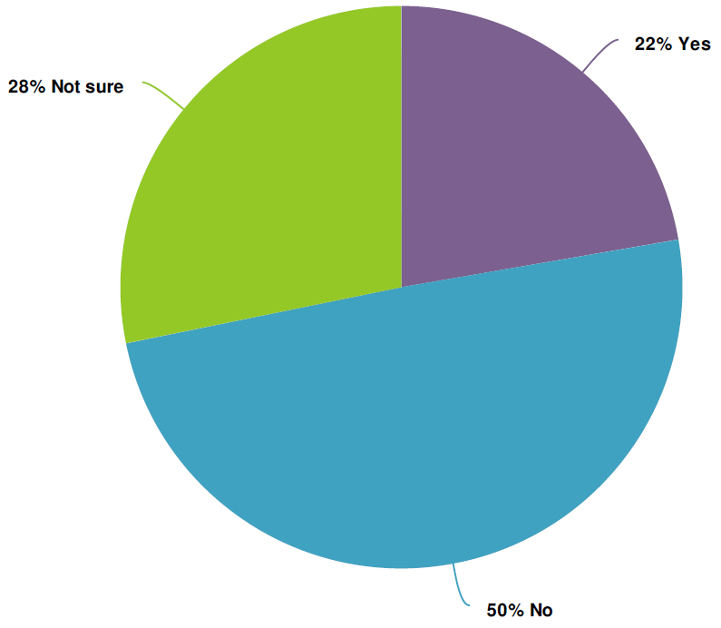
WYSH – Statewide
Of those who took the WYSH survey, only 22% of youth said they received the sexual health education that they needed or wanted
21% of youth said they first learned about sexual topics from pornography
20% of youth said they could not talk to a trusted adult about their sexual health, another 21% said they are not sure

Slide 20
WYSH Survey

Slide 21

Harassment | Perceived Sexual Orientation
In 2014, 2016, and 2018 rates of students being harassed for their perceived sexual orientation have remained consistent:
    12% for 8th graders
    9% for 10th graders
    7% for 12th graders

Slide 22
Sexual Behavior

Slide 23
Sexual Behavior
Over 3% of 12th graders, 4.5% of 10th graders, and 4% of 8th graders indicated that their first age of sex was 12 and younger.

Slide 24
Sexual Assault Prevalence | 2014-2108 Trend

Slide 25
Sexual Assault Prevalence, cont’d.
In the 2018 administration of the Healthy Youth Survey:
    24.6% of 8th graders
    31.1% of 10th graders
    and 31.4% of 12th graders
    witnessed a peer force themselves sexually on another person.

Slide 26
Youth Voice Survey Data
What are your 3 takeaways from looking at this data?
What opportunities are there to address the needs of youth?
What thoughts about sexual health education were confirmed during this presentation?
Other thoughts?

Slide 27
Legislative Youth Advisory Council (LYAC)
Established in 2005
22 members ages 14-18
  Get involved with Washington state government
  Learn and experience the legislative process
  Voice opinions regarding issues of importance to youth
  Become more politically aware
  Become engaged in the civic process
  Make a difference!
Office of the Lieutenant Governor/OSPI

Slide 28
Youth Voice - LYAC
How well are we meeting student needs?
What, if anything, needs to change re: SHE?
What opportunities exist re: SHE?
What challenges exist re: SHE?

Slide 29
Public Comments
What questions do you have after reading comments from the public comment survey?
What thoughts do you have? (Tentative conclusions, discussion points for future meetings, etc.)

Slide 30
Public Comments
How would survey data be most useful?
  Continue to provide weekly reports of comments
  Provide demographic reports also
  Provide summaries of main themes

Slide 31
Next Steps
Meeting #3 – Sept. 12 – Virtual (Zoom)
Curricula – what are districts using currently?
Profiles Data – what SHE topics are schools teaching?
Successes and Challenges – Case Examples
Public Comments – review of survey results

Slide 32

Closure
Any final comments or questions?

