Slide 1
Career Survey
Please complete the career survey. Final exams will not be opened until I have received your completed survey
“The General Assembly of Georgia enacted the BRIDGE Law (House Bill 400) on May 20, 2010. This law was passed to ensure that Georgia’s 6th - 12th grade students were made aware of available college and career options.”
https://www.gadoe.org/Curriculum-Instruction-andAssessment/CTAE/Documents/BRIDGE-separate-card.pdf

Slide 2
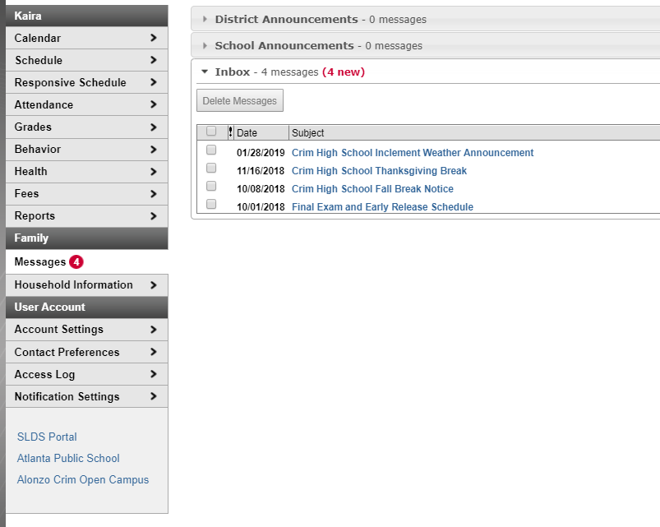
Log into my backpack Using
Username: Network ID
Password: Lunch Number
Log Into Infinite Campus
Click on SLDS Portal

Slide 3
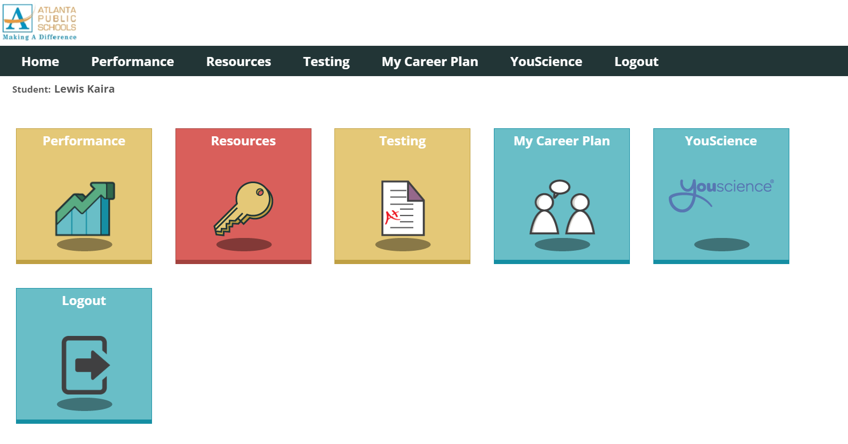
Once in the SLDS Portal
My Career Plan will be Displayed
Click on “My Career Plan”

Slide 4
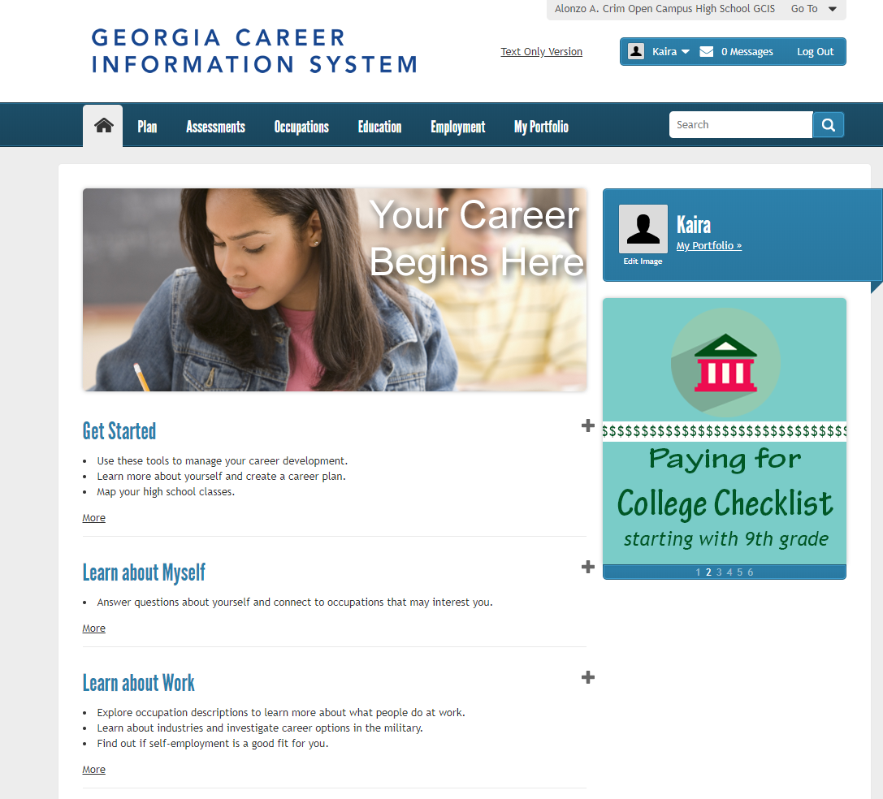
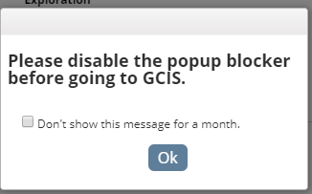
Click on GCIS
Disable your pop up blockers

Slide 5
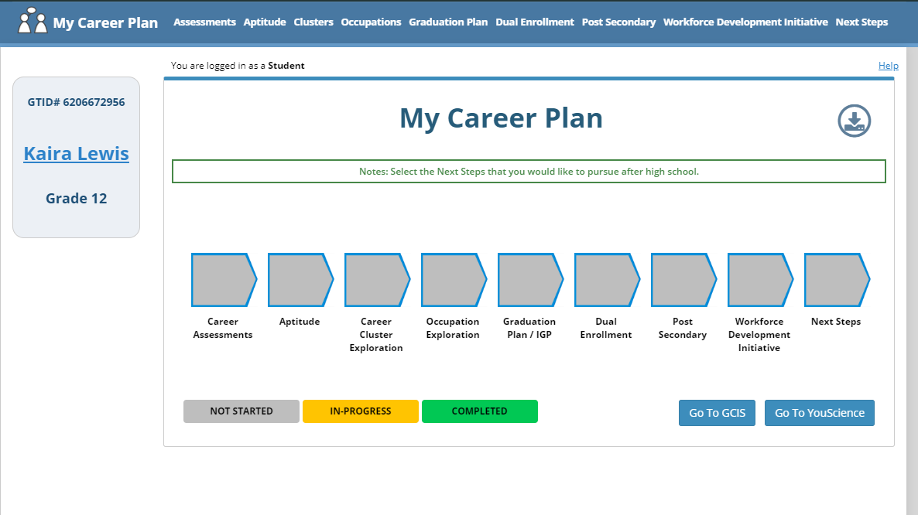
You should see a summary of your activities

Slide 6
Seniors
1. Click on Graduation/IGP Plan and Update it
2. Complete the senior survey https://bit.ly/2KSfSoU

Slide 7
Juniors
1. SAVE 3 choices of post secondary options in your career profile.
2. Research at least one additional workforce development initiative.
3. Update your Graduation plan/IGP

Slide 8
Sophomores
1. complete a career interest and aptitude Survey
2. Review and Revise your Graduation Plan/IGP

Slide 9
Freshmen
1. Explore at least 3 Careers and save those 3 Results in their Profile.
2. Review, Revise your Graduation Plan, IGP

Slide 10

Final exams will not be opened until I have received your completed activities.
Feel free to take a picture of your completed activities and send them to me.
Ayanna.echols@atlanta.k12.ga.us

