Slide 1
Standardized Testing

Slide 2
What are the Standardized Tests?
PSAT - 10th and 11th grade
SAT - spring of 11th grade and fall of 12th grade
ACT- spring of 11th grade and fall of 12th grade
TOEFL - Test of English as a Foreign Language
MCAS - ELA, Math, and Science

Slide 3
Why Do FHS Students Take Them?
MCAS:
State graduation requirement
There can be scholarship opportunities
PSAT:
Practice test for the SAT
SAT or ACT:
College admissions requirement for most 4 year colleges / universities
TOEFL:
Some colleges / universities require for students whose first language is not English

Slide 4
Mental preparation to deal with test anxiety.
Before the exam you can do several things.
Begin your review/practice process early. This reduces last minute anxiety.
Arrive at the exam location early. Tardiness only causes more stress! Relax and don’t talk about the test with friends or other students- frantic review is often more confusing than helpful. Also, do not sit near anyone who seems anxious, as it will only serve to make you more anxious

Slide 5
Practice as a way to Prepare
Free Practice SAT or ACT
https://www.powerscore.com/sat/help/content_practice_tests.cfm
MCAS Practice Questions
http://www.doe.mass.edu/mcas/testadmin/practice/

Slide 6
Be test-wise and have a plan for taking a test.
Some initial tension is normal. Generally when you receive a test, stop for a moment, take several deep breaths, relax, and then start reviewing direction and test items.
In a timed test, make a schedule for answering questions. Allow more time for a higher point question. Pace yourself to get as many questions as possible answered. Knowing how well you are progressing will eliminate anxiety over whether or not you will finish the exam.

Slide 7
Be test-wise and have a plan for taking a test [cont.]
Don’t speed too much time on any question. If you can’t come up with the answer, move on. You can always come back if you have time. Higher scores will usually result from trying all items.
If you get stumped on a question or series of questions, move on to questions you can answer. This will get your mental process and concentration ready for more difficult questions

Slide 8
Relaxation Techniques
Go for a walk. Allow adequate time prior to the exam to go for walk. Clear your mind as you walk and enjoy the sense of relaxation.
Avoid discussing the test with anyone- especially fellow classmates as that only serves to fuel anxiety.
Take a series of 10 deep breaths, holding each breath for 10 seconds. Slowly release your breath.
While sitting or lying down, tense all the muscles in your body. Hold the tension for several seconds. Release, let your muscles relax completely. Repeat, as needed until you’re feeling feel less anxious and have a deeper sense of relaxation.
Stretch. Stretching your muscles invigorates the body and is a great pick-me-up, especially if you are groggy

Slide 9
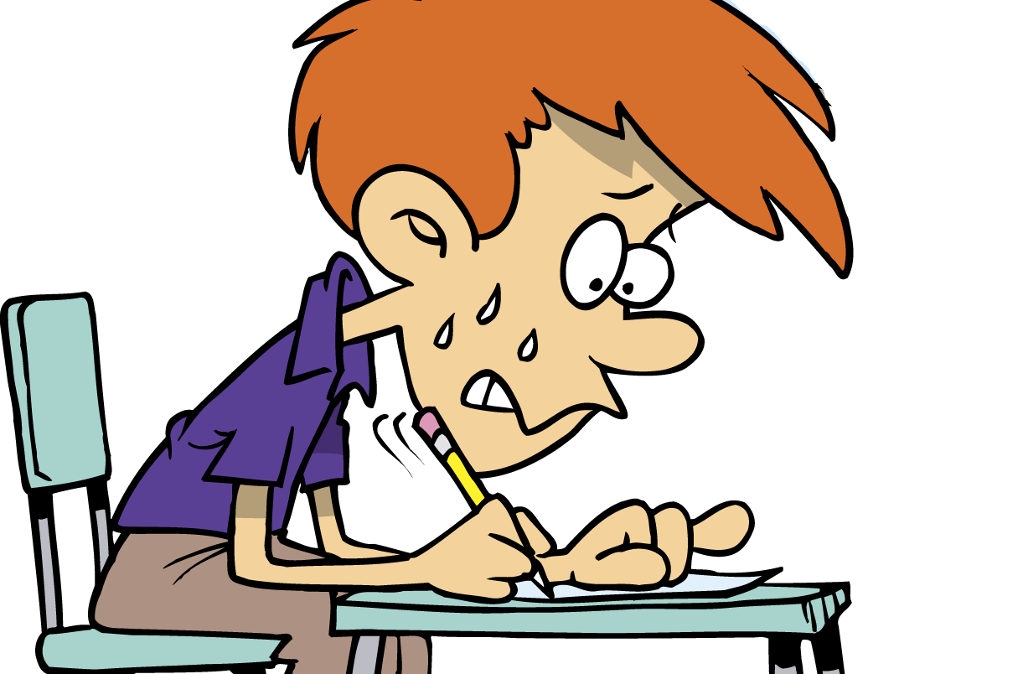
Video - Managing Test Stress (click to view)

Slide 10
Click to View
Test Relaxation Meditation

