Slide 1



Hang on Tight
We are going for a technology ride!
QUICK TIP: After you click on a file folder, click anywhere on file folder to open it up and look inside.
Click on a FILE CABINET HANDLE to open it. Check out some great HOW TO VIDEOS for all your tech needs!
Watch this short video to learn how to make Ms.Caramico
STOP TALKING!

Slide 2

Technology 101
Click on a file folder to pull it out of the drawer and see what's inside.
Topic A: Split Your Screen
Topic B: Take a Screenshot
Topic C: Copy, Cut & Paste
Topic D: Make & Use a Hyperlink
Notes:
Click on a file folder to pull it out of the drawer and see what's inside.

Slide 3
How to Split Your Screen for Students

Slide 4
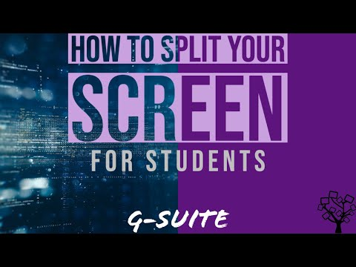
How to Split Your Screen
Chrome Extension -Dualless
Q.) Why would I need this?
A.) This is a great feature to use when you need to work on more than one screen at a time. For example, when you're on a zoom call meeting and need to pull up something your teacher is talking about.
Notes:
This is a great feature to use and you need to work on more than one screen at one time. Like when you're on a zoom call meeting and need to pull up something your teacher is talking about.

Slide 5
How to Take a Screenshot

Slide 6
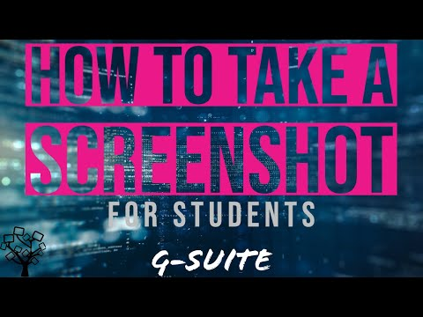
How to Take a Screenshot
Q.) Why would I need this?
A.) Screenshots are a great way to show someone else what you are seeing on your computer screen. This helps when you want to show someone how to find something or even ask someone for help finding something on your screen.
Notes:
Why would I need this? Screenshots are great way to show someone else what you are seeing on your computer screen. This helps when you want to show someone how to find something or even ask someone for help finding something on a page.

Slide 7
How to Quickly Copy, Cut & Paste

Slide 8
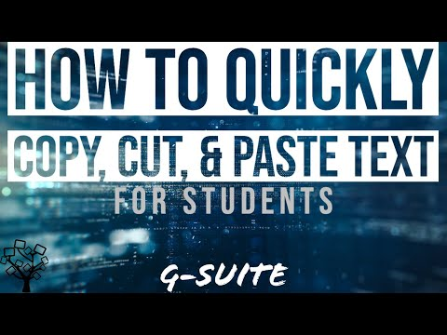
How to Quickly Copy, Cut & Paste
Q.)Why would I need this?
A.)In the fifth grade it's really important to cite text correctly. The best way to do this is to find quick ways to copy, cut and paste.
Notes:
Why would I need this? In the fifth grade it's really important to cite text correctly. the best way to do this is to find quick ways to copy cut and paste.

Slide 9
How to Make and Use a Hyperlink

Slide 10

How to Make and Use a Hyperlink
Q.) Why would I need this?
A.) Your teachers will use hyperlinks to help you quickly find websites, slides, or videos that are helpful to you. You can also use hyperlinks to quickly find and share these things with your teacher for an assignment.
Notes:
Why would I need this? Your teachers will use hyperlinks to help you guys quickly find websites or web pages that are important or helpful to you. You can also use hyperlinks to quickly find important web pages or websites for yourself or to share with your teacher for an assignment.

Slide 11
Google 101
Click on a file folder to pull it out of the drawer and see what's inside.
Topic E: Use Google Classroom
Topic F: Send an Email
Topic G: Customize Google Slides
Topic H:

Slide 12
How to Use Google Classroom

Slide 13

How to Use Google Classroom
Legendary’s Google Classroom Codes:
Math: PRIVATE
ELA: PRIVATE
Science: PRIVATE
Soc.St.: PRIVATE

Slide 14
How to Write an Email

Slide 15
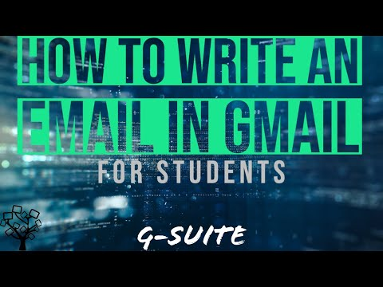
How to Write an Email
Q.) Why would I need this?
A.) It's important in 5th grade to use self help skills like writing an email to ask questions, share information, and get the help that you need.
Notes:
Why would I need this? It's important in 5th grade to use self help skills like writing an email to ask questions, share information, and get the help that you need.

Slide 16
How to Customize Google Slides

Slide 17
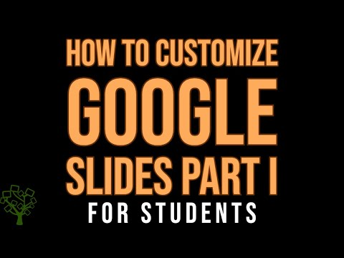
How to Customize Google Slides Pt.1
Q.) Why would I need this?
A.) Well duh, because Google slides are fun! This, How to Videos File Cabinet, was made on a Google Slide just like the Team Legendary Scavenger Hunt. It’s much more fun than a simple black and white google doc.
Notes:
Why would I need this? Well duh, because Google slides are fun! This how to videos file cabinet was made on a Google Slides just like the team legendary scavenger hunt.

Slide 18
Add a title here.

Slide 19
How to Customize Google Slides Pt.2

Slide 20
Coming Soon
Click on a file folder to pull it out of the drawer and see what's inside.
Topic I:
Topic J:
Topic K:
Topic L:

Slide 21
Add a title here.

Slide 22
Here goes your title

Slide 23
Add a title here.

Slide 24
Here goes your title

Slide 25
Add a title here.

Slide 26
Here goes your title

Slide 27
Add a title here.

Slide 28
Here goes your title

Slide 29
Cool Tech Tools
Pt. 1
Click on a file folder to pull it out of the drawer and see what's inside.
Topic M: FlipGrid
Topic N: Pear Deck
Topic O: Screen Record with Loom
Topic P: Adobe Spark

Slide 30
How to Use FlipGrid

Slide 31

How to Use FlipGrid
Check out this cool tech tool that we may use in class.

Slide 32
How to Use Pear Deck

Slide 33

How to Use Pear Deck
Check out this cool tech tool that we may use in class.

Slide 34
How to Screen Record with Loom

Slide 35
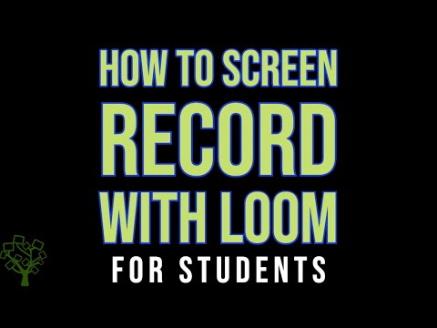
How to Screen Record with Loom
Check out this cool tech tool that we may use in class.

Slide 36
How to Make a Video with Adobe Spark

Slide 37
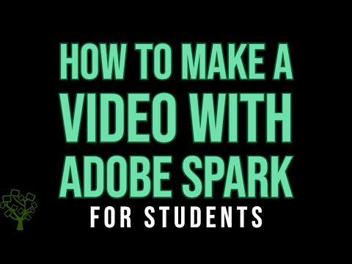
How to Make a Video with Adobe Spark
Check out this cool tech tool that we may use in class.

Slide 38
Cool Tech Tools
Pt.2
Click on a file folder to pull it out of the drawer and see what's inside.
Topic Q: Use Padlet
Topic R: Use Seesaw
Topic S:
Topic T:

Slide 39
How to Use Padlet

Slide 40

How to Use Padlet
Check out this cool tech tool that we may use in class.

Slide 41
How to Use Seesaw

Slide 42
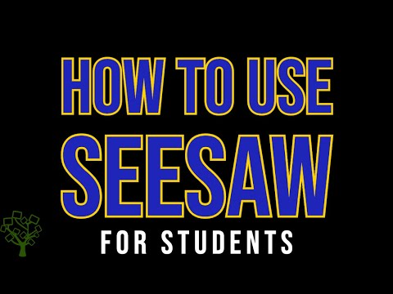
How to Use Seesaw
Check out this cool tech tool that we may use in class.

Slide 43
Add a title here.

Slide 44
Here goes your title

Slide 45
Add a title here.

Slide 46
Here goes your title

