Slide 1


Using AI
To Assess Student Writing
Peter C. Paccone
11/9/23
Power With Responsibility

Slide 2

Peter Paccone
SMHS Social Studies Teacher
Featured in Time Magazine article The Creative Ways Teachers Are Using ChatGPT in the Classroom
Teacher Advisory Board and Community Outreach Manager, Class Companion
Current member of CB’s AI in AP Teacher Advisory Committee
Taught UCLA Summer School course, ChatGPT for Change
Recently appeared on Larry Mantle AirTalk podcast, As The New School Year Begins, How Are Teachers Handling Students’ Use Of AI?
Founder of the AI in AP Social Studies FB Group
To appear next month on Larry Jacobs’ Education Talk Radio podcast; AI-relating topic still to be determined
Teaching AP Social Studies in the Era of ChatGPT webinar organizer.
Power With Responsibility

Slide 3

Where are you in terms of your use of AI to Assess Student writing?
Power With Responsibility

Slide 4
Session Overview
Class Companion
  Features and benefits.
  Activity
  Reflect and Share
  50 minutes
Diffit
  Features and benefits.
  Activity
  Reflect and Share
  30 minutes
Other AI-Writing-Feedback Platforms
  10 minutes
Power With Responsibility

Slide 5
Objective 1
Explore Class Companion
Power With Responsibility

Slide 6
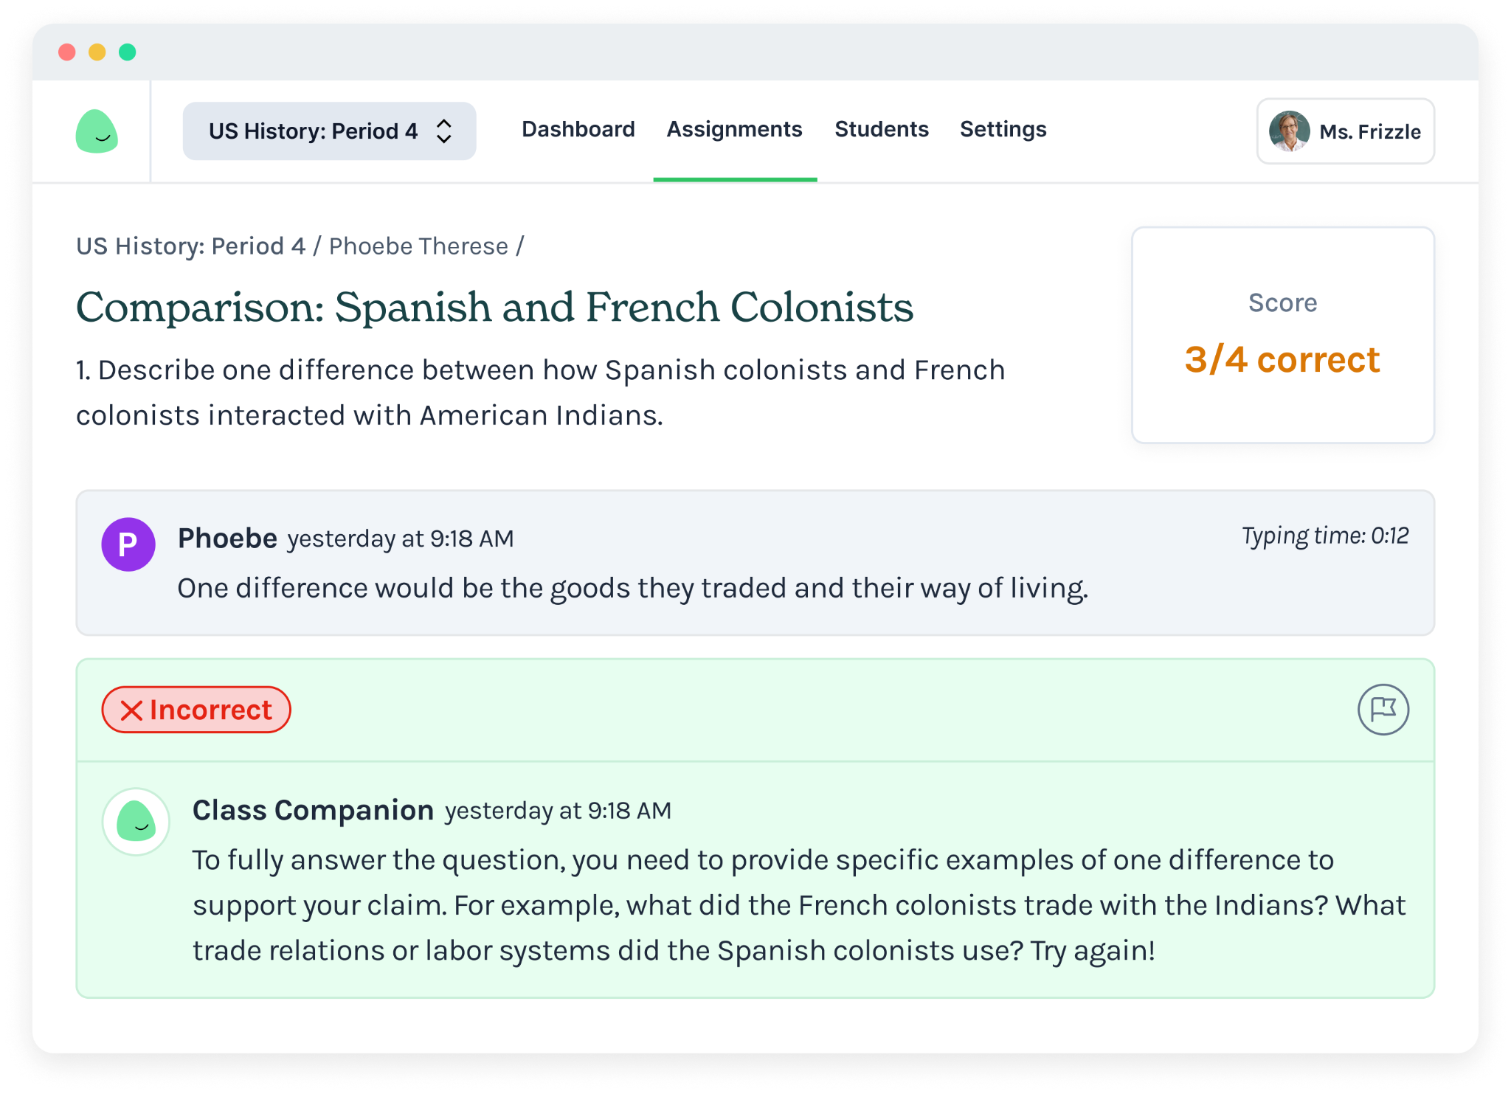

Instant feedback on written assignments.
You’re in control. Focus feedback on specific skills. Free to use.
Low stakes practice motivates students to improve and reduces fear of failure and incentive to cheat.
https://classcompanion.com

Slide 7

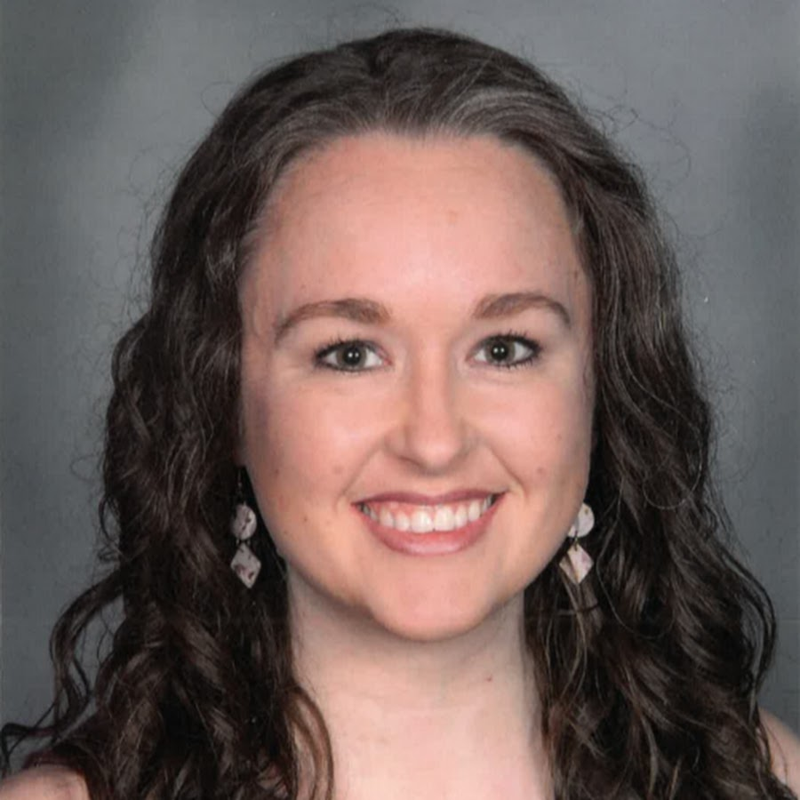
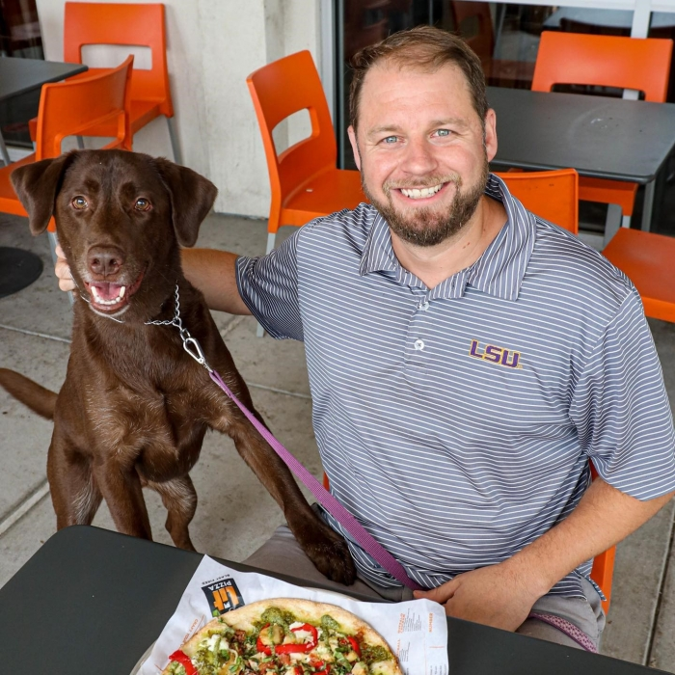
“I love that I’m able to direct the AI’s feedback. I can target specific skills that students struggle with. I still read every assignment, but it enables me to give more practice. It’s changing how I approach teaching this year.”
— Leonie Maneevone, CA
“Class Companion helps students build confidence. They have autonomy to try again or move on and can contest a critique to give me the opportunity to weigh in. A tool that boosts student success without placing additional burden on teachers, although it feels like an understatement, is miraculous.’”
— Melissa Rogers, IA
“My students overwhelmingly prefer assignments using Class Companion. They love the immediate, constructive feedback. It increases understanding and retention, and it allows us to save valuable time and delve deeper into more interactive, discussion-based lessons, fostering a deeper understanding of the subject matter.”
— Ryan Bravata, LA

Slide 8
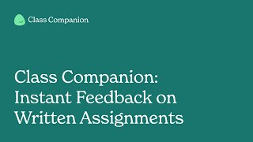

Slide 9
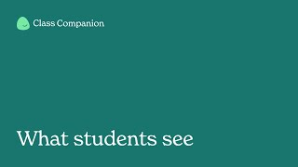

Slide 10
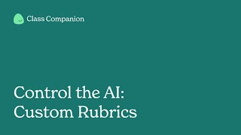

Slide 11
📚 Activity 1
Preview a Built-In Assignment
Go to the Assignment tab
Click Add assignments > Add from content library
Filter for an assignment you like
Click Preview
Engage with the AI
Click Add to class(es) and select up to 5 attempts
Note: These use built-in rubrics. You can also customize your own in the next activity.
Power With Responsibility

Slide 12
📚 Activity 2
Import an Assignment & Choose a Rubric
Go to the Assignment tab
Click Add assignments > Import assignment
Paste in an assignment (your own or from ChatGPT)
Click Next
Choose a rubric or create your own (bonus challenge!)
Review and click Finalize
Click Add to class(es) and select up to 5 attempt
Power With Responsibility

Slide 13
Class Companion Featured in Forbes
On October 5, Forbes Magazine featured Class Companion in a lengthy article entitled Class Companion Puts AI To Work Helping Teachers Help Students. Here’s how the article closes out:
“Perhaps the best measure of promise for any digital tool is when students complain not about its presence but its absence. Tom Richey, a teacher in South Carolina, said, “My students really enjoy it. Last week, my students were doing an assignment on paper, and they asked, why aren’t we using Class Companion?” This will ultimately be the test. Unless a product is easy to use and delivers outsized impact, odds are it will fall by the wayside. Class Companion is off to a promising start. I look forward to following its evolution.”
Power With Responsibility

Slide 14
Reflect & Share
Power With Responsibility

Slide 15
Objective 2
Explore Diffit
Power With Responsibility

Slide 16

What is Diffit?
3:12
Click here to view the Diffitwebsite

Slide 17
Reflect & Share
Power With Responsibility

Slide 18
Objective 3
Other Platforms
Power With Responsibility

Slide 19
Grammarly: One of the most popular writing assistance tools, Grammarly uses AI to detect grammar, punctuation, and style errors. It also offers suggestions for vocabulary enhancement and tone adjustments.
Revision Assistant by Turnitin: Specifically designed for instant feedback, this tool provides suggestions on clarity, coherence, and other writing aspects.
Write with Transformer: This tool is powered by OpenAI's models and provides suggestions as you type, helping writers craft sentences and paragraphs.
QuillBot: A paraphrasing tool that uses AI to rephrase or reword sentences, paragraphs, or articles while retaining the original meaning.
Eli Review: This platform uses AI to guide peer review processes, helping students give and get feedback on their writing.
Brisk AI Co Teacher The platform claims to be able to detect AI writing in google docs,

Slide 20
create and source worksheets and resources, and give feedback on student work
MagicSchool AI The platform helps teachers to make lesson plans, differentiate, write assessments, write IEPs, communicate clearly, and more.
Grammarly: One of the most popular writing assistance tools, Grammarly uses AI to detect grammar, punctuation, and style errors. It also offers suggestions for vocabulary enhancement and tone adjustments.

Slide 21

What is Eli Review
1:47
Click here to view the Eli Review Website

Slide 22

What is Magic School
12:47
Click here to view the Eli Review Website

Slide 23
As of January 2022, here's a general overview of the pricing models for each of the tools mentioned on the previous slide:
Grammarly:
Free Version: Offers basic grammar, punctuation, and spelling checks.
Paid Version (Grammarly Premium): Provides advanced feedback on clarity, engagement, delivery, and writing style. Also includes plagiarism detection and vocabulary enhancement suggestions.
Turnitin:
Paid: Turnitin is primarily used by educational institutions, and they typically purchase licenses for their students and faculty. It's not generally available for individual purchase for personal use.

Slide 24
Revision Assistant by Turnitin:
Paid: Like Turnitin, Revision Assistant is also primarily aimed at educational institutions. Schools and districts typically purchase licenses.
Write with Transformer:
Write with Transformer" was a free tool provided by OpenAI as a demonstration of its capabilities. However, the status might have changed, and it's worth checking their official website for the most recent information.
QuillBot:
Free Version: Offers basic paraphrasing capabilities with a word limit.
Paid Version (QuillBot Premium): Provides additional features, including multiple writing modes, increased word limit, and faster processing.

Slide 25
Eli Review:
Paid: Eli Review is primarily designed for educational settings, and institutions or instructors typically purchase licenses for their courses.
Magic School
???
Please note that the availability, features, and pricing models of these tools may have changed over time. It's therefore always a good idea to visit the official websites of these tools or contact their customer support for the most up-to-date information.

Slide 26
Reflect & Share
Power With Responsibility

Slide 27
Miscellaneous
Power With Responsibility

Slide 28
Reducing the Workload of Grading Papers: A Few Ways Artificial Intelligence Can Help (An AI Cafe podcast)
Dr. Caroline Fell Kurban is the advisor to the Rector at MEF University. Caroline previously held the position of Director of the Center of Research and Best Practices for Learning and Teaching (CELT) at MEF University. She also teaches on the Faculty of Education. She has taught, trained and managed in schools and universities in her twenty-year career. She holds a BSc in Geology, MSc in TESOL, MA in Technology and Learning Design, and a PhD in Applied Linguistics.
Juli Ross-Kleinmann is an experienced Administrator/ Instructional Specialist who has worked in primary, secondary, and higher education. Skilled in, authentically integrating educational technology. professional development, curriculum planning, instructional design, and organizational leadership. Juli has a Master of Science in Education (Administration & Supervision) focused in Elementary and Middle School Administration/Principalship from Fordham University. She served for three years on the board of ISTE and is an ISTE Certified Educator.
Dan Jones earned a BS in Middle Grades Education from Ashland University and a Master’s Degree in Curriculum and Instruction from American College of Education. Dan is an FLGI Master Teacher whose professional interests include e-learning and technology, as well as Project-Based Learning.
Dr. Thomas Mennella has been an instructor in higher education for over ten years. Starting as a lecturer at the University of Massachusetts – Amherst, and then moving on to an Assistant Professorship at Delaware State University (DSU), Tom is now an Associate Professor at Western New England University in Springfield Massachusetts.
Power With Responsibility

Slide 29
“It perplexes me when educators frequently raise concerns about online privacy, given that most schools utilize internet-based communication systems. Virtually every school employs a phone system that operates over the internet. Similarly, our email systems are hosted online, handling both local and distant communications. We even rely on platforms like Google Docs and Google Drive to store sensitive student data. Additionally, we use online software for IEP management. So, why does AI usage specifically become the primary point of contention regarding privacy? I would love to hear your views or am I missing the boat. (My wife says I miss it frequently)”
Jeff Swisher (teacher)
Power With Responsibility

